Slide 1
Leadership and Ethics
Day 1: Good to Great, STAR framework, case assignment
November 19, 2019

Slide 2
Where are we?
Housekeeping
Position statements (your last!) are graded and posted
No more extra credit contracts written after Thanksgiving (presentations, ok)
Schedule
Presentations Thursday (11/21) or Tuesday (11/26)
Final celebration of learning: December 11, 3:00-5:30 p.m.
Practice celebration (pre-gaming?)

Slide 3
Leadership (in one lecture…right)
In business, is leadership more important than opportunity (industry, timing, hard work)?
Are great leaders common or rare? Why?
What is Good to Great?
“Good is the enemy of great.”
Greatness defined
Relative to what?
Notes:
15 years of cumulative stock returns at or below the general stock market, followed by 15 years of cumulative stock returns at least 3x stock market
15 years is too long for lucky breaks
Key question is not: what did the good to great companies have in common, it was: what did the good to great companies have in common that distinguished them from their peers?

Slide 4
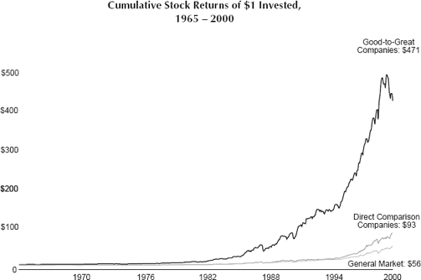
Notes:
Methods: let the data speak and reverse engineering exceptional performance

Slide 5
Notes:
Criteria :15 years cumulative stock returns at or below general stock market; transition point; cumulative returns at least 3x the market for next fifteen years
Independent of industry – if whole industry showed this performance, company was dropped

Slide 6
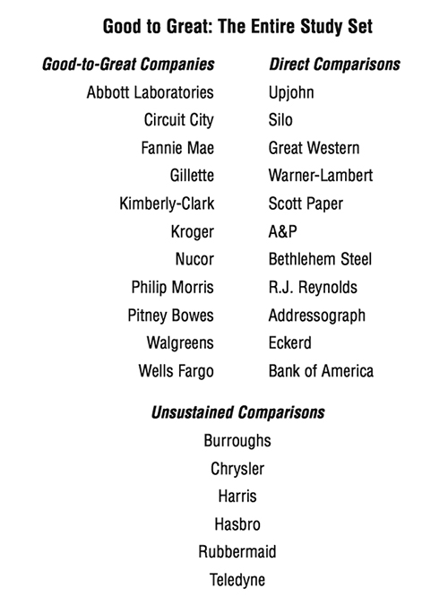
Notes:
What do you see? Boring ass companies. No Coca-Cola. No GE. No HP. No blue chips, per se.

Slide 7
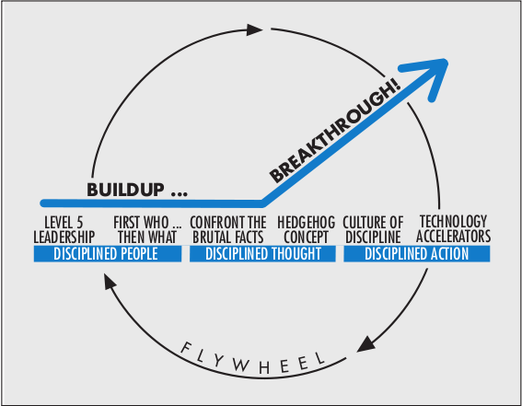

Slide 8
Level 5 Leadership
Humility + Will = Level 5
Compelling and sincere modesty
Unwavering resolve that the company would succeed
Ambition?
Yes, but for the company, not for yourself!
Setting up successors for success – the hardest part
The window and the mirror
Why does this matter?
Truman quote
Notes:
Not celebrity executives who rode in on a white horse. Many, not all, were internal hires with little reputation outside the company. Common features were self-effacing, quiet, reserved, even shy. But they are not timid.

Slide 10
Business

Slide 12
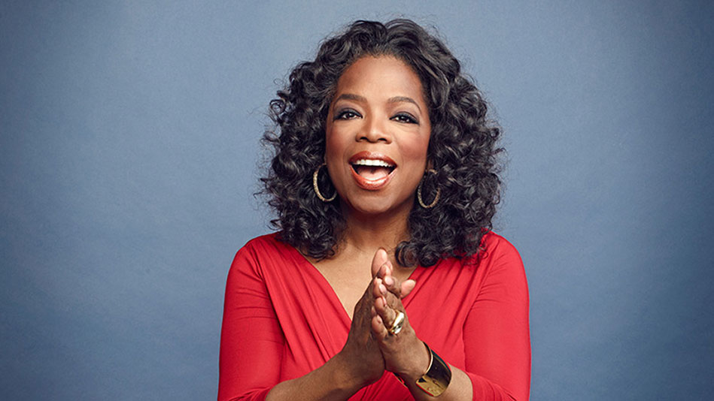
Notes:
What happens to the empire if she disappears?

Slide 13
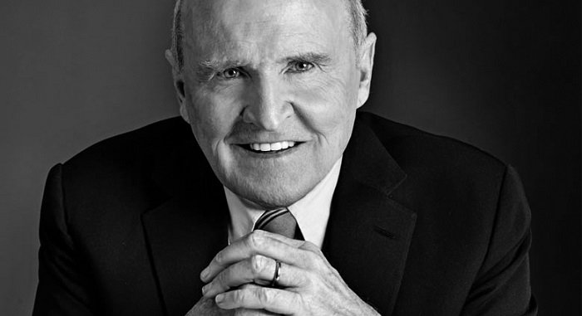

Slide 14
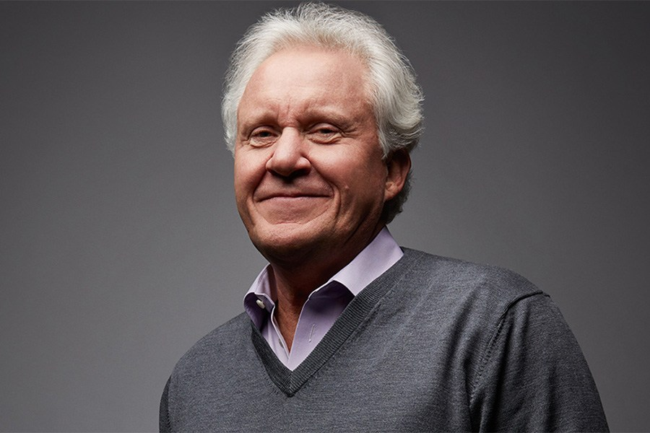

Slide 16
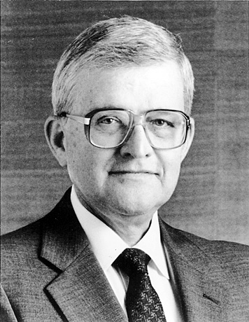
Notes:
Darwin Smith – Kimberly Clark – stodgy old paper company with dozens of paper mills around the country that produced coated paper.
Bold decision – sell the mills and compete in the cutthroat world of consumer paper-products
Akin to the general who burned the boats upon landing (succeed or perish)
How did they do?
With Darwin Smith at the helm, Kimberly Clark produced cumulative stock returns 4.1 times general market, outperforming GE, HP, etc.
And if stock returns don’t impress you, perhaps you’ve heard of: Huggies Kleenex

Slide 17
Civics and Politics

Slide 18
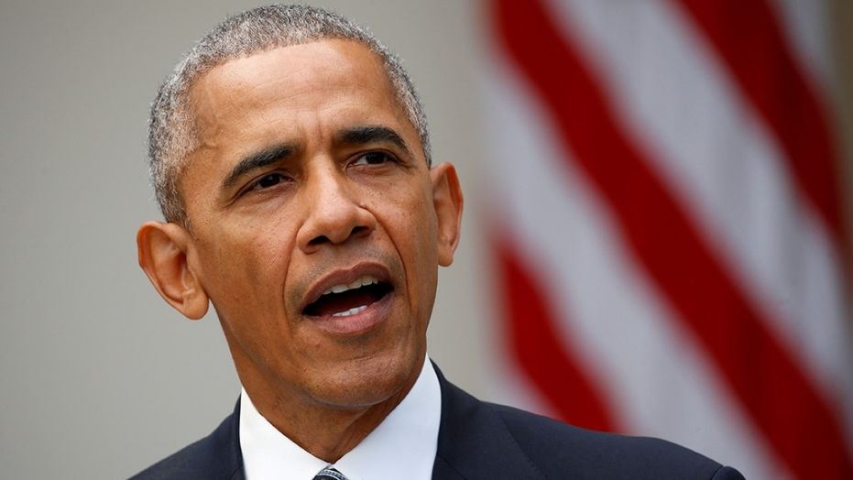

Slide 20
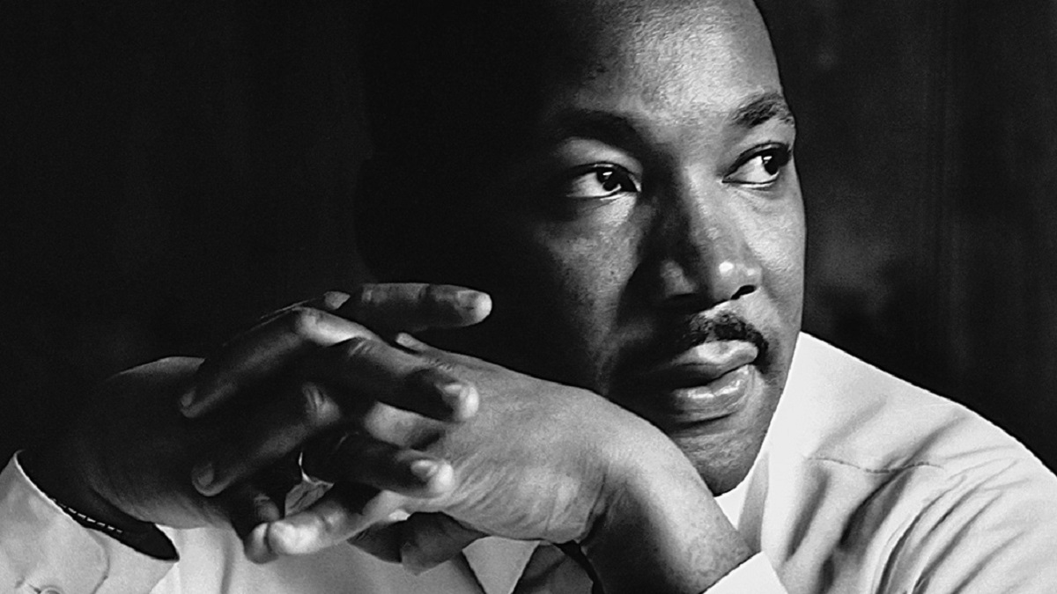

Slide 21
Sports

Slide 22
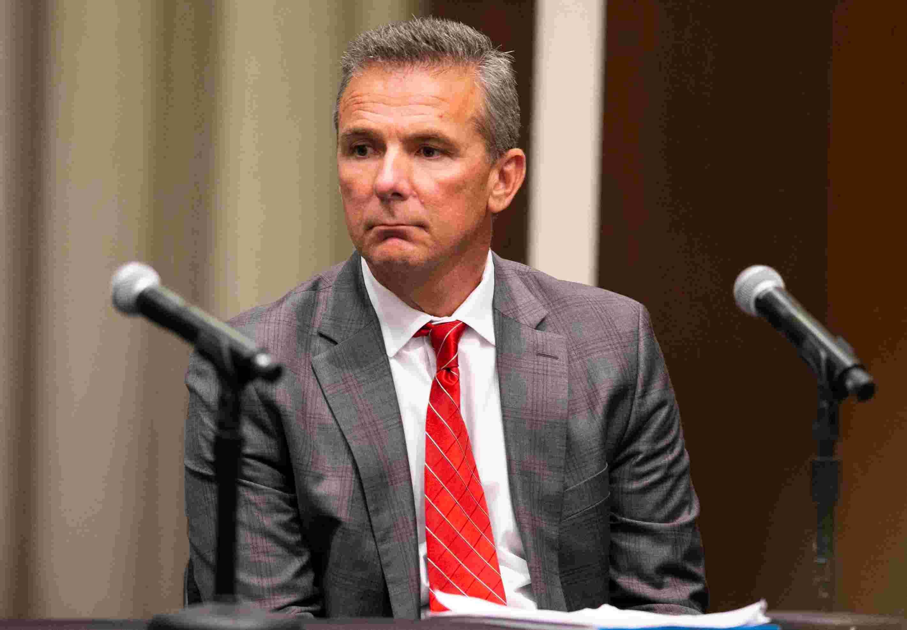

Slide 23
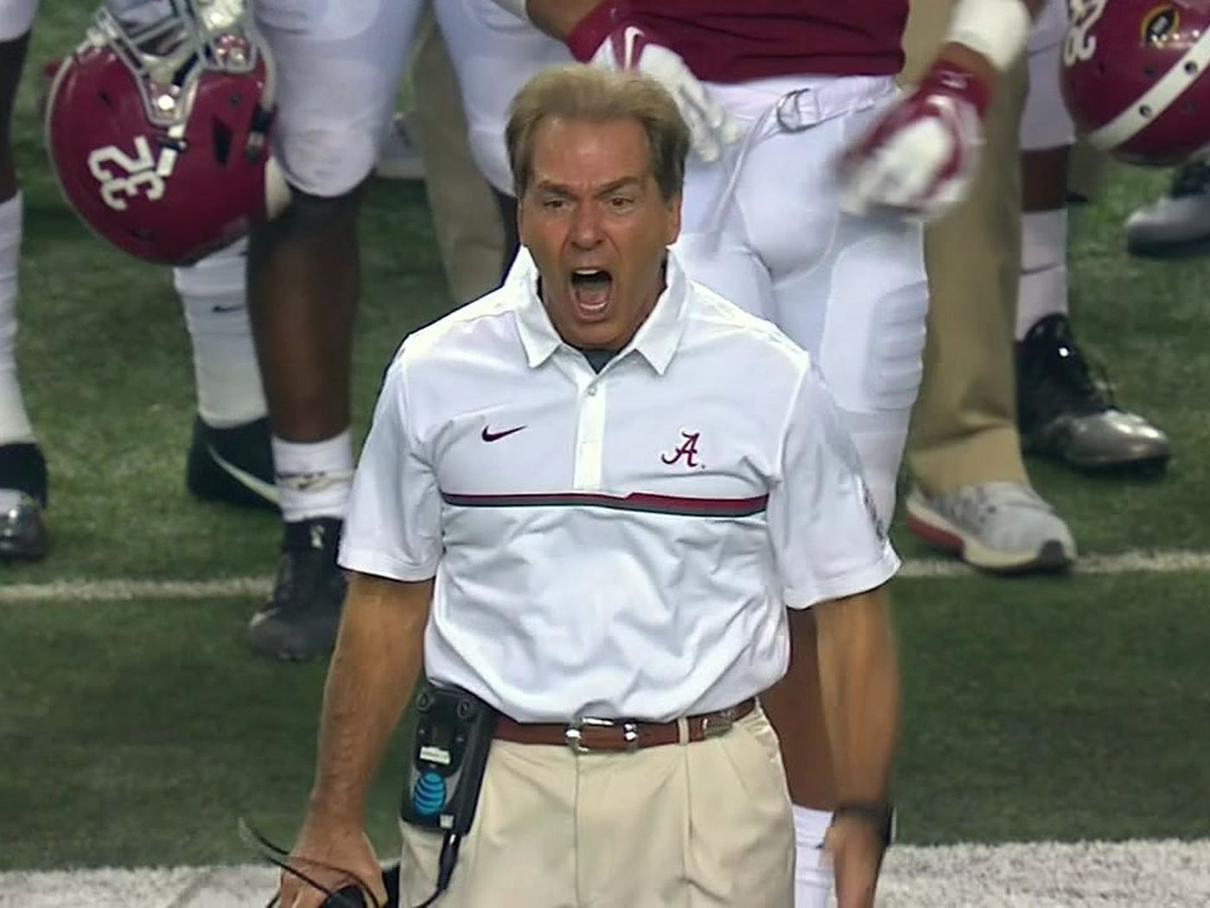

Slide 24
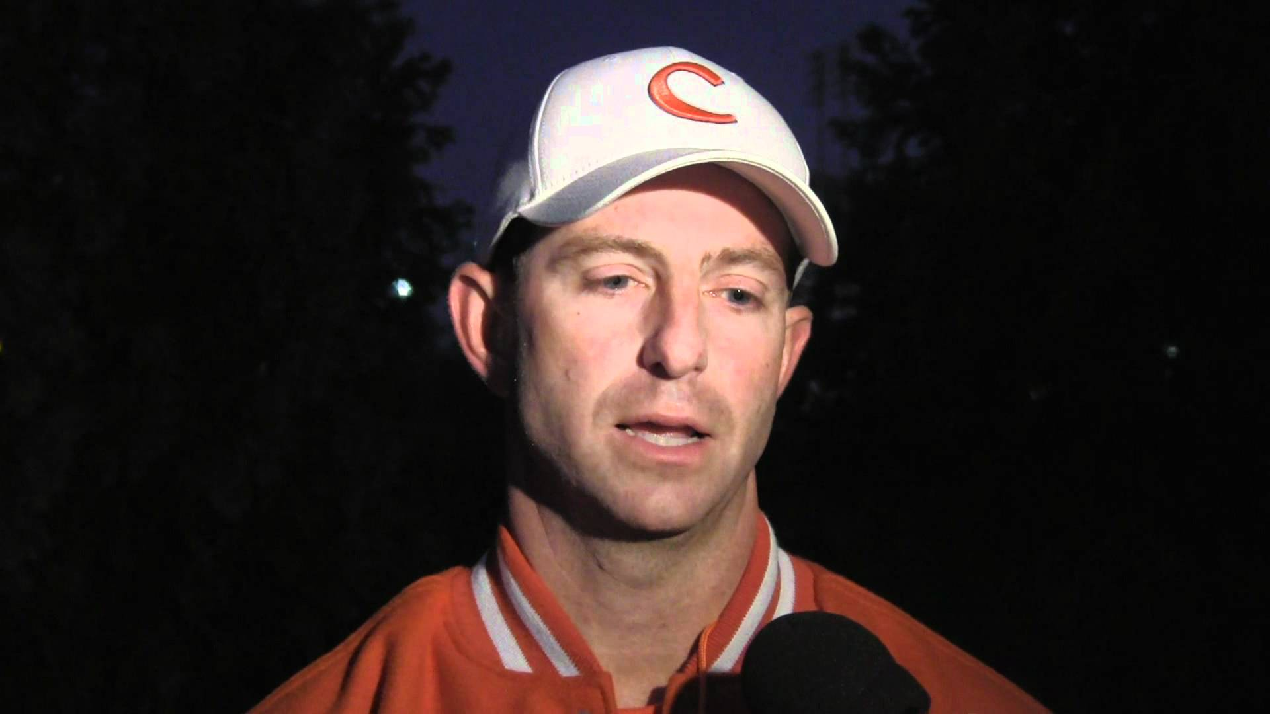

Slide 25
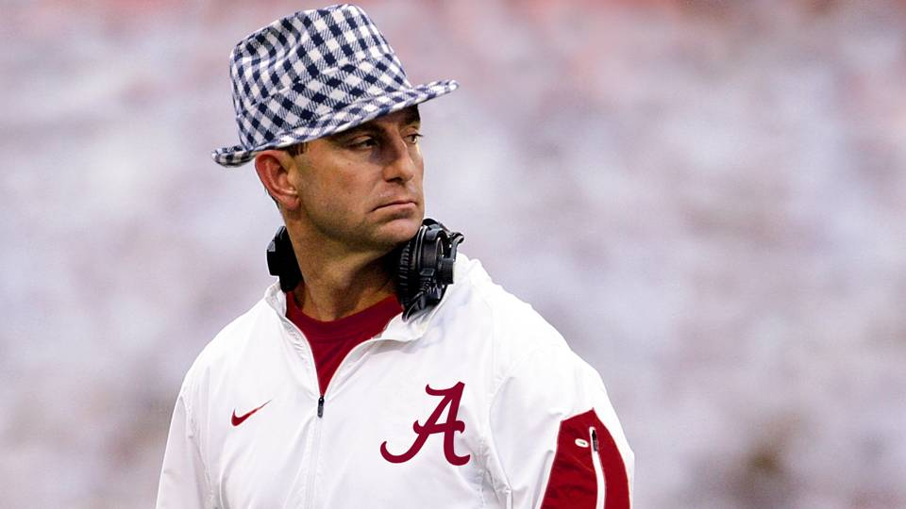

Slide 26
Questions, honest ones
Where do you find Level 5 Leaders, only at the top?
Can Level 5 Leadership be learned or cultivated?
What discourages/hides/hinders Level 5 Leaders?
One answer: misplaced optimism

Slide 28
Notes:
Darwin Smith – Kimberly Clark – stodgy old paper company with dozens of paper mills around the country that produced coated paper.
Bold decision – sell the mills and compete in the cutthroat world of consumer paper-products
Akin to the general who burned the boats upon landing (succeed or perish)
How did they do?
With Darwin Smith at the helm, Kimberly Clark produced cumulative stock returns 4.1 times general market, outperforming GE, HP, etc.
And if stock returns don’t impress you, perhaps you’ve heard of: Huggies Kleenex

Slide 29
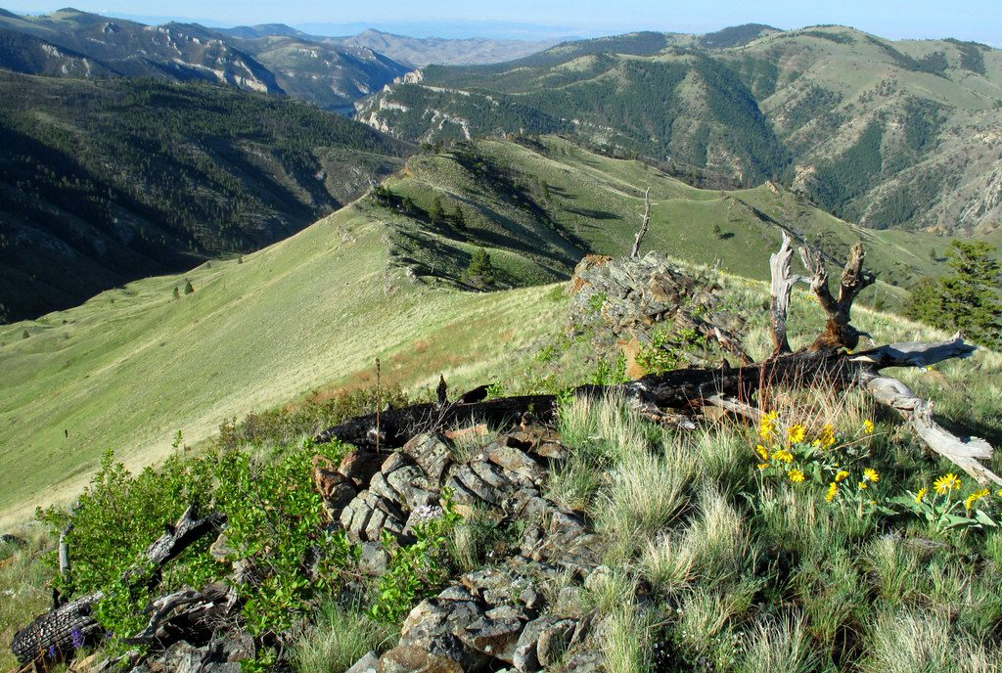

Slide 30
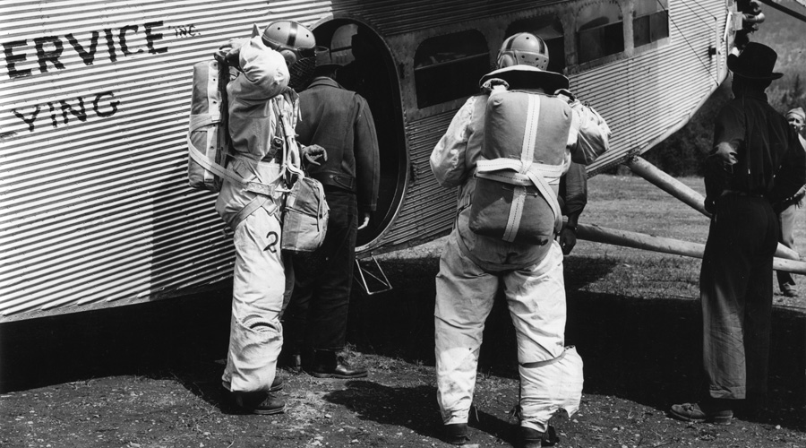

Slide 31
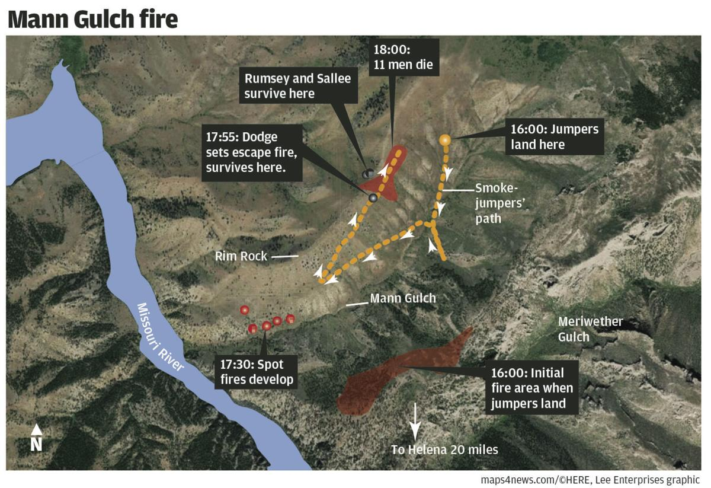
Notes:
The Mann Gulch fire was a wildfire reported on August 5, 1949, in a gulch located along the upper Missouri River in the Gates of the Mountains Wilderness (then known as the Gates of the Mountains Wild Area), Helena National Forest, in the U.S. state of Montana. A team of 15 smokejumpers parachuted into the area on the afternoon of August 5, 1949, to fight the fire, rendezvousing with a former smokejumper who was employed as a fire guard at the nearby campground. As the team approached the fire to begin fighting it, unexpected high winds caused the fire to suddenly expand, cutting off the men's route and forcing them back uphill. During the next few minutes, a "blow-up" of the fire covered 3,000 acres (1,200 ha) in ten minutes, claiming the lives of 13 firefighters, including 12 of the smokejumpers. Only three of the smokejumpers survived. The fire would continue for five more days before being controlled.

Slide 32
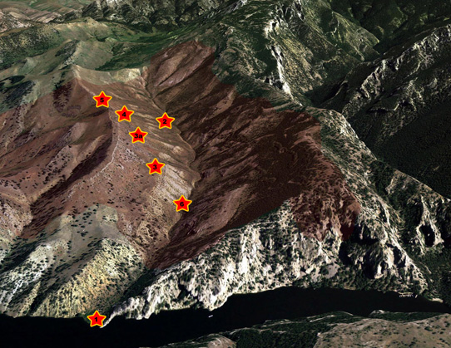

Slide 33
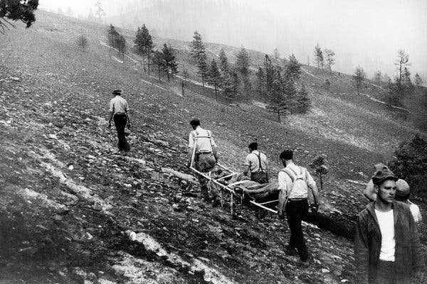

Slide 34
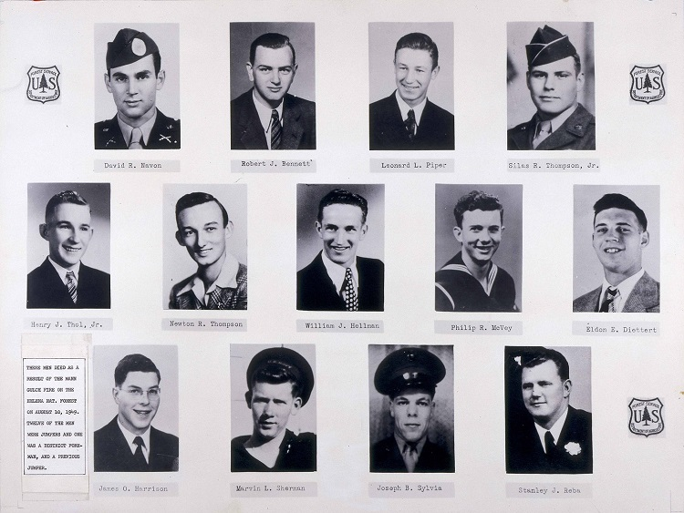

Slide 35
[transition]

Slide 36
STAR Decision-Making Model
Stop: Recognize ethical issue, identify stakeholders, and develop three possible solutions
Test: Apply at least 3 tests to 3 solutions (3x3 table)
Act: Use test results to make a decision.
Reflect: Consider the outcome, take responsibility, and learn.

Slide 37
Assignment
5 minute presentation due 11/20 or 11/26
Role play as the leadership team for your organization – groups of 4 or 5
Articulate values, vision, mission (see Quimby, which we haven’t discussed)
Apply STAR framework to the ethical issue
Stop: Recognize the issue, identify stakeholders, and choose three possible solutions
Test: Apply at least three tests to three solutions (3x3 table)
Act: Make your choice (explain discussion if not unanimous)
Reflect: Compare what the organization did with what your team would have done.
Use PowerPoint, Spark, or interpretive dance to communicate your analysis
Possible Scores: 5 (excellent) to 1 (poor)
Peer Evaluation: Develop a plan today for dividing points

Slide 38
Ethics Cases – choose topic, date Kirshe, Sullivan 11/21 schedule on Canvas
Heartland Payment Systems – data breach
Equifax – data breach
Tylenol – drug contamination
Google – Dragonfly
Google – AI ethics board
Facebook – data sharing
Dawn – marketing
Fannie & Freddie – mortgage
Penn State – sexual assault
FamilyTreeDNA – privacy

