Slide 1
Project
Concept
Proposal
Status Reports
Final report
Presentation

Slide 2
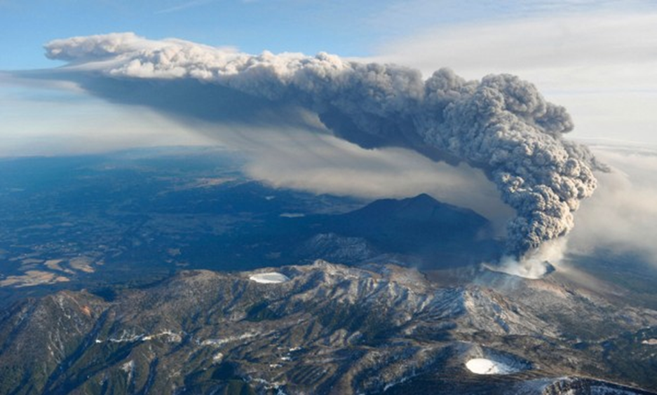
Advection and Dispersion
Fresh ash plume from Eyjafjallajokull volcano
http://blogs.crikey.com.au/planetalking/2011/02/02/nature-v-air-travellers-and-everyone/

Slide 3
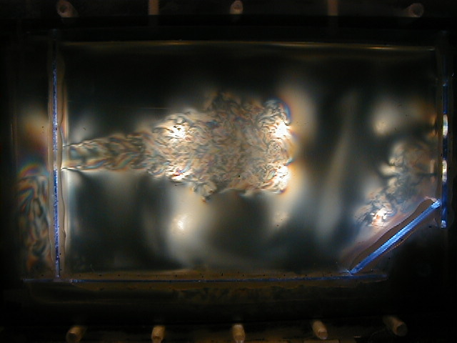
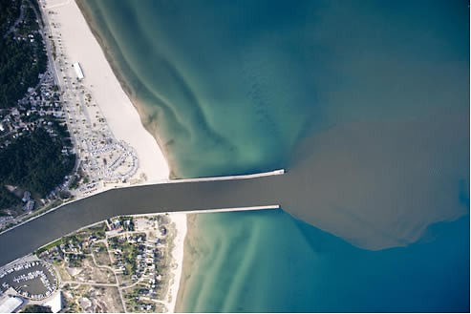
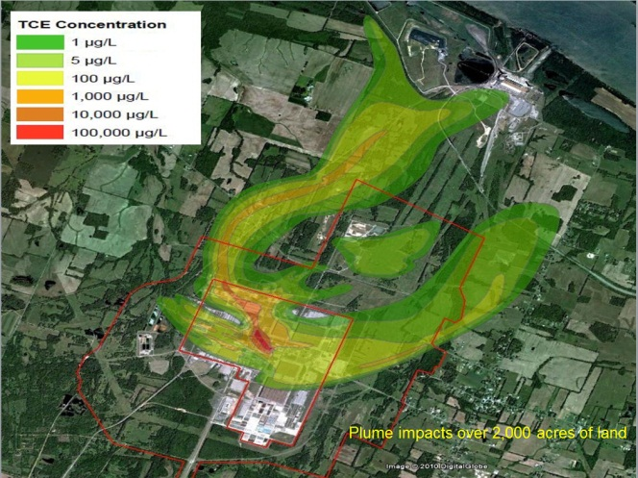
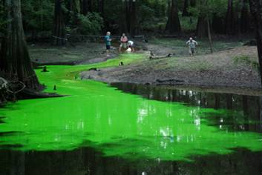
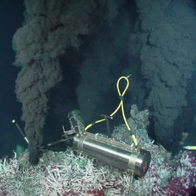
Plumes, jets, and mixing
Jet of birefringent fluid
A free jet issuing into a quiescent fluid. The flow rate of the jet is around 2 cm/ sec; the volume of the jet is around 50 mL. The horizontal length of the field of view is about 15 cm. The flow visualization uses an inorganic, streaming birefringent fluid
Grand River into Lake Michigan
Dye Tracer in Stream
Groundwater plume, Paducah, KY
Hydrothermal vent
http://therapidian.org/water-quality-grand-river
http://www.globalunderwaterexplorers.org/content/ames-sink-tracer-test
http://www.newswise.com/articles/good-vibrations-from-deep-sea-smokers-may-keep-fish-out-of-hot-water
http://www.efluids.com/efluids/gallery/gallery_pages/Blackstock.jsp
http://therapidian.org/water-quality-grand-river

Slide 4
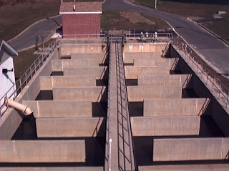
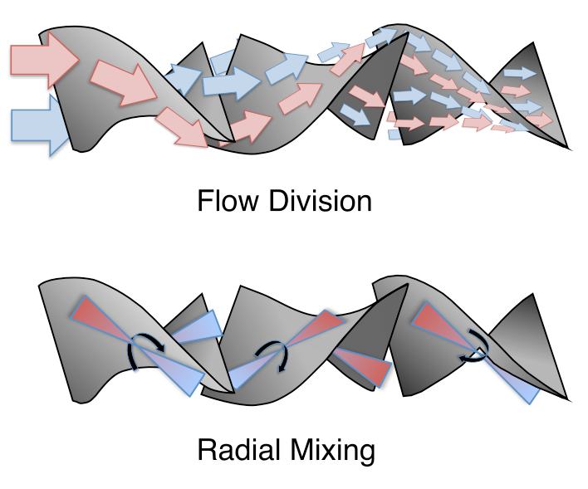
Static Mixers
Mix fluids using energy from flow alone
Chlorine Mixing Tank
In-line Mixer
Clemson Waste Water Treatment Plant
http://www.crustbuster.com/Products/dry-fertilizer-products~blending-and-handling.html
http://water.me.vccs.edu/math/flocculation_math.html
http://en.wikipedia.org/wiki/File:Chemineer_Kenics_Static_Mixer.JPG

Slide 5
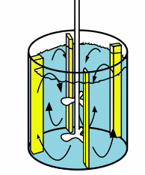
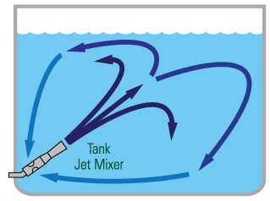
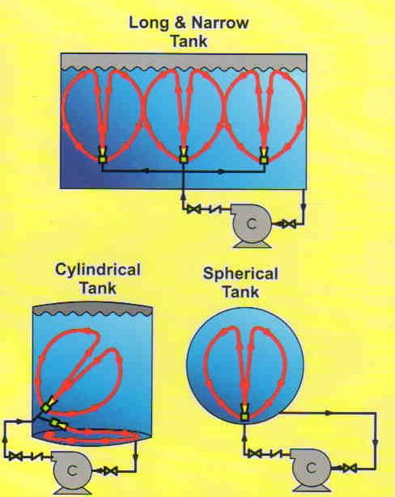
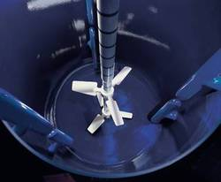
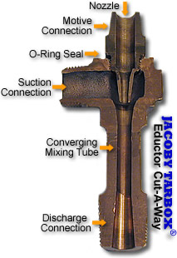
Active Mixers
http://www.crustbuster.com/Products/dry-fertilizer-products~blending-and-handling.html
http://water.me.vccs.edu/math/flocculation_math.html
http://en.wikipedia.org/wiki/File:Chemineer_Kenics_Static_Mixer.JPG

Slide 6
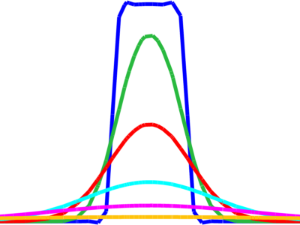
Advection and Diffusion
Advection: Transport of substance due to bulk motion of fluid. a.k.a convection (heat)
Advective mass flux: uC
Diffusion:
advection
Source w/ disp

Slide 7
Dispersion
Types: Longitudinal, Transverse
Causes
Gradient in flow velocity
Laminar , Taylor dispersion
Turbulent
Splitting of flow paths
Turbulent
Mechanical

Slide 8
Gradient in flow velocity
Longitudinal dispersion from velocity gradients
Molecular diffusion (green) reduces longitudinal dispersion

Slide 9
Splitting of flow paths
Mechanical
Turbulent
Transverse Dispersion
Longitudinal Dispersion
Transverse Dispersion
Longitudinal Dispersion

Slide 10
Mechanical Dispersion
Movement of mass due to splitting of flow paths, fluctuations in velocity, other. Demo
Photomicrograph of pore space
Constant head and no flow boundaries
Color is head, lines are streamlines
Source of contaminant

Slide 11
Dispersive Flux
Porous media
Turbulent flow

Slide 12
Conservation of Mass
Advection-Dispersion
Storage
Advective Flux
Diffusive Flux (Fick’s Law)
Dispersive Flux
Source
Governing
c = C
S=0 (for now)

Slide 13
Simulation of Advection-Dispersion
Governing
Boundary
Dirichlet, Specify Conc
Neuman, Specify diffusive flux
Specify advective flux
Cauchy, flux proportional to gradient
Need to know q
Constant, q
One-way coupling
q(t)→C
Two-way coupling
q(t)←→C

Slide 14
Mechanical Dispersion in Porous Media
α_{L}: longitudinal dispersivity[L]
α_{T}: transverse dispersivity[L]
Other formulations available

Slide 15
Plume in 1D flow

Slide 16
Example 1D flow

Slide 17
Dimensionless Form

Slide 18
Peclet Number
Peclet Number
L: characteristic length
v_{x}: velocity
D: diffusion or dispersion
Important time scales
t_{flow} = L/v
t_{diffuse} = L²/D
Relative importance of advection and diffusion

Slide 19
Dispersion and Peclet
http://www.sciencedirect.com/science/article/pii/S0169772211000180

Slide 20
Numerical Stability and Peclet
Cell Peclet number
Cell Peclet> 10-100 will cause problems
Decrease h or increase D
Particle tracking

Slide 21
Dispersion at different Peclet Numbers
Theodoropoulou et al. 2003
http://download.springer.com/static/pdf/613/art%253A10.1007%252Fs11270-006-9296-6.pdf?auth66=1363234017_ff68087b7f7be6bc5abd393dcab29e81&ext=.pdf

Slide 22
Dispersion in channels, conduits... Gradient in flow velocity
Longitudinal dispersion + diffusion in laminar flow
Longitudinal and transverse dispersion in turbulent flow

Slide 23
Turbulent Flow

Slide 24
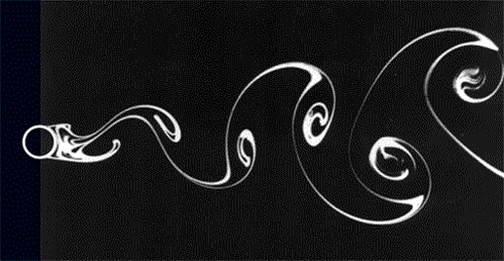
Turbulent Dispersion
Vortices occur over all scales, but the largest ones give the largest D_{m}
Need to be the largest vortices not explicitly simulated.

Slide 25
Estimating D_{m}
Laminar flow, pipe:
Turbulent pipe: D = 10.1 R u_{sh}; u_{sh}=(τ_{o}/ρ_{w})^{1/2}
Porous media: D = D*+α_{L}u
Infinitely wide channel: D=5.93 d u_{sh}
Vertical mixing in stream: D=0.067 d u_{sh}
Longitudinal in stream:

Slide 26
Values for D_{m} (m²/s)
Rivers
Vertical 10⁻¹-1
Transverse 10⁻¹-1
Longitudinal 10⁻¹-10³
Lakes
vertical 10⁻⁵-10⁻²
Transverse 10⁻³-1
Ocean 10⁻³-10⁴

Slide 28
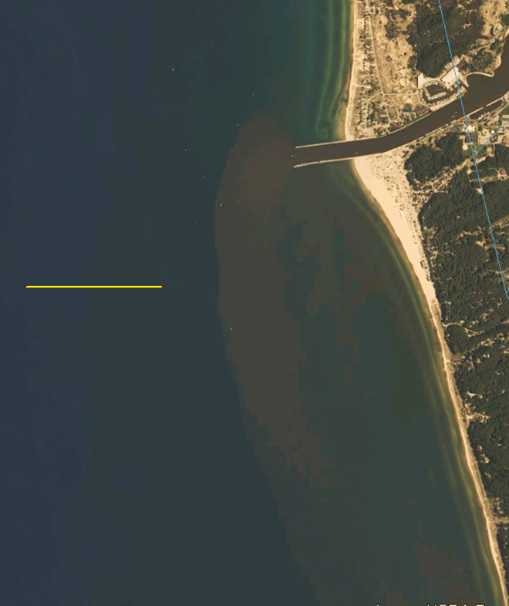

Slide 29
Grand River Plume

Slide 31
Peclet Number
Peclet Number
L: characteristic length
v_{x}: velocity
D: diffusion or dispersion
d: diameter of source
W: width of plume
ΔL: travel distance
W
ΔL

Slide 32
Dispersion in Porous Media
a_{L}=0.1x
1000
100
10
1
0.1
0.01
Photomicrograph of pore space
Longitudinal Dispersivity (m)
Constant head and no flow boundaries
Color is head, lines are streamlines
Scale of measurement (m)
1 10 100 1000 10,000 100,000

