Slide 1
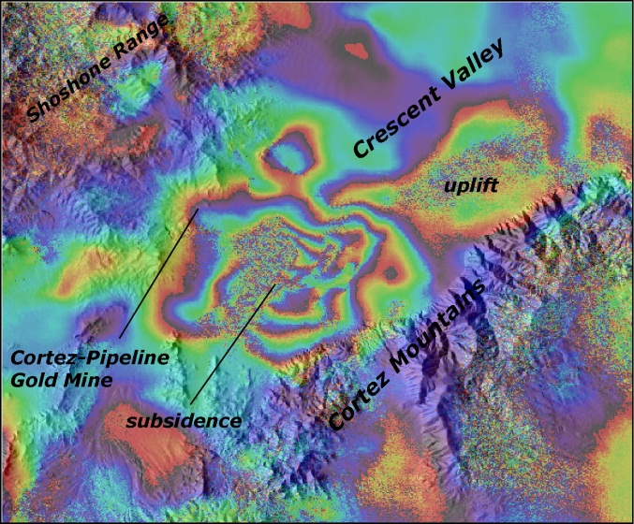
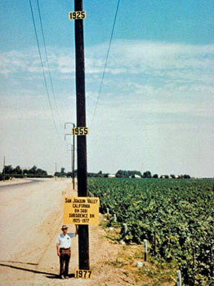
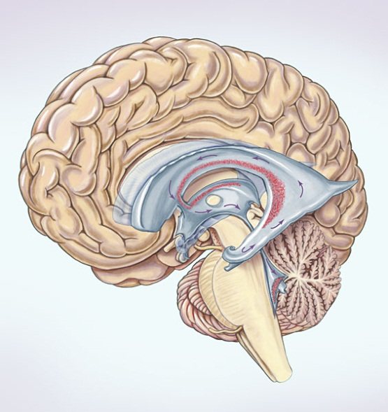
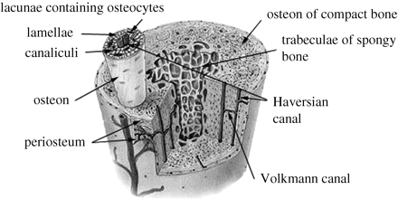
Poroelasticity
Coupled fluid flow and deformation in porous media

Slide 2

Conceptual Model
Total stress
Effective stress on solid
Pore fluid pressure

Slide 3
Effective stress causes deformation of solid

Slide 4
Deformation of solid compresses pore space

Slide 5
Include water

Slide 6
Increase total stress
Couple solid deformation to fluid pressure

Slide 7
Solid to Fluid Coupling
Volumetric Strain:
Volumetric Strain Rate:
If volume change of pm = ΔV of pores, and if the pores are filled with water:
Volumetric source of water
Mass source

Slide 8
Couple fluid pressure gradient to stress in solid
P
Pore pressure gradient
x
Distribution of pore pressure

Slide 9
Body Force
Force density
σ₁
σ₂
Δσ
Example
γ=ρg = unit weight = [F/V]= volume force

Slide 10
Couple fluid pressure gradient to stress in solid
P
Pore pressure gradient
x
Body Force
Distribution of pore pressure

Slide 11
Poroelastic Deformation
Fluid to Solid Coupling
  Pore pressure gradient = body force on solid
  Body force → Deformation of solid
Solid to Fluid Coupling
  Strain rate acts like fluid source
  Deformation changes pore size, pressure
Deformation of solid ←→Pore pressure change

Slide 12
Govern Eqs., Step by Step
Force Balance, stress and pressure
Conservation of Momentum, Solid
Constitutive equation, elastic solid=Hooke’s Law
Conservation of Mass, Fluid
Conservation of Momentum, Fluid=Darcy’s Law

Slide 13
1. Effective and Total Stress
σ_{T} Total stress
σ_{e} Effective stress
P Pore pressure
α Biot-Willis parameter
Analyze σ_{e} using elasticity
Analyze P using Darcy
Couple P and σ_{e}
Combine to get total

Slide 14
2. Conservation of Momentum of Solid
Apply to solid matrix
Storage
Advective Flux
Diffusive Flux
Source
Governing
c = ρv
A= vc= vvρ
Units of stress or pressure

Slide 15
3. Hooke’s Law relate stress and strain
Non-porous
Poroelastic
Total and effective stress and pressure
Equate non-porous with effective stress
Rearrange in terms of total stress

Slide 16
3. Hooke’s Law relate stress and strain
Non-porous
Poroelastic

Slide 17
2. and 3. Navier Equation
Steady state
2. Momentum
3. Hooke’s Law
Substitute into first row as example. Only one pressure derivative because of the δ_{ij}
See notes on the steps to get this form using index notation

Slide 18
4. Conservation of Mass of Fluid
Water in Porous Media
Storage
Advective Flux
No Diffusive Flux
Source
Governing
c = ρφ

Slide 19
4. Conservation of Momentum of Pore Fluid
Storage
Advective Flux
Diffusive Flux
Source
Governing
c = ρv
A= vc= vvρ

Slide 20
Governing Eqns
2. Momentum/solid
3. Constitutive
Hooke’s Law
poroelastic
4. Momentum/fluid
Darcy’s Law
5. Mass/Fluid
Poroelastic
1.

Slide 21
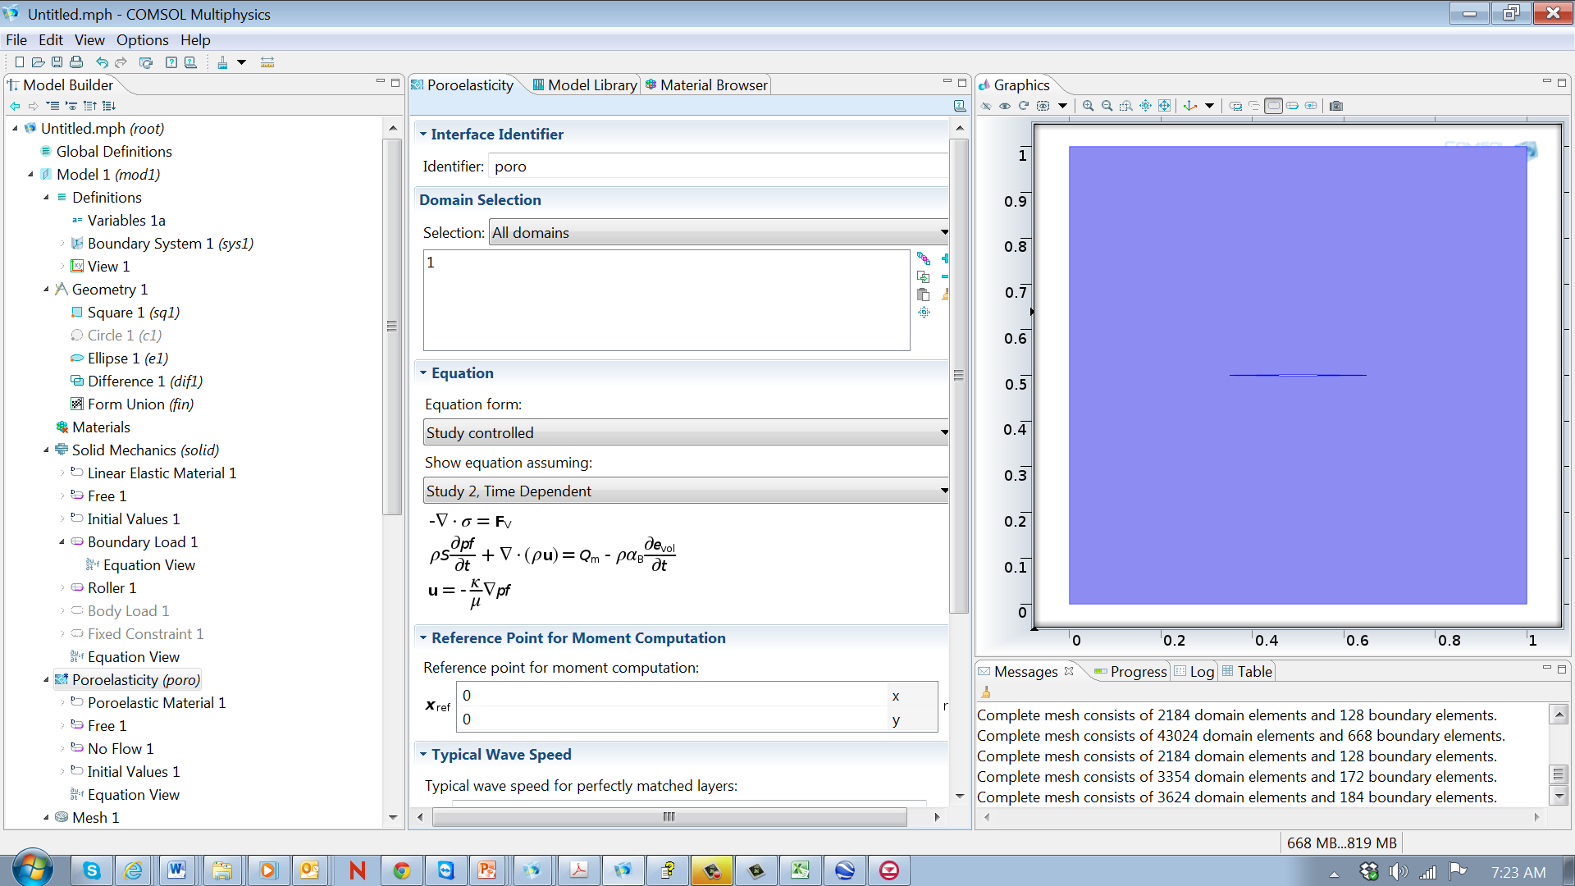
Governing Eqns
Implementation in Comsol
Momentum/solid
Constitutive
Hooke’s Law
poroelastic
Momentum/fluid
Darcy’s Law
Mass/Fluid
Poroelastic

Slide 22
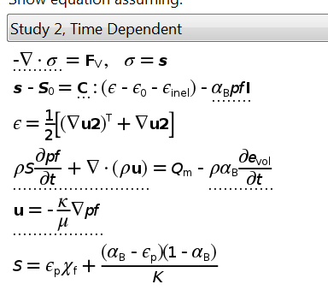
Governing Eqns
Implementation in Comsol
Momentum/solid
Constitutive
Hooke’s Law
poroelastic
Momentum/fluid
Darcy’s Law
Mass/Fluid
Poroelastic

Slide 23
Governing Eqns
Implementation in Comsol
Momentum/solid
Constitutive
Hooke’s Law
poroelastic
Momentum/fluid
Darcy’s Law
Mass/Fluid
Poroelastic

Slide 24
Governing Eqns
Implementation in Comsol
Momentum/solid
Constitutive
Hooke’s Law
poroelastic
Momentum/fluid
Darcy’s Law
Mass/Fluid
Poroelastic

Slide 25
Governing Eqns
Implementation in Comsol
Momentum/solid
Constitutive
Hooke’s Law
poroelastic
Momentum/fluid
Darcy’s Law
Mass/Fluid
Poroelastic

Slide 26
Governing Eqns
Implementation in Comsol
Momentum/solid
Constitutive
Hooke’s Law
poroelastic
Momentum/fluid
Darcy’s Law
Mass/Fluid
Poroelastic

Slide 27
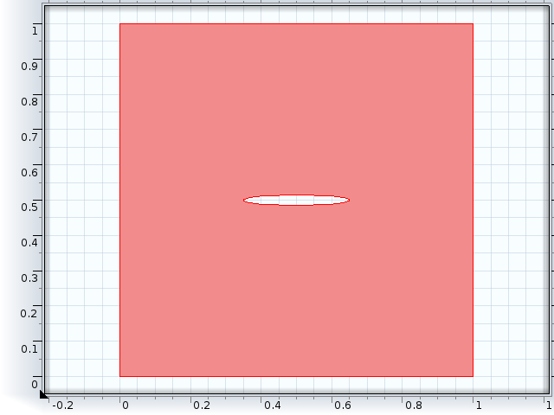
Boundary Conditions
1 set of conditions for pressure/flow
1 set for displacement/stress

Slide 28
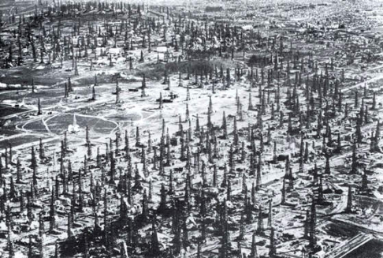
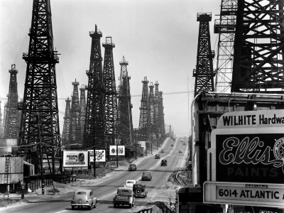
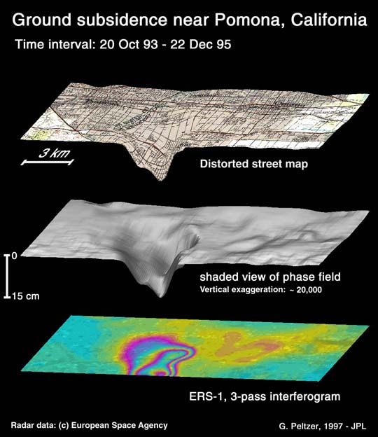

Examples
Oil wells in LA, 1930s
Consolidation
Sedimentary basins
Subsidence from pumping
Faulting
Seismic waves
Biomedical
LA, 1930s
Subsidence in Central Valley, CA
Deformable porous media
Measured with InSAR
http://www-radar.jpl.nasa.gov/sect323/InSar4crust/LA_fig2.jpg

Slide 29
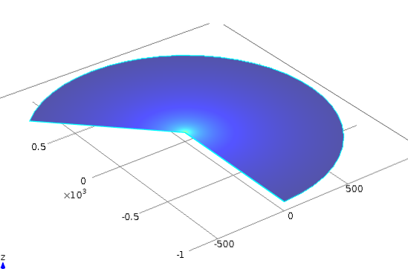
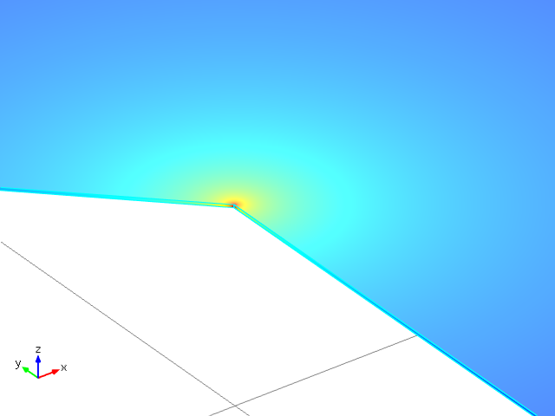
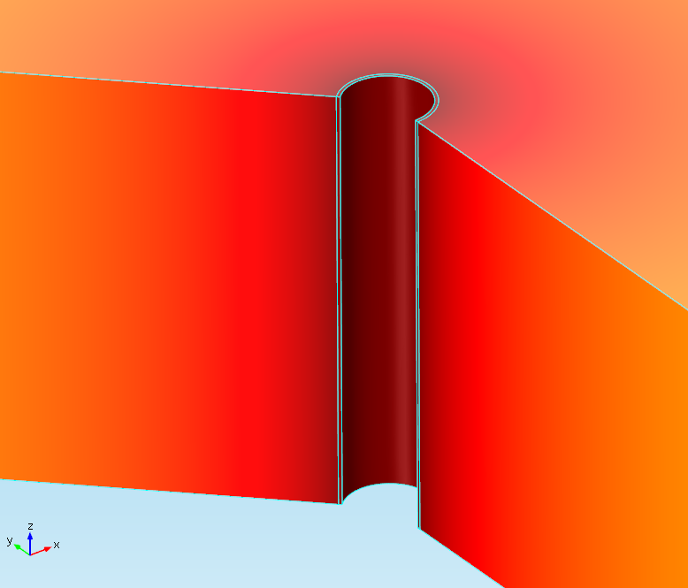
Example
Steady injection into well
Objectives and Motive
Deformation near well
Casing integrity, seal
Deformation away from well
Monitoring
Faulting
Important Processes
Fluid flow through porous media
Elastic deformation of solid
→poroelastic
r

Slide 30
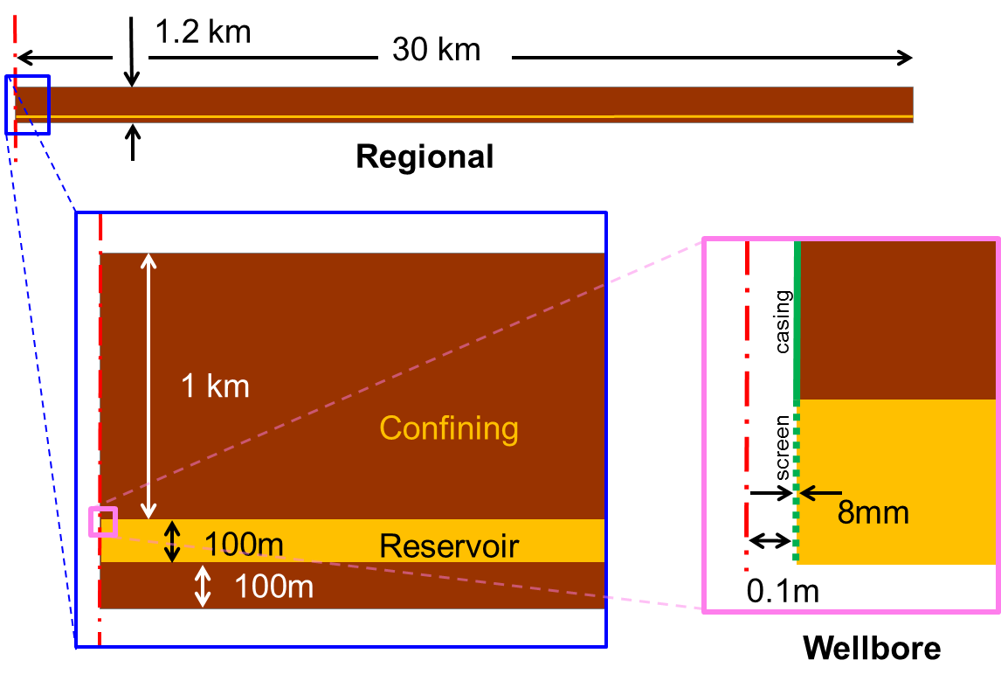
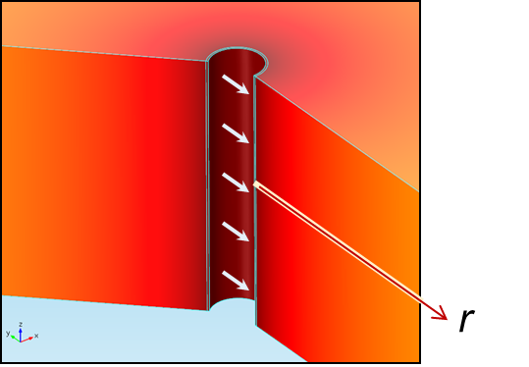
Geometry and Parameters
Constant Q injection, 6 lps ~100gpm, Axial symmetry
Aquifer: k: 10⁻¹³m², b: 100m, E: 15GPa , R = 30km
Confining : k: 10⁻¹⁶m², b: 1000 m; E: 15GPa
Casing: k: 1nd; 8-inch, 8mm wall, E: 200GPa
Screen: k: 10⁻¹³m²; 8-inch, 8mm wall, E: 200GPa

Slide 31

Boundary conditions
Mechanics Fluid flow
σ_{T}=0
Load_z=0
σ_{T}=P
Load_r=pf
Inflow = well_flux
roller
No flow
Head=0

Slide 32
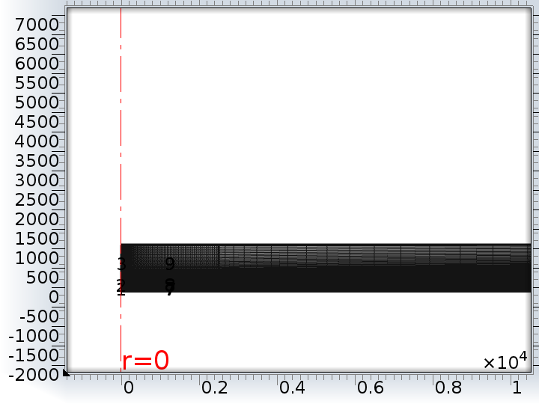
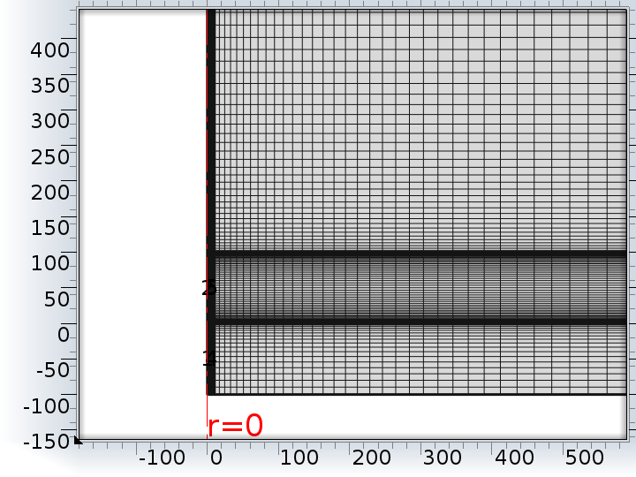
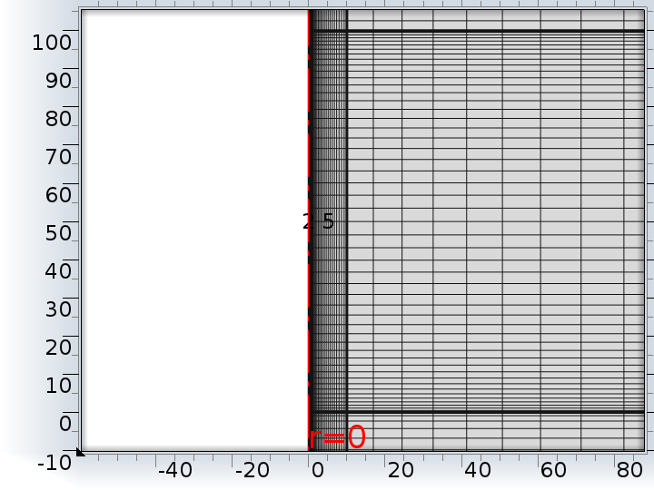
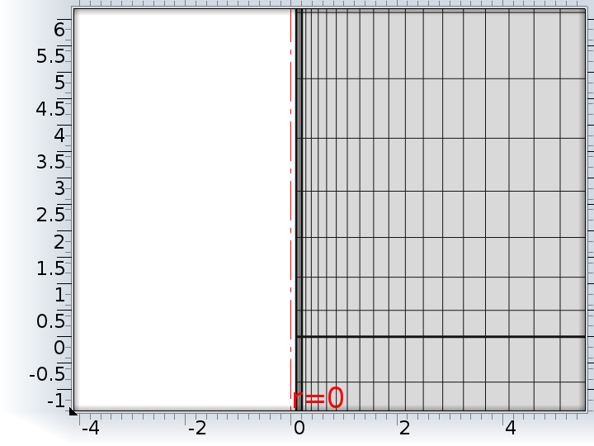
Discretization
Telescoping mesh to resolve casing in regional-scale simulation
Scales in meters

Slide 33
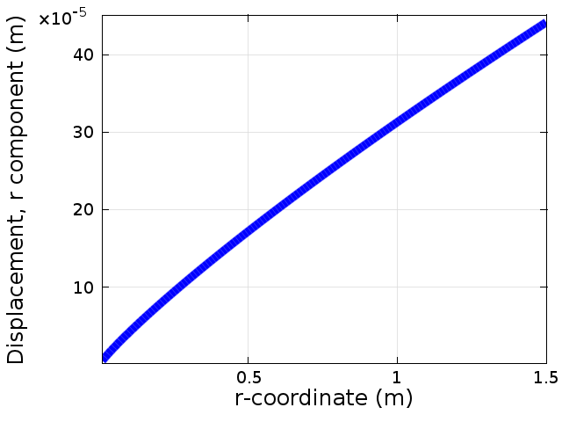
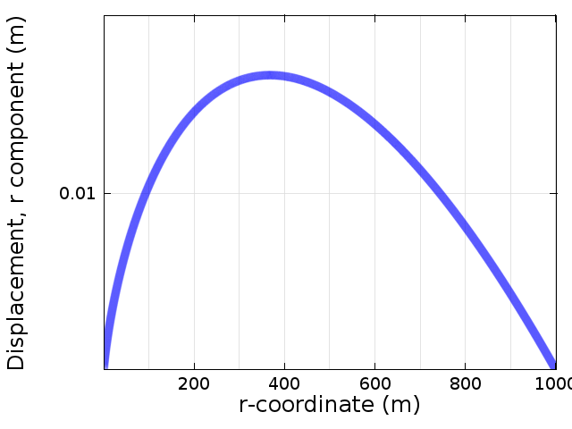
Radial displacement steady line source

Slide 34
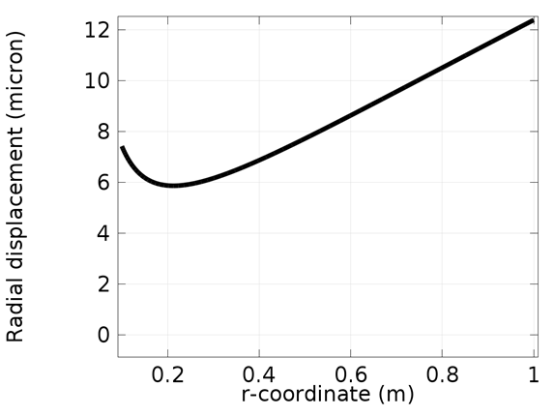
Radial Displacement
Near Well
Open Hole

Slide 35
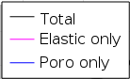
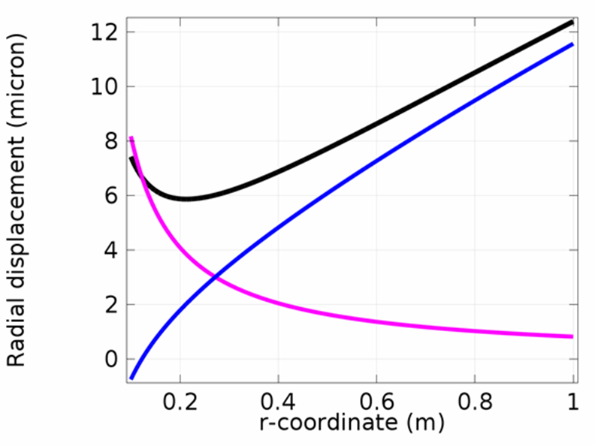
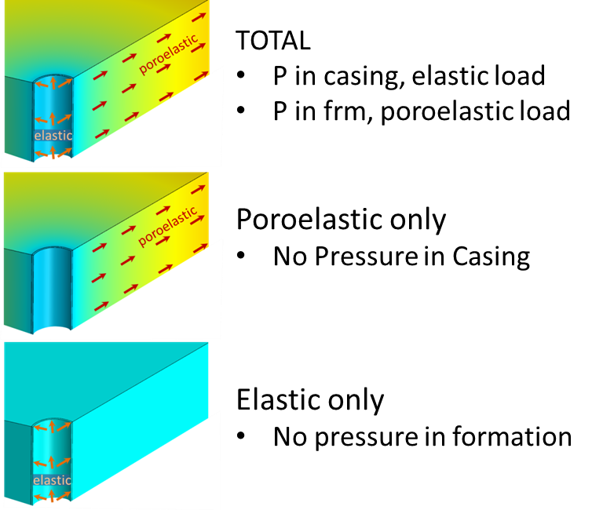
Radial Displacement
Open Hole

Slide 36
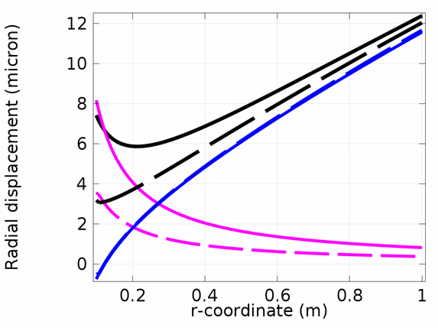
Radial Displacement
Open Hole and Cased Hole
open
cased
open
cased

Slide 37
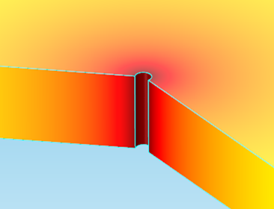
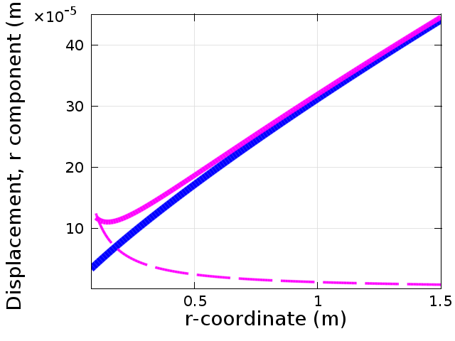
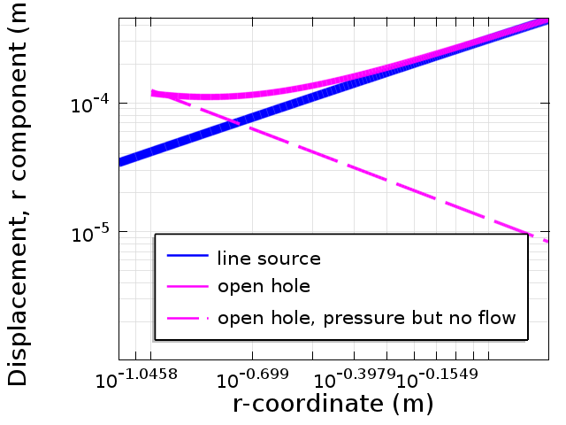
Near-well radial displacement
Open Hole
0.1 1.0

Slide 38
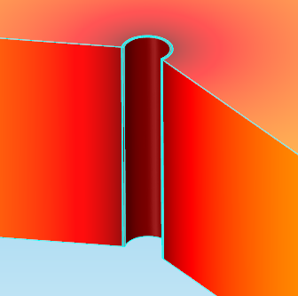
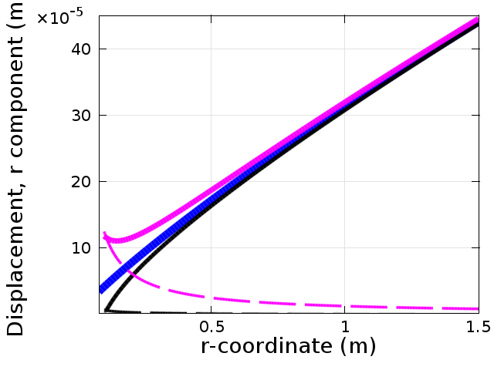
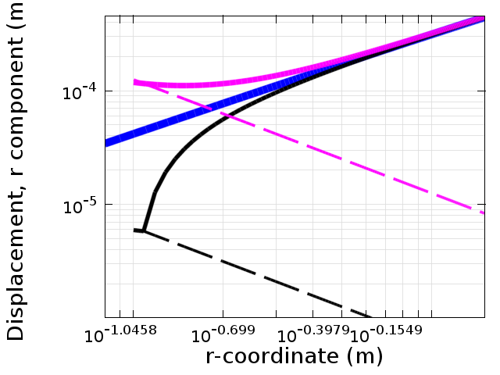
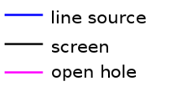
Near-well radial displacement
Screened hole, bonded to formation
0.1 1.0

Slide 39
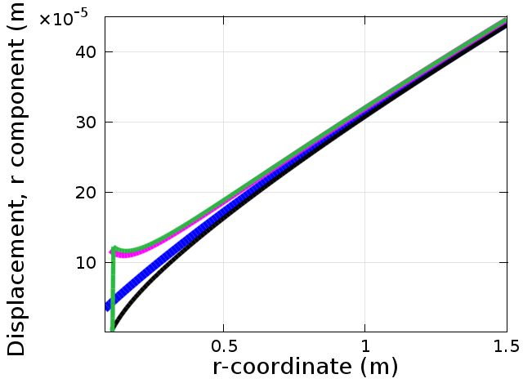
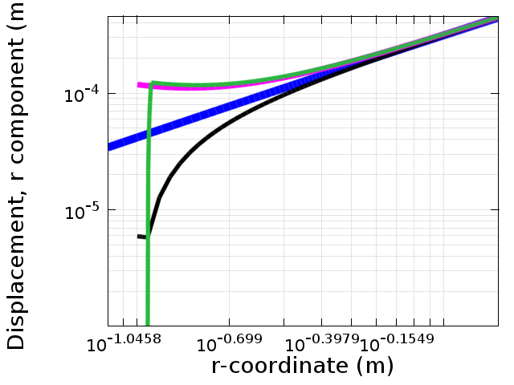
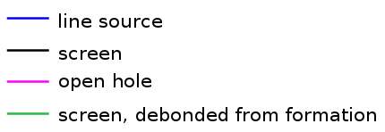
Near-well radial displacement
Screened hole, soft layer, no pre-stress
0.1 1.0

Slide 40

Vicinity of Well
1km
E=1E9 Pa, v= 0.25, p=1700 kg/m³,α=0.7,k=10⁻¹³m²
0.1km

Slide 41
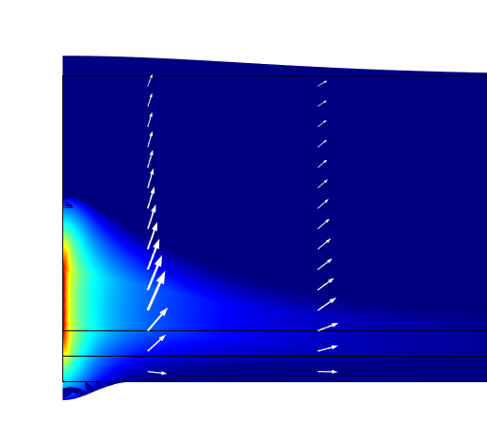
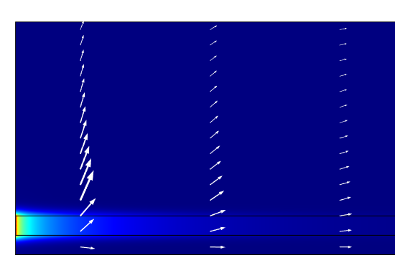
Hydraulic head and displacement after 1 months of injection
Original coordinates Deformed coordinates

Slide 42
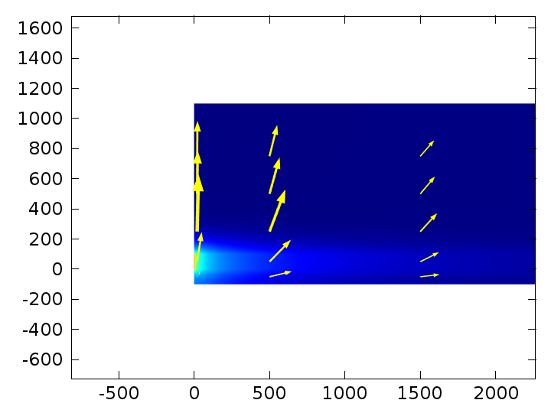
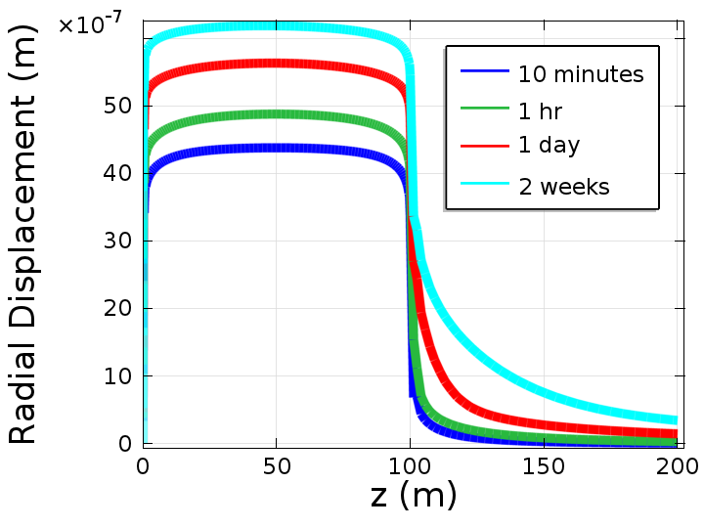
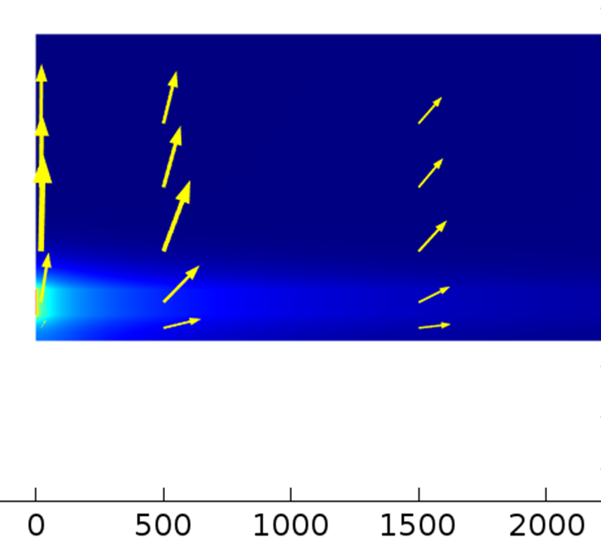
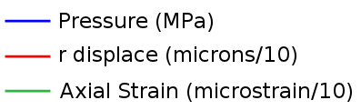
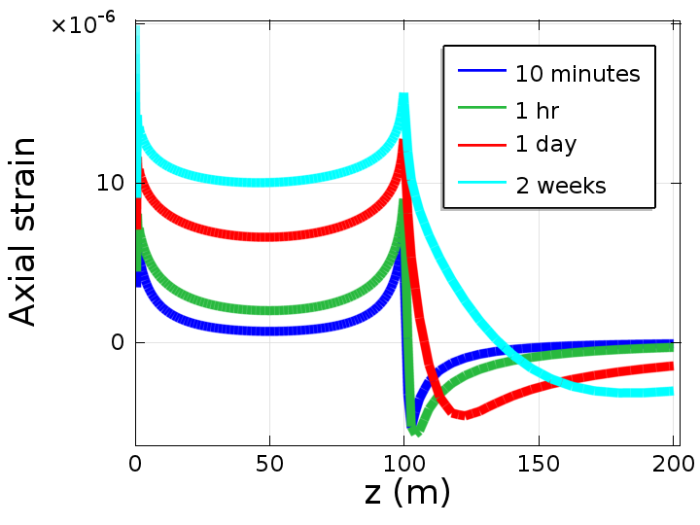
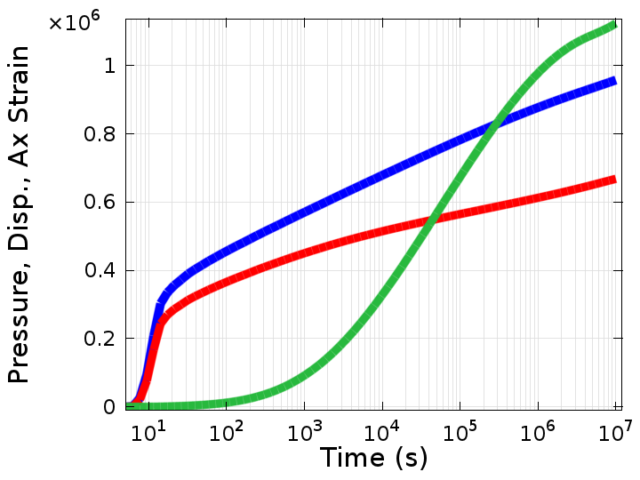
Response in Injection Well
1MPa
6 μm
4με

Slide 43
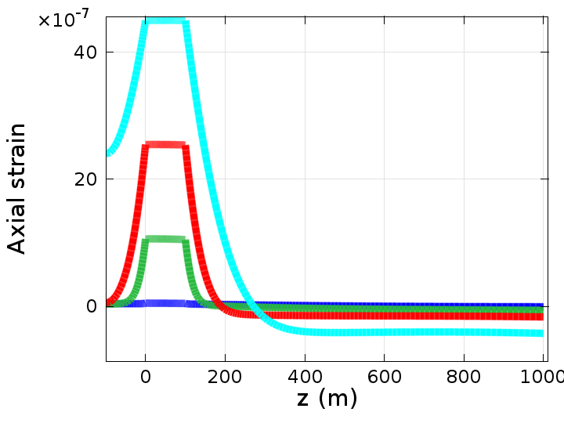
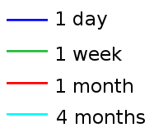
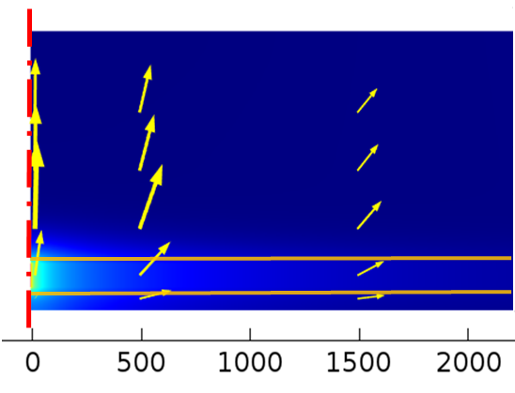
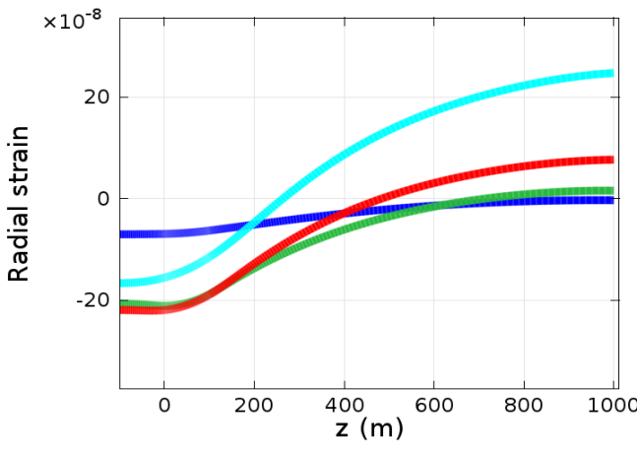
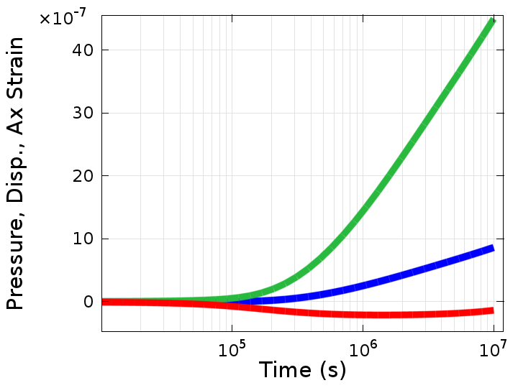
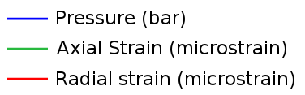


Profiles
Response in Monitoring Well
r = 1000m
Monitoring well location
4
3
2
1
0

Slide 44

Strain distribution
x-section as function of time
Color = positive (tensile) strain
Grey = negative (compressive) strain
Color cutoff: +/-0.05 με
Blue band = pressurized

Slide 45


Vertical displacement of ground surface and top of formation
Pore pressure at piezometers in aquifer and confining unit. Noordbergum effect causes head to drop

Slide 46
Properties and Volume Force
Properties
Ε: Young’s Modulus [M/(TL²)] (1-75 GPa rock) (0.01-1 GPa) soil
ν: Poisson’s ratio [-] (0-0.5) (0.2-0.35) rock (0.3-0.45) soil
ρ: density [M/L³] (2000-2700 kg/m³) rock
(1600-2100 kg/m³) soil
F_{v}: Volume force, Body force 10⁴ Pa/m water
Coupling to fluid pressure, [Pa/m]

Slide 47
Properties and Sources
Properties
ρ: fluid density [M/L³]
k: permeability [L²]
g: gravity acceleration [L/T²]
μ: viscosity [M/LT]
M: inverse Biot Modulus [1/L]
Source
Q_{m} : mass source [M/(L³T)]
Q_{me:}
Hydraulic conductivity
Assume properties are constant for basic problems (saturated, locally deformable).
Properties vary as functions of h or p if unsaturated, non-local deformation

Slide 48
Sign convention
+ stress = tension
-stress = compression
1st principle stress = most tensile; 3rd principle stress=most compressive
1st principle strain = most dilational; 3rd principle strain = most compressive.
Boundary conditions
  Boundary stress acts in coordinate direction using “Global coordinate” (+y = up; +x=left to right).
  Boundary stress acts in outward normal direction when using “Boundary system”
  Boundary pressure acts on inward normal direction when using “boundary system”

