Slide 1
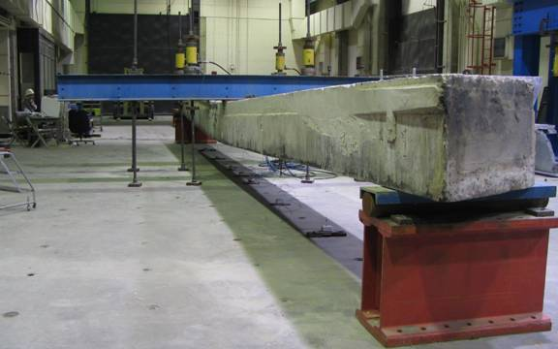
Deformation of Solids

Slide 2
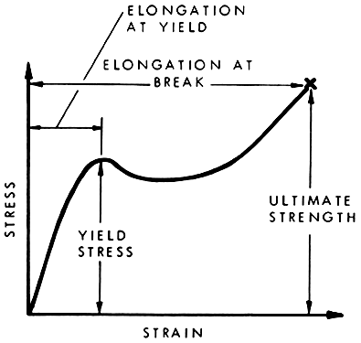
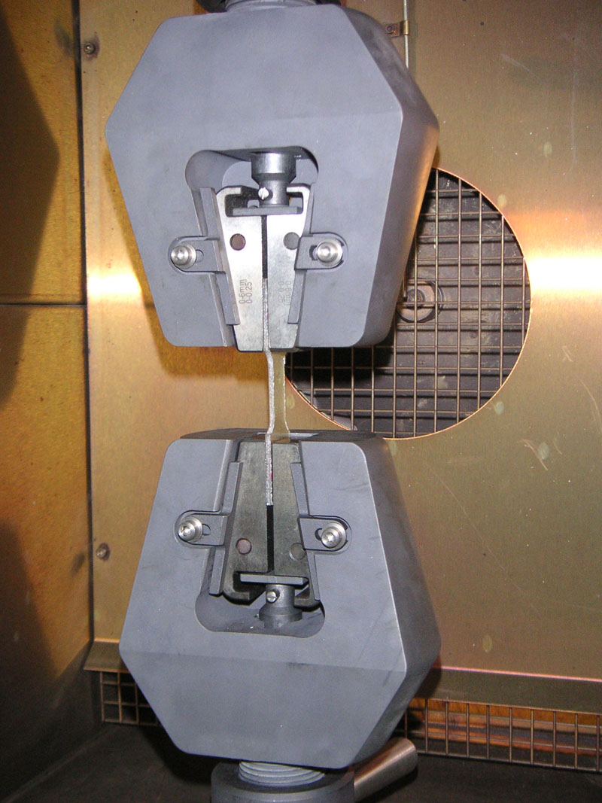
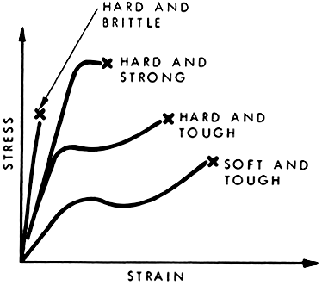
Tensile test

Slide 3
Nomenclature
Force; normal, shear
Stress; compression, tension, shear, sign
Displacement
Strain; normal, shear, volumetric
Modulus, compressibility
Poisson’s Ratio
Plastic
Yield

Slide 4
Stress and Strain Tensors
Different notation, same meaning
Strain Tensor
http://www.britannica.com/EBchecked/media/2307/The-nine-components-of-a-stress-tensor

Slide 5
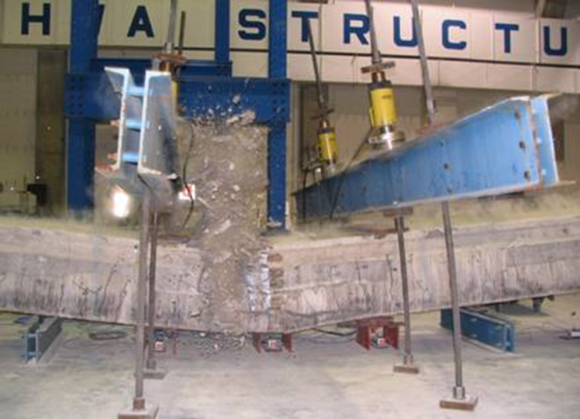
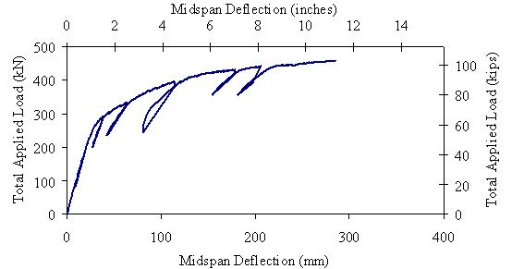
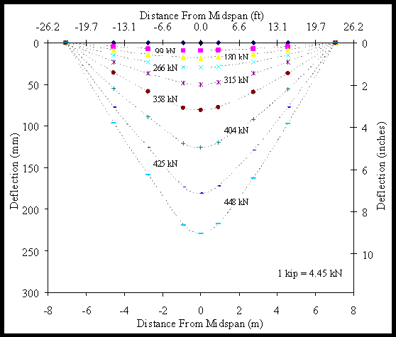
Load Test a Beam
Elastic behavior, flexural stiffness, yield, ultimate strength, residual, stiffness, failure load

Slide 6
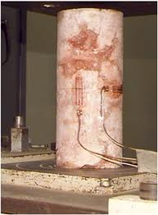
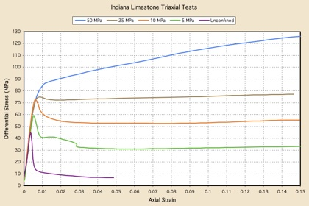
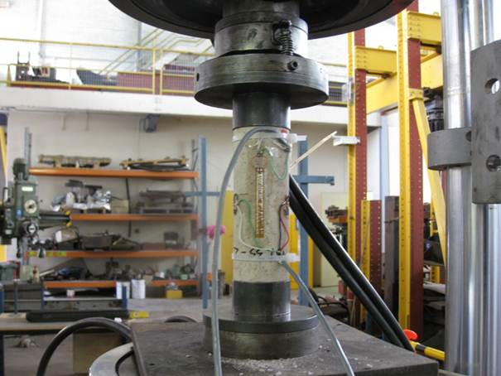
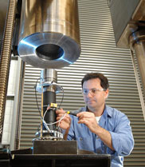
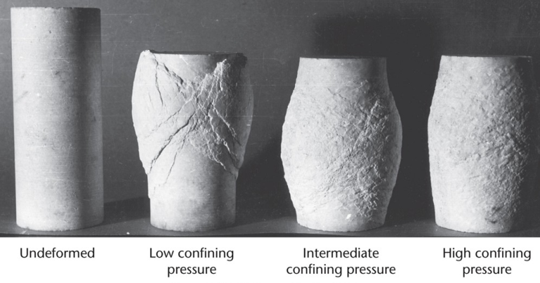
Stress strain of rock
E=120MPa/0.01 = 12000MPa=12GPa

Slide 7
Elastic Modulus
Modulus = stress/strain
Modulus = 1/Compressibility
Material Modulus Pa
v. soft clay 10⁶
Soft clay, loose sand, saprolite 10⁷
Stiff clay, dense sand 10⁸
Soft sandstone 10⁹
Water 2 x 10⁹
Well cemented sandstone 10¹⁰
Crystalline rock, quartz 10¹¹

Slide 8
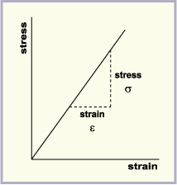
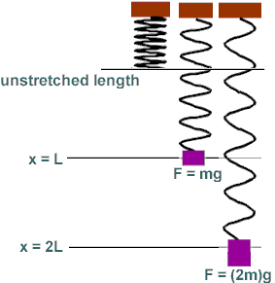
Hooke’s Law

Slide 9
Hooke’s Law relate stress and strain

Slide 10
Governing Equation Navier Equation
Conservation of Momentum
Definition of Stress and Strain
Hooke’s Law—Constitutive Law
A little algebra

Slide 11
Conservation of Momentum
Storage
Advective Flux
Diffusive Flux
Source
Governing
c = ρv
A= vc= vvρ
Units of stress or pressure

Slide 12
Constitutive Law Displacement, velocity, strain and strain rate

Slide 13
Navier eqn. mixed stress and displacement

Slide 14
Navier Eqn. in terms of displacement Steady state
See notes on the steps
Same as

Slide 15
Boundary Conditions
Displacement
Stress
u displacement vector
stress tensor
P pressure
C₁ known function
n unit vector normal to boundary
You must have geometry constrained so the entire region cannot move. Either at least one boundary “fixed” or multiple “roller” boundaries.

Slide 16
Properties and Volume Force
Properties
Ε: Young’s Modulus [M/(TL²)] (1-75 GPa rock) (0.01-1 GPa) soil
ν: Poisson’s ratio [-] (0-0.5) (0.2-0.35) rock (0.3-0.45) soil
ρ: density [M/L³] (2000-2700 kg/m³) rock
(1600-2100 kg/m³) soil
F_{v}: Volume force, Body force 10⁴ Pa/m water
The most common volume force is unit weight, which creates stresses due to gravity loading. Water pressure gradients also create a volume force in porous media.

Slide 17
Sign convention
+ stress = tension
-stress = compression
1st principle stress = most tensile; 3rd principle stress=most compressive
1st principle strain = most dilational; 3rd principle strain = most compressive.
Boundary conditions
Boundary stress acts in coordinate direction using “Global coordinate” (+y = up; +x=left to right).
Boundary stress acts in outward normal direction when using “Boundary system”
Boundary pressure acts on inward normal direction when using “boundary system”

Slide 18
Example 1 Boundary load on a block
Specified load, σ_{y}=-1E6 Pa
fixed
E=1E9 Pa, v= 0.25, p=2500 kg/m³.

Slide 19
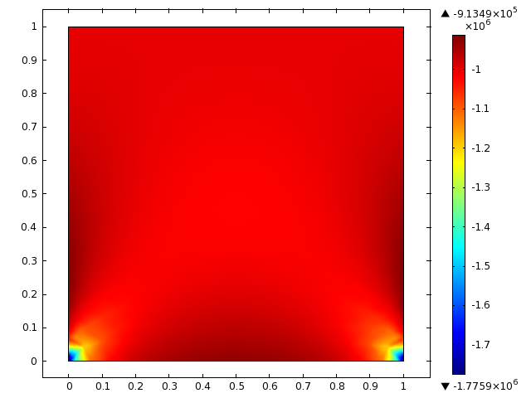
Baseline result
3rd principle stress (most compressive)

Slide 20
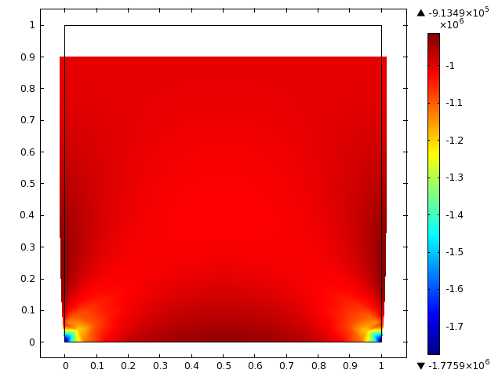
Baseline result
3rd principle stress (most compressive)
Notice sides bulging out from compression.
Also notice stress concentration in corners at bottom.

Slide 21
Example 2 Boundary load on a block
Specified load, σy=-1E6 Pa
How to remove the stress concentration in corners?
Try roller boundary.
This will not converge because the geometry is not sufficiently constrained—the entire body could move.
roller
E=1E9 Pa, v= 0.25, p=2500 kg/m³.

Slide 22
Example 2 Boundary load on a block
Specified load, σy=-1E6 Pa
Use roller boundaries on 3 sides.
roller
E=1E9 Pa, v= 0.25, p=2500 kg/m³.

Slide 23
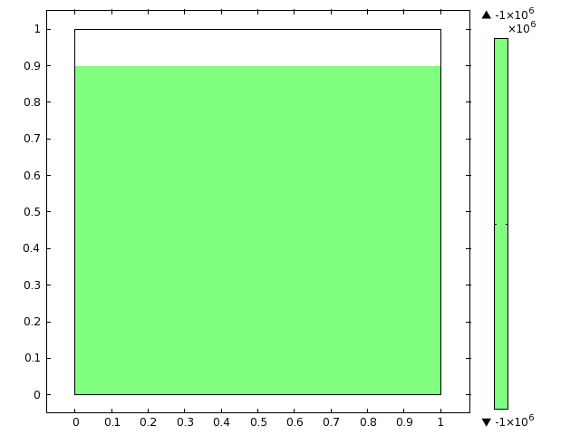
The roller boundaries cause the deformation to be homogeneous through the body.

Slide 24
Example 3 Body Force
Body force Fy = -ρg = -2500*9.81
fixed
E=1E9 Pa, ν= 0.25, ρ=2500 kg/m³.

Slide 25
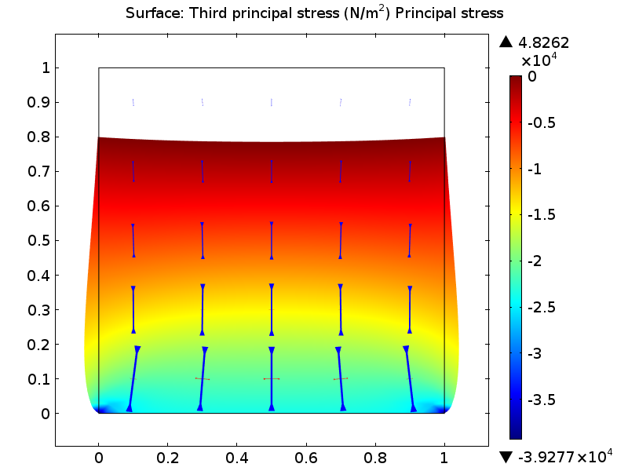
Stresses Body force and roller b.c.

Slide 26
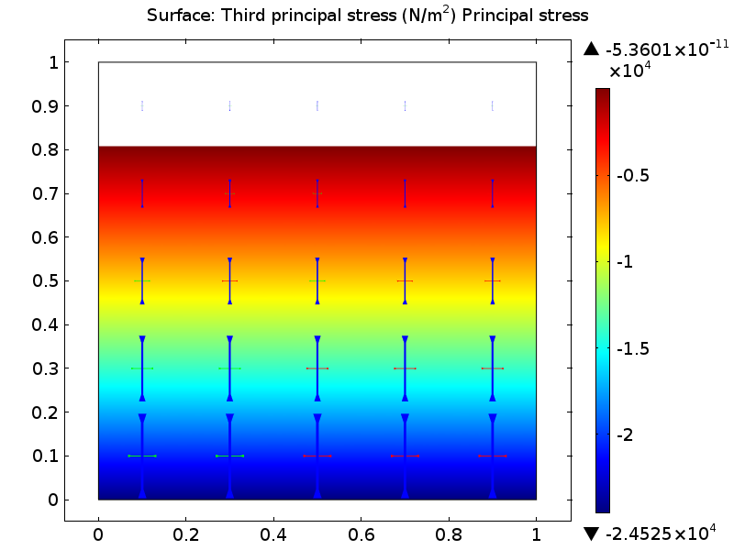
Stresses Body force and roller b.c.

Slide 27
Example 4 Stress Concentration

Slide 28
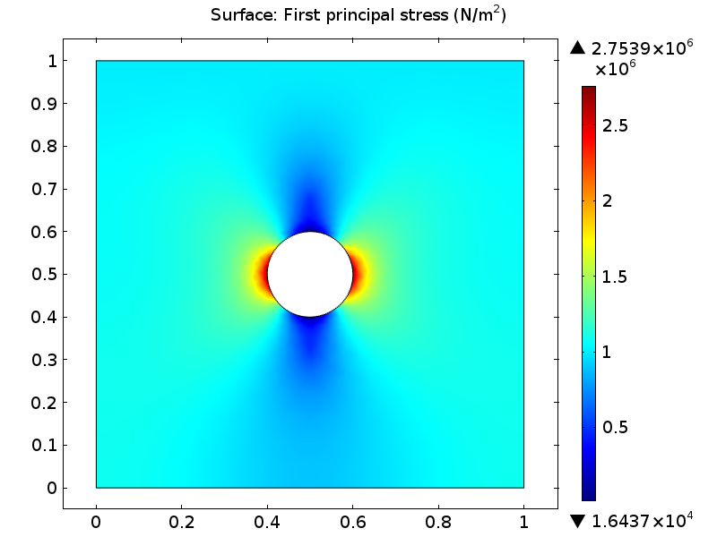
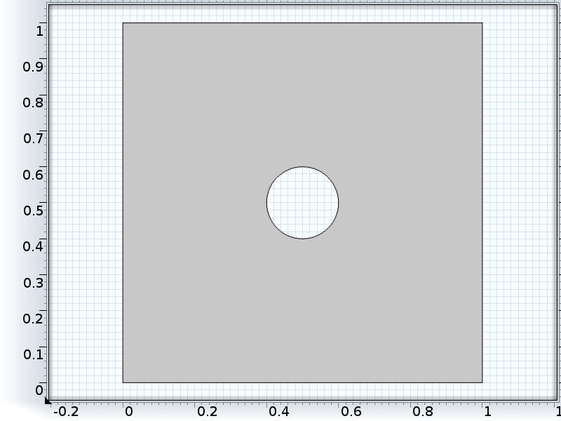
Stresses concentrated by a circular hole
Boundary load = 1E6 Pa, roller on others
Radius =0.1m
Applied tension = 1E6 Pa
Max Tension on wall of hole = 2.7E6Pa

Slide 29
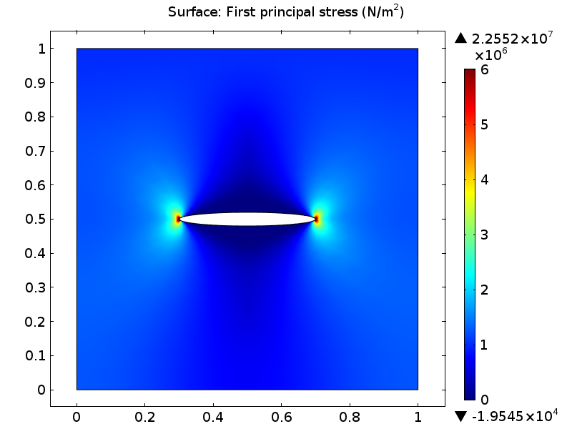
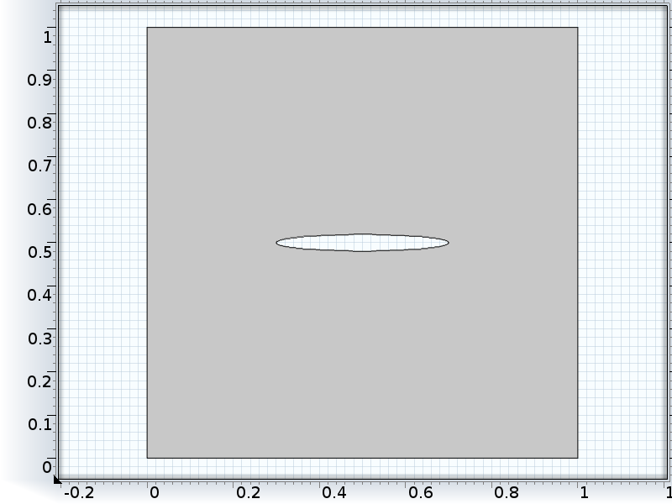
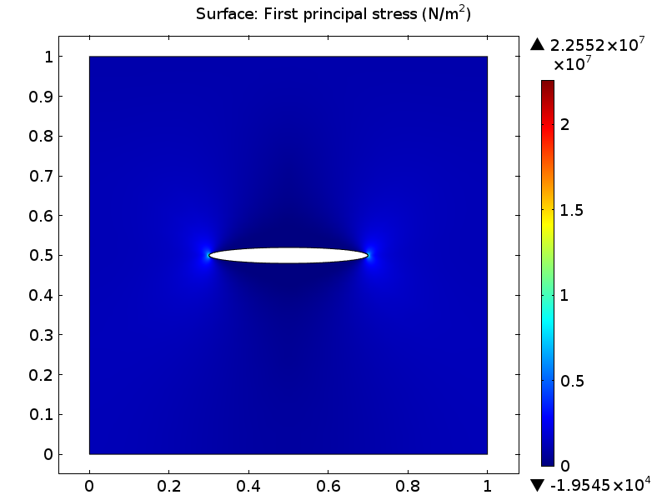
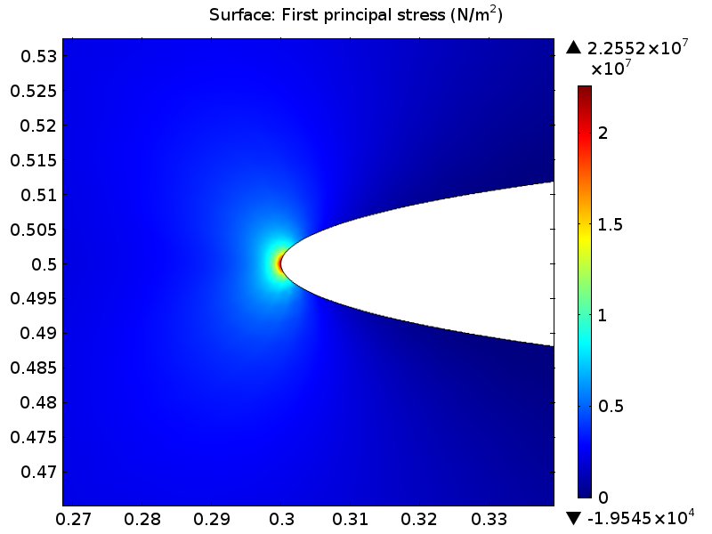
Boundary load = 1E6 Pa, roller on others
Ellipse semi-axes= 0.2 and 0.02 m
Stress at tip 22 MPa
Elliptical hole→fracture

Slide 30
Example 4 Body Force with hole
Body force Fy = -ρg = -2500*9.81
fixed
E=1E9 Pa, v= 0.25, p=2500 kg/m³.

Slide 31
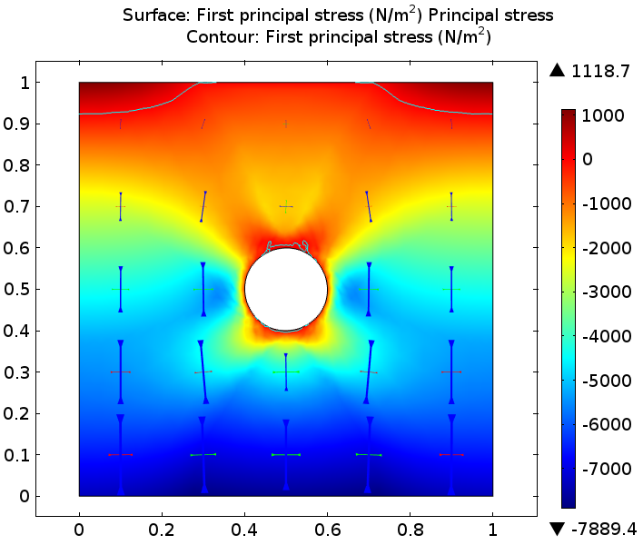
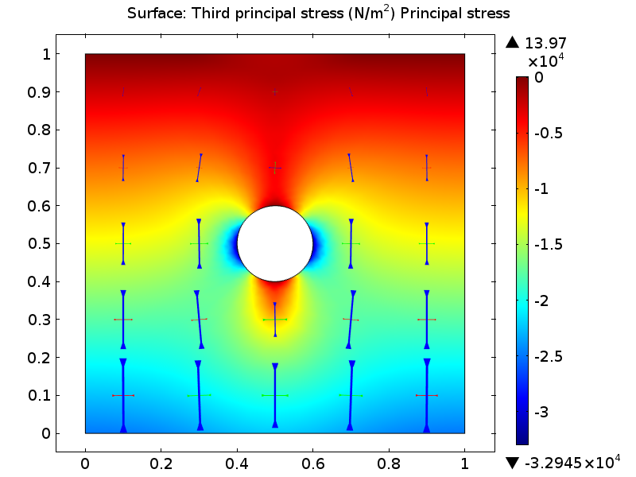
Circular hole loaded by body force Tunnel
First Principle Stress 3rd Principle Stress

Slide 32
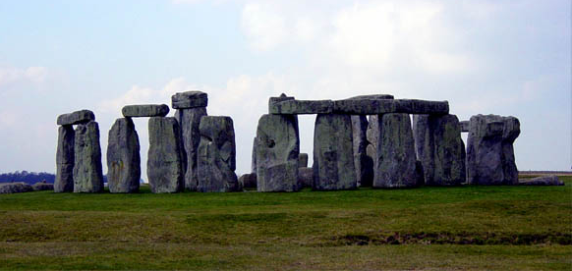
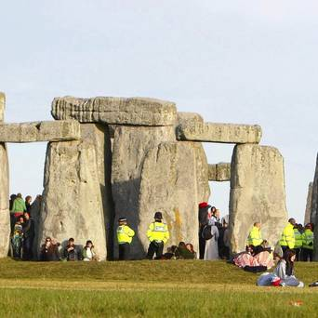
Designing Stonehenge
Ring of rock columns and beams, ~2600BC
Sandstone sarsen 50 tons, Dolerite
Π shape structures 5m high x 5m wide,
Beams 3m long x 0.5 m thick w 1.5m spacing
How to design beams so they last 4600 years?

Slide 33
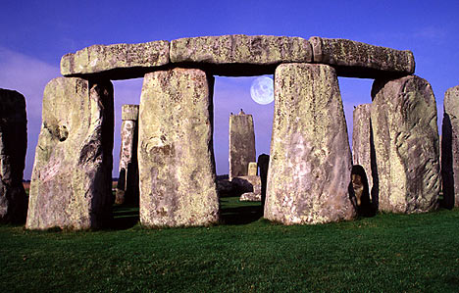
Designing Stonehenge

Slide 34
3m
0.5m
roller
0.75m 1.5m 0.75m
Property | Sandstone | Dolerite
Young’s Modulus (GPa) | 10 (1-20) | 40 (10-70)
Density (kg/m3) | 2000 | 3000
Poisson’s ratio | 0.3 (0.2-0.38) | 0.2 (0.1-0.3)
Tensile strength (Mpa) | 10-30 | 10-30

Slide 36
Earth tide
Gravity changes with time due to tides. This effect changes the body force and causes deformation. It can be included by making g a periodic function of time.
ρ = 9.81* (1+C₁*cos(4*π*t/86400))
Body force Fy = -ρg = -2500*9.81
This example is transient, so a new study was included to represent this case.

Slide 37
Deformation of Solids

