Slide 1
Project
Describing Methods

Slide 2
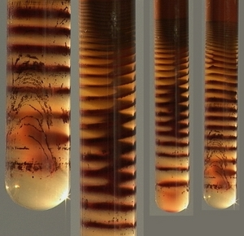
Reactive Transport
Silver dichromate forming Leisegang rings in a test tube experiment
http://www.insilico.hu/liesegang/index.html

Slide 3
Reactive Transport Conceptual
A+B→C
A
A
C
B
B
Reactions require transport

Slide 4
Conceptual Model
A+B←→C
Reaction Rate
Intrinsic rate
Transport-- combine reactants, remove products
Processes
Advection
Dispersion
Diffusion
Time scale for reaction, t_{r}
Time scale for transport, t_{t}
Damkohler Numbers: t_{t}/t_{r}
Da_{I}: t_{advect}/t_{react}
Da_{II}: t_{disperse}/t_{react}
Scale

Slide 5
Reaction Locations and Mixing
Bulk Material
Fluid— Multi-scale mixing, dispersion, length scale
Solid– Diffusion dominant
Interfaces
Fluid-Solid
Liquid-Gas
No flow at interface→diffusion
Mass transfer over stagnant layer

Slide 6
Important Scales
Time scales

Slide 7
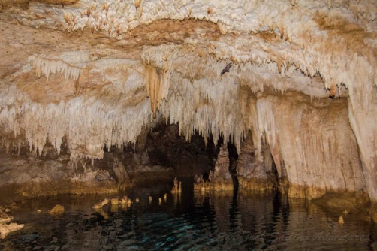
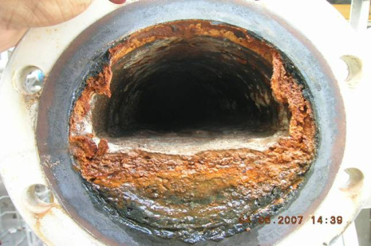
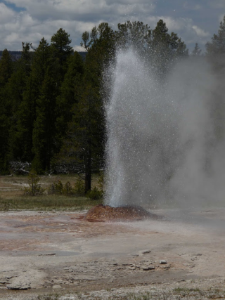
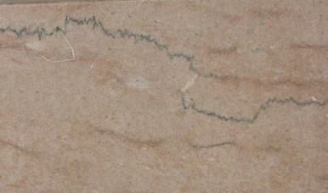
Coupled effects Reaction ←→Transport
Cave in Bali
Reaction changes K , porous media flow
karst, diagenesis
Reaction changes D, subsequent reaction rate
Biofouling, reactor performance
Heat affects reaction rate
Geothermal, remediation
Other chemicals, competing/synergistic reaction
Bioprocesses, waste water treatment
Precipitates affect density, flow
Flocculation, mixtures
Stress affects reaction, reduces K, flow
Diagenesis, sintering
Biofouling in pipe
Geyser in Yellowstone
Styolites in limestone
http://www.seatrekbali.com/seasons-greetings-seatrek/
http://www.merusonline.com/biology
http://onlinelibrary.wiley.com/doi/10.1002/hyp.9492/pdf

Slide 8
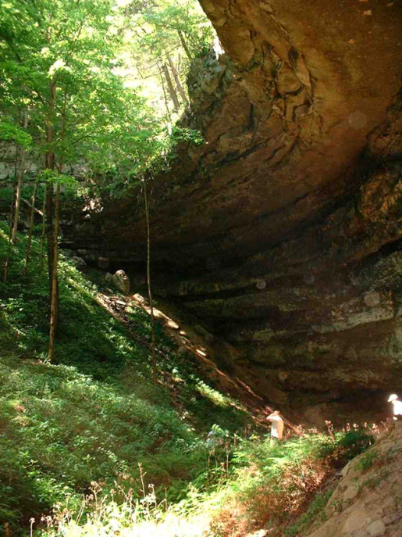
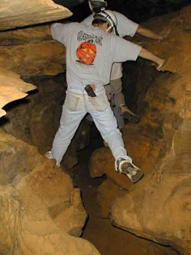
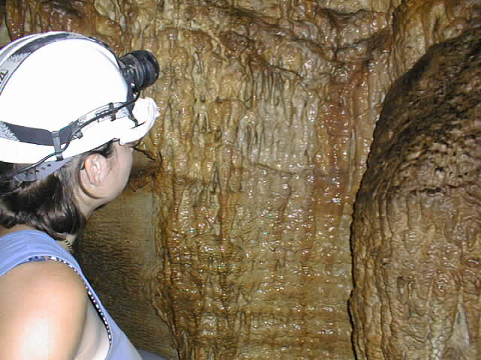
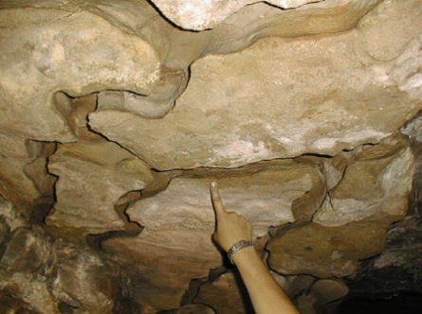
Coupled effects Reaction changes K
A+B→C
Precipitation-Dissolution-change porosity
Couple through porosity, φ
Kozeny-Carmen equation
Verma Pruess (1988)
Permeable reactors
Karst
http://onlinelibrary.wiley.com/doi/10.1002/hyp.9492/pdf

Slide 9
Governing Equation
Advection-Dispersion-Reaction
Storage
Advective Flux
Diffusive Flux (Fick’s Law)
Dispersive Flux
Source
Governing
c = C
S=R

Slide 10
Simulation of Advection-Dispersion-Reaction
Governing
Boundary
Dirichlet, Specify Conc
Neuman, Specify diffusive flux
Specify advective flux
Cauchy, flux proportional to gradient
Initial Conditions
C(x,y,z,0) = C_{i}
Parameters
D: hydrodynamic dispersion
R: reaction rate→kinetics
μ, ρ: fluid properties
k: permeability
q, P Flow, pressure
T Temperature
Stress
C_{i} other conc

Slide 11
Idealized Conceptual Models
Case 1. 1-D flow, Steady
Steady state, C changes with x, not t
Plug flow reactor
Along streamtube/flowpath
Reactive wall
Case 2. Thoroughly mixed, transient
Transient, C changes with t, not x
Tank reactor, CSTR
Pore, Pond, Lake, Atmosphere

Slide 12
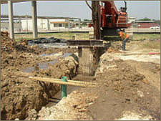
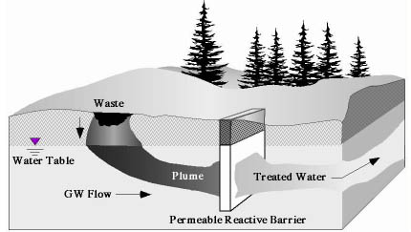
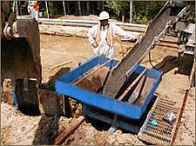
Permeable reactive barrier
Permeable material that sorbs or breaks down contaminants on contact.
Metallic iron→ reduce chlorinated solvents
Limestone, phosphate→ precipitate metals
Activated carbon, zeolites→ sorb contaminants
Compost, mulch, sawdust→biodegradation

Slide 13
Idealized Conceptual Models
1. Reaction during 1-D, steady flow

Slide 14
Idealized Conceptual Models
Case 1. Reaction during 1-D flow
Characteristic length scale:
Time scale for reaction
Time scale for advection (travel time):

Slide 15
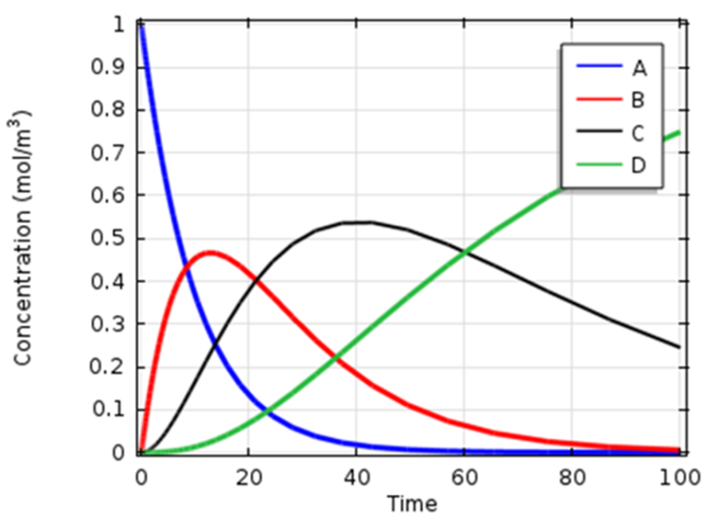
More general case other reactions, non-uniform v
First-order Decay Chain
Distance along flowpath
Temporal changes map out to spatial zones

Slide 16
Non-ideal factors
Preferred flowpaths
Incomplete contact of reactants, affect k1
Non-ideal interface,
Water, precipitates, longer diffusion time
Storage along tube without reaction
Matrix diffusion
Reactions alter flow
Precipitation, dissolution, biofilm
Result:
q, k₁, D change with time/space

Slide 17
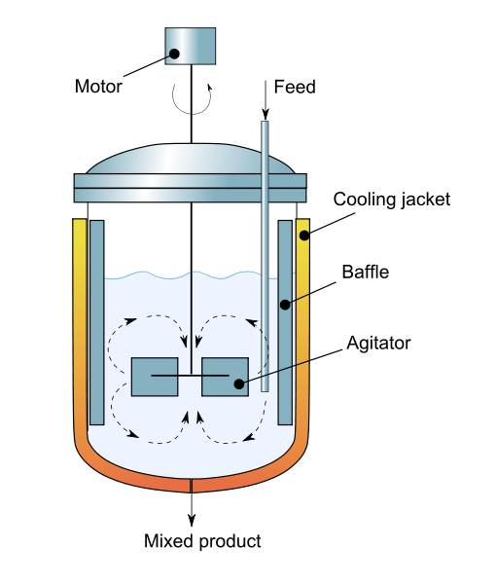
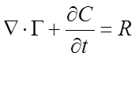
Idealized Conceptual Model
Case 2. Reaction in mixed region
CSTR, Lake, Ocean, pore
A
Δx

Slide 18
Reaction in a mixed region
No reaction, k₁=0, conservative tracer

Slide 19
Residence Time Distribution Pulse tracer test
C_{in}
t
Cout
t
E
A=1
0 a
t
Notes:
First animation. Area of curve gives the relative mass of C with a residence time less than the upper limit. Second animation: Area under curve is the relative mass with residence time between the limits. F(t) is the fraction of the mass with residence time between t=a and t=b.

Slide 20
Residence Time Distribution Step tracer test
C_{o}
C_{in}
t
C_{o}
Cout
t
1.0
F
t
Notes:
First animation. Area of curve gives the relative mass of C with a residence time less than the upper limit. Second animation: Area under curve is the relative mass with residence time between the limits. F(t) is the fraction of the mass with residence time between t=a and t=b.

Slide 21
Residence Time Distribution
E
t_{m}
t
Moments of RTD
1.0
F
t
Notes:
First animation. Area of curve gives the relative mass of C with a residence time less than the upper limit. Second animation: Area under curve is the relative mass with residence time between the limits. F(t) is the fraction of the mass with residence time between t=a and t=b.

Slide 22
Diagnostics Plug Flow Column
Ideal
E
Bypass
Low K zones
How to use moments to diagnose?

Slide 23
Diagnostics
Pulse input into CSTR
Dead zone
E
Bypass
Ideal mixing

Slide 24
Residence time and Reaction
Residence time = time molecule in reactor
First-order rxn only depends on residence time
Other rxn also depend on mixing
Macro-mixing→flow paths
Micro-mixing→mechanical dispersion, diffusion

