Slide 1
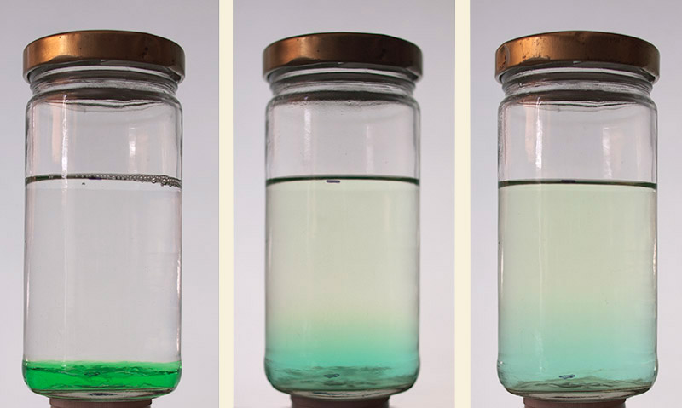
Diffusion
Mass transfer in the absence of fluid motion
http://theonlinephotographer.typepad.com/the_online_photographer/2011/07/fixer-doesnt-sink.html

Slide 2
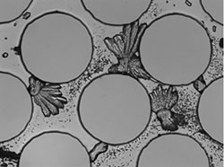
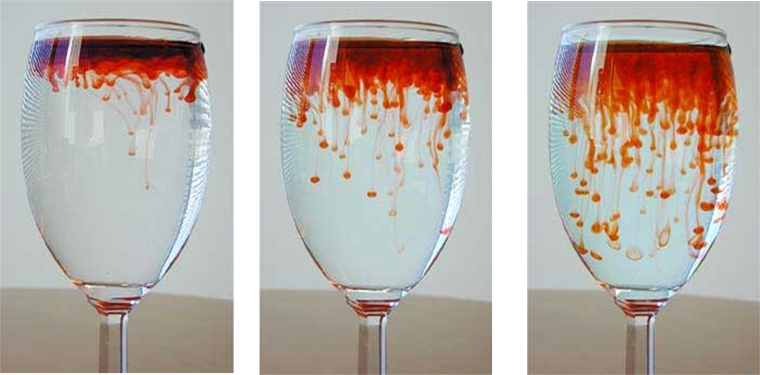
Important role in many processes
Precipitation
Calcite precipitate at pore scale
Mixing
Local-scale blending of fluids
Mass transfer. Gas Liquid
http://green.usc.edu/content/lab-chemical-recycling

Slide 3
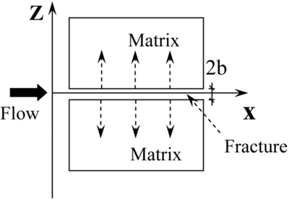
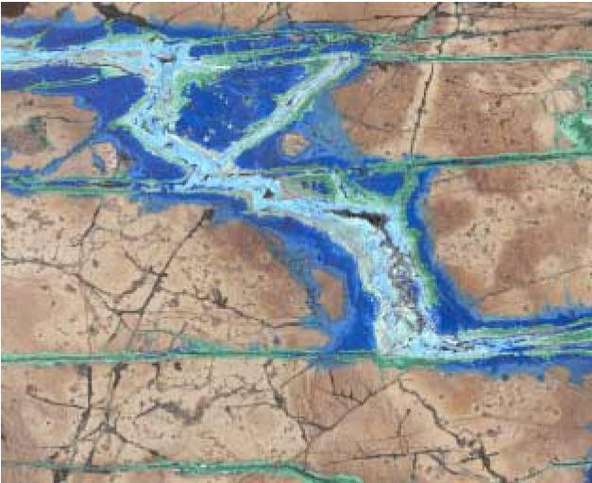
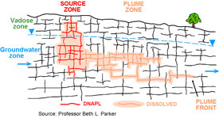
Ore Deposits and Contaminated Sites
Fracture filled with three generations of copper-bearing minerals: azurite (blue), malachite (green), chrysocolla (light blue). These minerals record changing fluid compositions and seal the pathway for fluid migration. Image; B. Dutrow.
http://www.bing.com/images/search?q=rock+fracture+alteration&view=detail&id=A37113F2466D716C0850455C09769678B8527041&first=61&FORM=IDFRIR

Slide 4
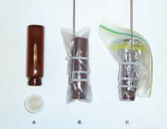
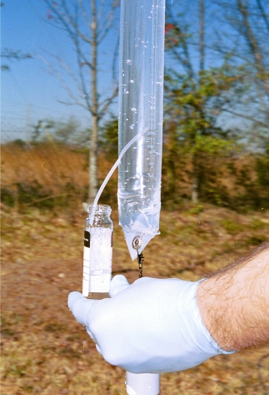
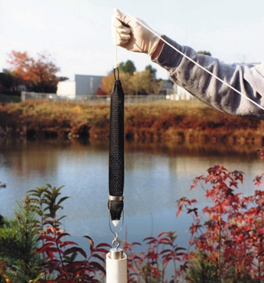
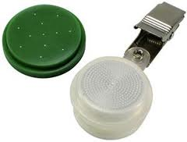
Diffusion Sampler

Slide 5
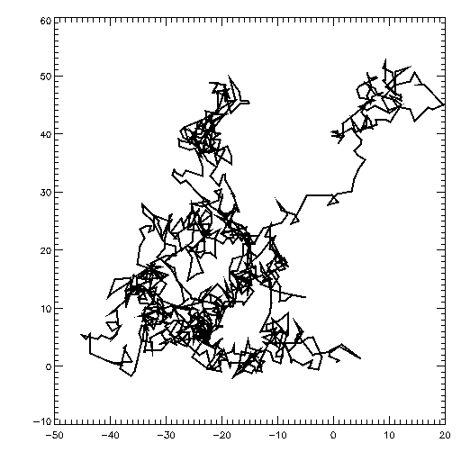
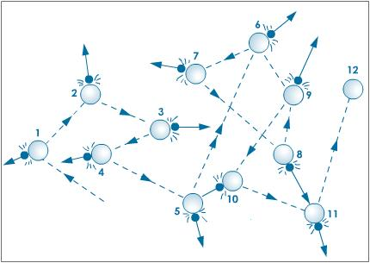
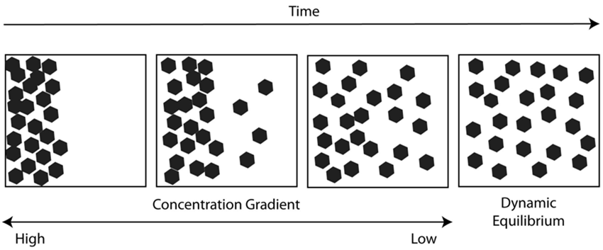
Brownian Motion

Slide 6
Chemical potential
Ideal solutions

Slide 7
Concept for Mass Flux
Flux from high to low chemical potential
Flux magnitude proportional to gradient or potential difference

Slide 8
Diffusion through liquid
Conceptual
Stokes law:
Assume (Einstein, 1905):
Equate and rearrange:
From previous page:
Mass flux:
v
Cussler [1997, p.116]

Slide 9
Mass Flux
C
x
Fick’s Law
D: Diffusivity[L²/T]
Mass Transfer Law
k: mass transfer coefficient [L/T]
k~D/L
C₁: reference concentration [M/L³]

Slide 10
Conservation of Mass
Diffusion
c = C
Storage
No Advective Flux
Diffusive Flux (Fick’s Law)
Source
Governing
S=0 (for now)

Slide 11
Simulation of Diffusion
Governing
Boundary
Dirichlet, Specify Conc
Neumann, Specify flux
Cauchy, flux proportional to gradient

Slide 12
D in water
General
Ions, small molecules
~ 10⁻⁹ m²/s
Water self-diffusion
2.3x10⁻⁹ m²/s at 25ºC
Proteins, large molecules
10⁻¹⁰ -10⁻¹¹ m²/s
Solute | 10⁻⁶ D_{aq} in cm²/s | Reference or source
Hydrogen | 45.0 | 4
Nitrogen | 18.8 | 4
Oxygen | 20.0 | 10
Carbon dioxide | 19.2 | 4
Methane | 14.9 | 4
Ethane | 12.0 | 4
Propane | 9.7 | 4
Benzene | 10.2 | 4
Hydrogen sulfide | 16 | 22
Formic acid | 14.1 | 4
Acetic acid | 12.1 | 4
Propionic acid | 10.6 | 4
Butyric acid | 8.7 | 27
Benzoic acid | 10.0 | 4
Succinic acid | 9.4 | 4
p-Aminobenzoic acid | 8.4 | 16
Fluorescein | 5.4 | _ª
Methanol | 15 | 16
Glycerol | 9.4 | 22
Urea | 13.8 | 4
Glucose | 6.7 | 16
Sucrose | 5.2 | 4
Lactose | 4.9 | 22
Maltose | 4.8 | 22
Raffinose | 4.3 | 16
0.5-2x10⁻⁹ m²/s
Stokes-Einstein
10⁻¹⁰ m²/s
0.5-2x10⁻⁹ m²/s
http://books.google.com/books?id=TGRmfTrsPTQC&pg=PA143&lpg=PA143&dq=diffusion+constant+table&source=bl&ots=7EWMwcA4xh&sig=AzbYYO7F3oydinzD2IW0SIyUpsA&hl=en&sa=X&ei=MBkkUZWhM4rS9AS04YCgCQ&ved=0CFsQ6AEwBTgK#v=onepage&q=diffusion%20constant%20table&f=false

Slide 13
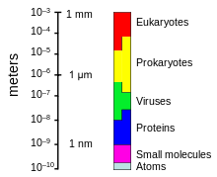
Can microbes move by diffusion?
Stokes-Einstein
Check with example
Lithium in Water
r_{c}: 0.076x10⁻⁹m
T: 293K
μ: 0.001Pa s=0.001kg/m s
Sizes of small things
Prokaryote in Water
r_{c}: 1000x10⁻⁹m
T: 293K
μ: 0.001Pa s=0.001kg/m s
http://en.wikipedia.org/wiki/Bacteria#mediaviewer/File:Relative_scale.svg

Slide 14
D in gas
General
10⁻⁵ -10⁻⁴ m²/s
Chapman and Eskog eq.
From kinetic theory
~1-10x10⁻⁵ m²/s
Cussler [1997]
http://www.ptl.ethz.ch/education/Mass_Transfer/Chapter_5.pdf

Slide 15
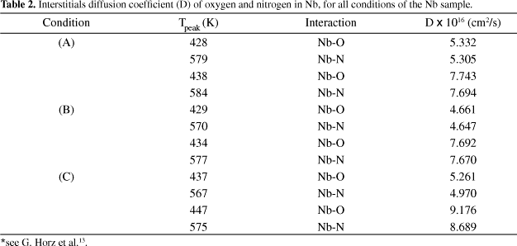
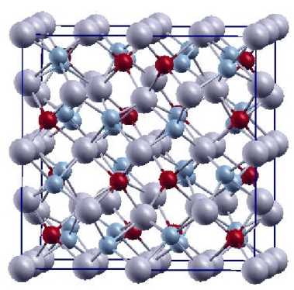
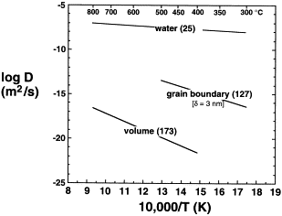
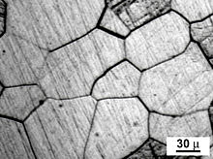
D in solids
General
~10⁻¹⁵ -10⁻³⁰ m²/s
Depends on temperature, material, structure, direction
~10⁻²⁰ m²/s
Diffusivity Tensor
Diffusion in calcite aggregate
http://www.scielo.br/scielo.php?pid=S1516-14392006000400015&script=sci_arttext
http://www.sciencedirect.com/science/article/pii/S0012821X98001502

Slide 16
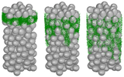
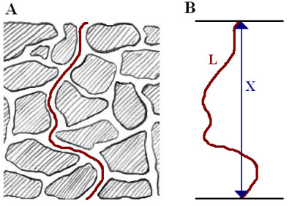
D in Porous Media
Saturated Conditions
Partially Saturated
Millington Quirk
Buckingham
Penman
Tortuosity
http://www.tue.nl/onderzoek/instituten-groepen-scholen/top-research-groups/eindhoven-multiscale-institute/events/past-events/14-01-2013-porous-media/
[Logan, 2012]

Slide 17
Diffusion Constant
Porous
Media
Single
Phase
gas liquid
gas liquid solid
polymer
-log(D m²/s)

Slide 18
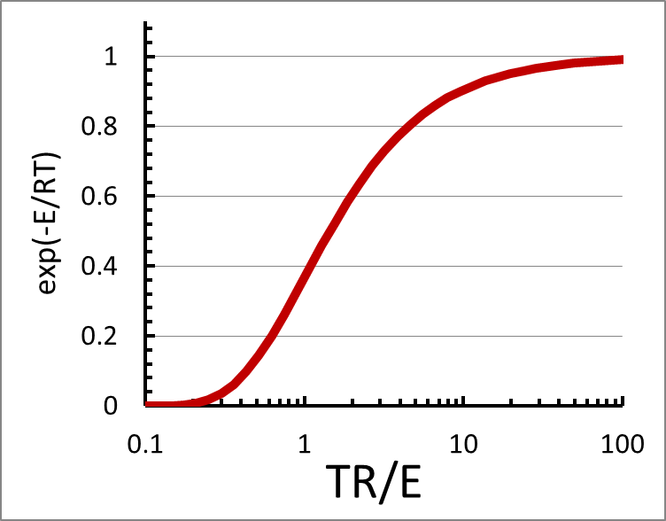
Temp effects on D
Arrhenius:
Stokes-Einstein
Increasing T will increase D

Slide 19
Scaling
Sherwood number mass transfer vel./ diffusion velocity
Stanton Number mass transfer vel./flow velocity
Schmidt Number diffusion momentum/diffusion of mass
Peclet Number flow velocity/diffusion velocity

Slide 20
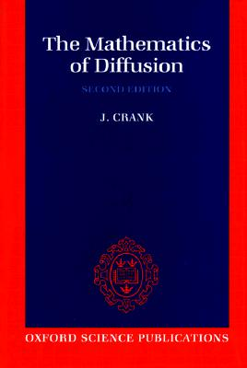
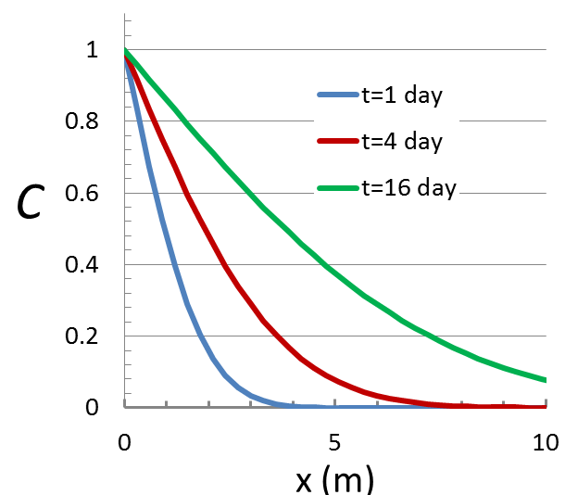
Analyses
Many analytical solutions available
Example: 1-D diffusion into a half-space
b.c. C(0,t)=C_{i}
C(∞,t)=0
i.c. C(x,0)=0
Approximation
L

Slide 21
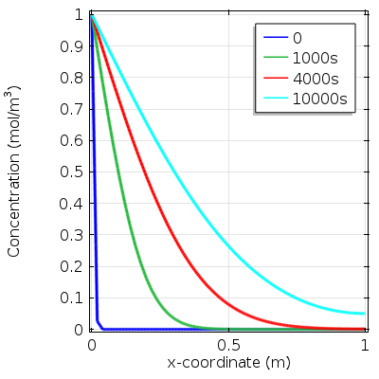
D = 10⁻⁵ m²/s
Diffusion through gas

Slide 22
D = 10⁻⁹ m²/s
Diffusion through liquid
How will the results change?
x coordinate (cm)

Slide 23
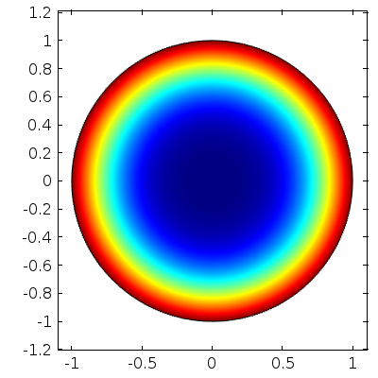
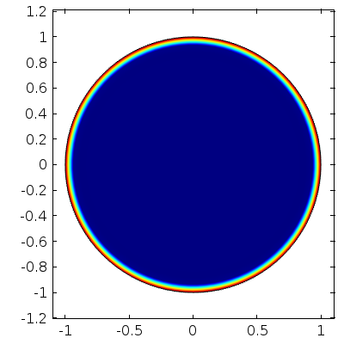
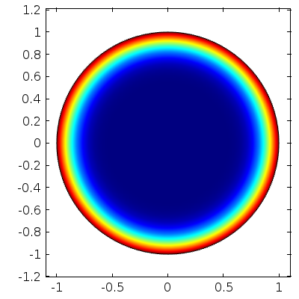
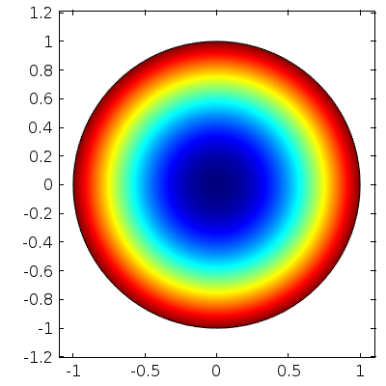
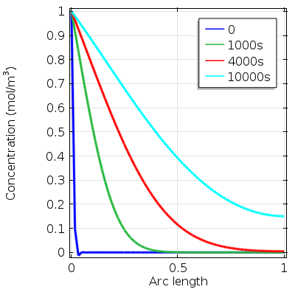
Diffusion into a Sphere
D=10⁻⁵ m²/s

Slide 24
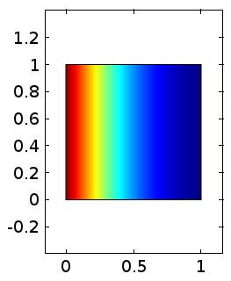
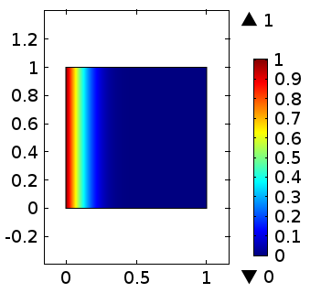
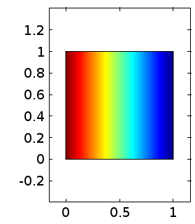
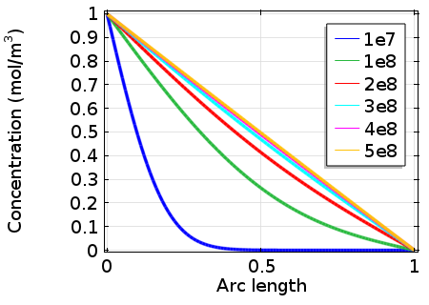
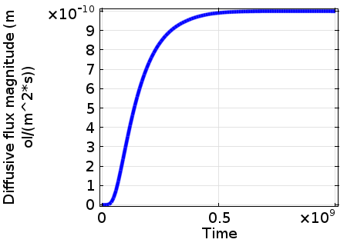
Effect of boundary

Slide 25
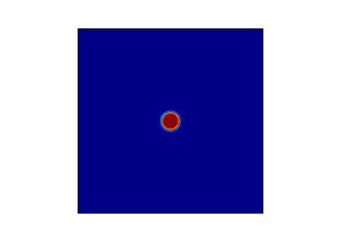
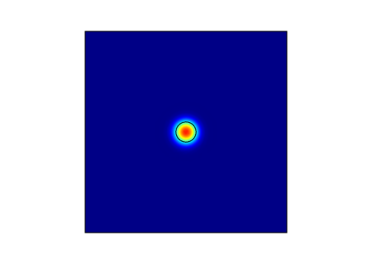
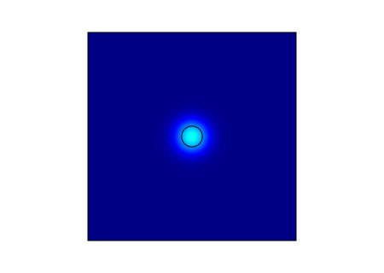
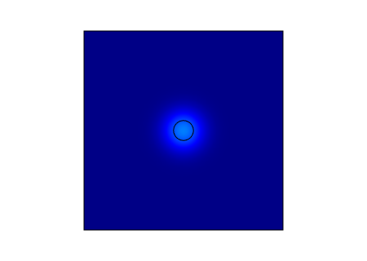
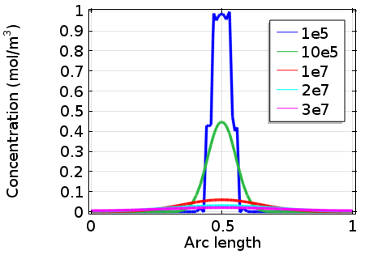
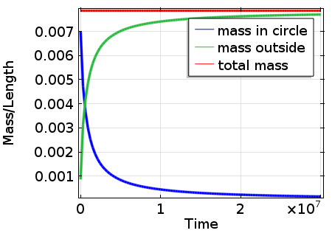
Diffusion from Circle

Slide 26
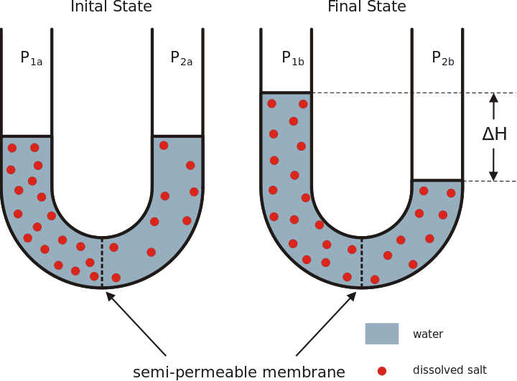
Osmosis
http://legacy.hopkinsville.kctcs.edu/sitecore/instructors/Jason-Arnold/VLI/Module%202/m2cellfunctionandenergetics/m2cellfunctionandenergetics6.html
http://scienceaid.co.uk/biology/cell/osmosis.html
http://en.wikipedia.org/wiki/File:Osmose_en.svg

Slide 27
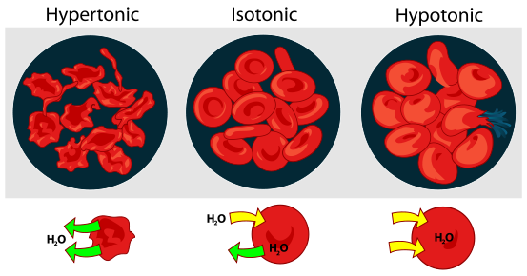
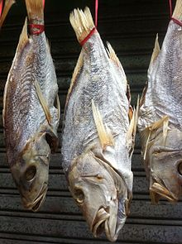
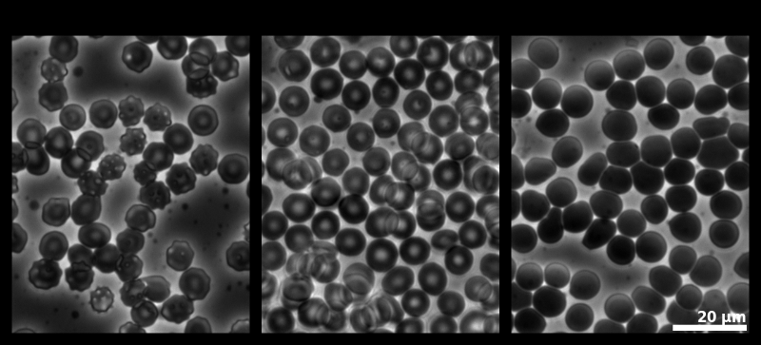
Osmosis and cells
Salted fish
Effects of osmosis on red blood cells

Slide 28
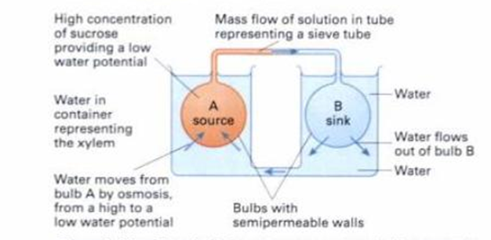
Osmosis and plants
Amaryllis blooming sequence

Slide 29
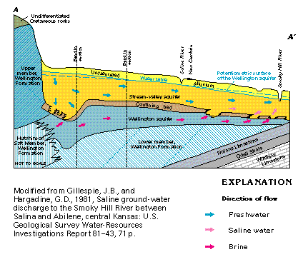
Osmosis and overpressured brine
Overpressured brine in Qikou Depression, China. Du et al. 2010.

Slide 30
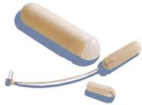
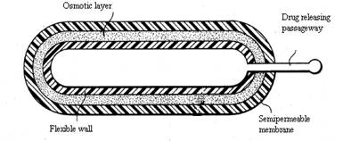
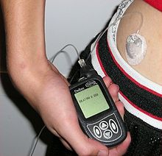
Osmotic pump
Continuous dispensing of drug
Uniform rate
Commercially available
Mostly for lab testing (apparently)

Slide 31
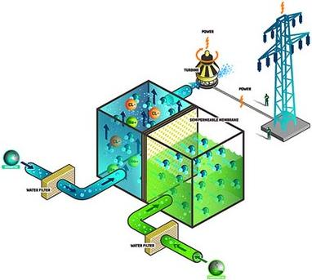
Osmotic power
Osmotic power plant, Norway
Experimental right now
Commercial plant in 2015
http://www.nordicenergysolutions.org/innovation/demonstration-pilot/ocean-energy/osmotic-power-pilot/?searchterm=osmotic

Slide 33
Parameter Estimation
Estimate D from measurements of C

