Slide 1
Multi-phase flow
Mixture of
  Gas, liquid, solid
  Multiple liquids w/ different properties
Conceptual
  Discrete phases
  Distinct properties, interface
  Mixture
  Properties depend on ratio of phases in mixture

Slide 2
Important
Surface tension, σ
Velocity, v
Size, L
Viscosity, μ
Density, ρ
Dimensionless numbers balancing forces

Slide 3
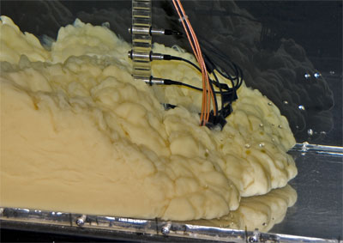

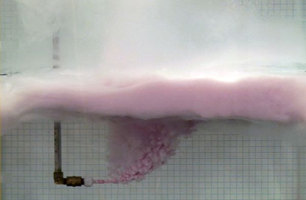
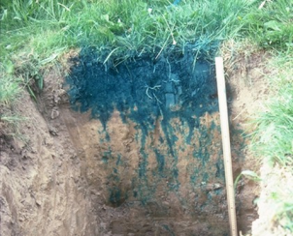
Types of flow
Particles in fluid
  Bubbly, sediment, droplets, dust, ash
  Bulk fluid properties vary with concentration
Free surface
  Liquid and gas
  Interface important, ignore properties of one fluid
Multiple fluids
  Slug flow, immiscible liquids, composition contrasts
  Properties of both fluids and interface important
Porous media
  Partly saturated w/ water, multiple fluids
  Properties vary with saturation

Slide 4
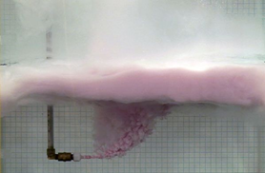
Simulation Methods
Many small discrete particles in fluid
  Vol fraction controls visc/density of mixture,
  Momentum transfer between solid and gas
  Mixture model, Euler-Euler method 1 continuous, 1 dispersed phase
  Particle tracking
Free surface
One fluid with moving interface
  Moving mesh, Alternative Lagrange Euler (ALE)
  Level set or phase field.
  Shallow water eqns.
Multiple fluids
  Two fluids with interface
  Level set or phase field to track interface, surface tension, adhesion
Porous media
  Fluid saturation varies
  Richard’s equation, variable water saturation
  Two-three phase Darcy, two or more fluids.

Slide 5
Outline
Review approach for single phase fluid
Variations
  Two fluids
  Mixtures
  Free surface
  Porous media

Slide 6
Conservation of Mass
Storage
Advective Flux
No Diffusive Flux
Source
Governing
c = ρ
A= uc =uρ

Slide 7
Conservation of Momentum
Storage
Advective Flux
Diffusive Flux
Source
Governing
c = ρu
A= uc= uuρ
Units of stress or pressure

Slide 8
Constitutive Equation (stress to strain rate)
Momentum Equation Rearranged
Navier-Stokes for Incompressible Fluid
( Comsol notation)

Slide 9
Boundary Conditions
Inlet, Outlet, Wall, Open, other
No slip, wall = default
Specify inlet and outlet
Need to specify pressure somewhere
Specify pressure
Specify velocity
n unit vector normal to boundary
u flux vector
C₁ known function

Slide 10
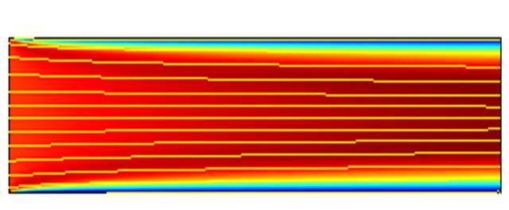
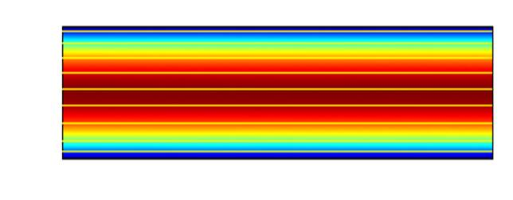
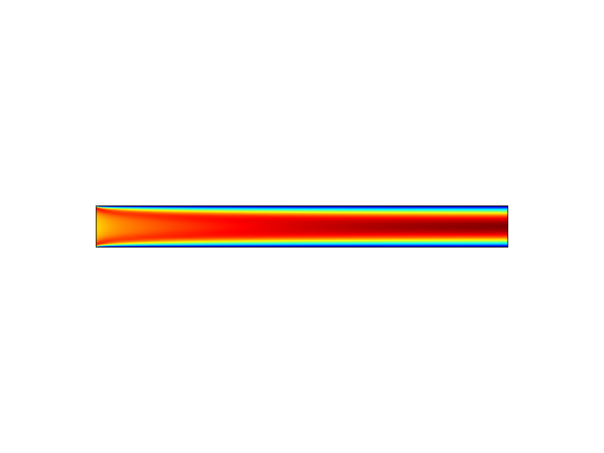
Options for boundary conditions
Velocity (uniform) =0.001m/s
Laminar Inflow = 0.001 m/s
1m entrance length
Pressure = 1
No viscous stress
Pressure=0
No viscous stress
Pressure=0
No viscous stress
Pressure=0
No viscous stress
Need to calculate Pressure in top two cases, calculate velocity in bottom case

Slide 11
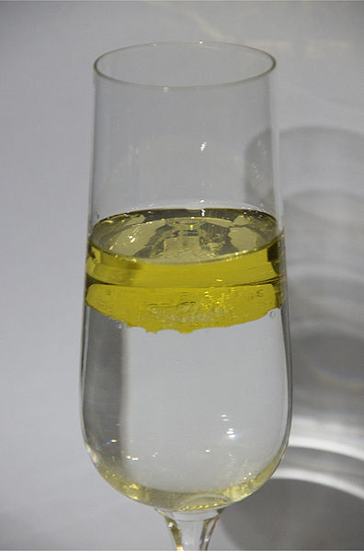
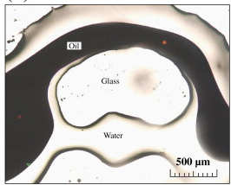
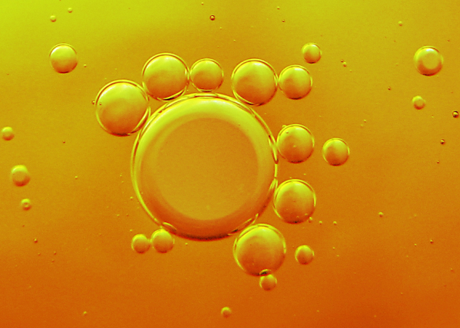
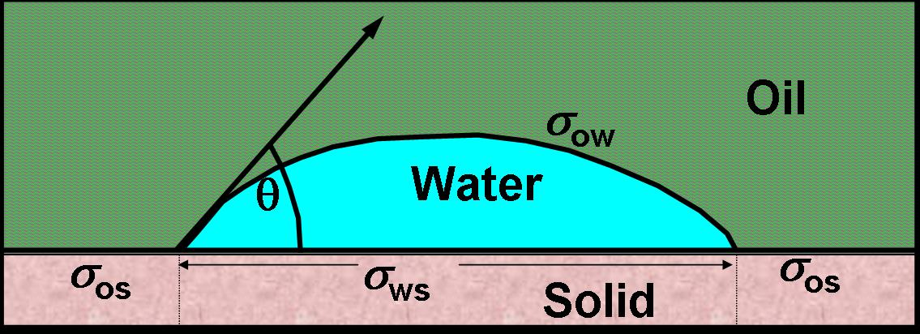
Discrete Fluid Phases
Small scale
Oil and water at pore scale
Surface forces solid-oil-water
Drops of oil in water
Surface tension
http://oc.wikipedia.org/wiki/Fichi%C3%A8r:Oil_in_water.jpg
http://www.flickr.com/photos/fdecomite/2141150298/lightbox/
→ Boundaries between fluid phases

Slide 12
1
2
σ

Slide 13
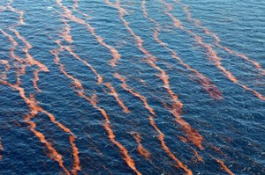
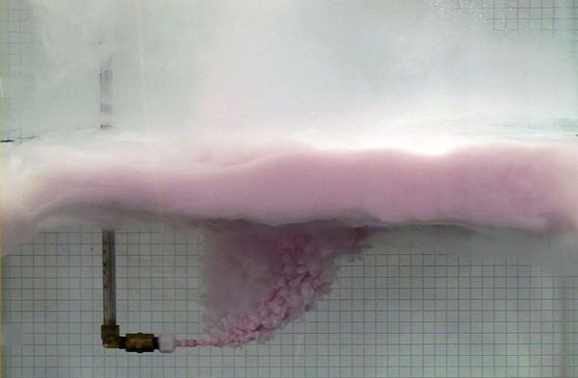
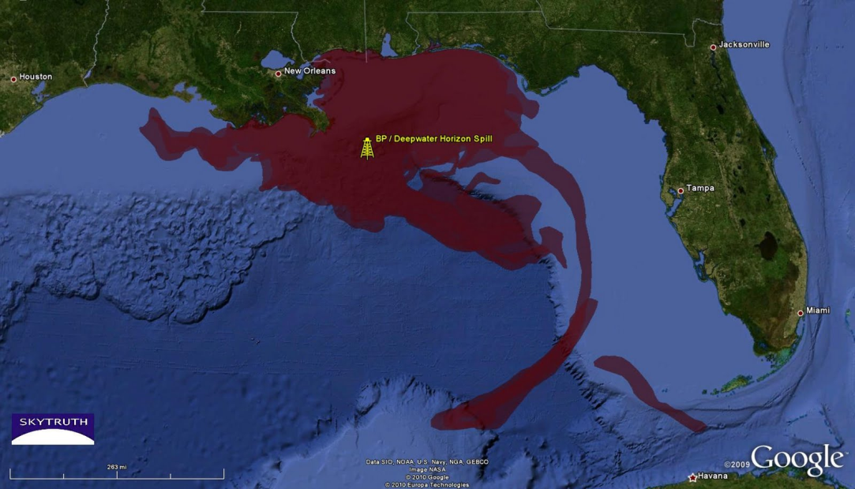
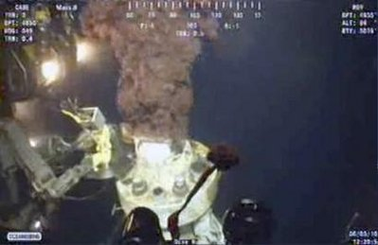
Oil in water
Macro-mega scale
Bands of oil floating in the ocean
http://www.backyardxscapes.com/blog/gulf-of-mexico-affecting-indigenous-wildlife-and-perhaps-much-more/
http://corollaries.unc.edu/tag/camassa/
http://www.eoearth.org/article/Deepwater_Horizon_oil_spill?topic=50364

Slide 14
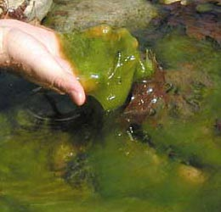

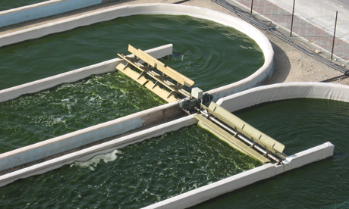
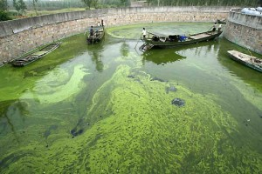
Algae

Slide 15
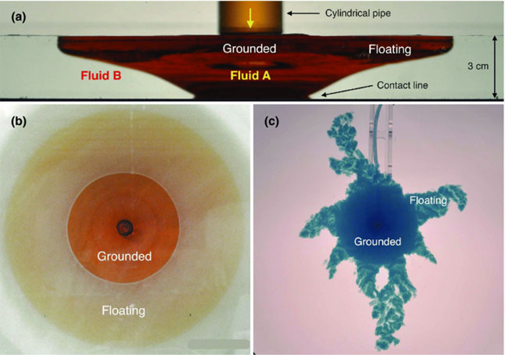
Two Fluids with Contrasting Density
[Sayag eta l. 2012]
http://pof.aip.org/gallery_of_fluid_motion

Slide 16
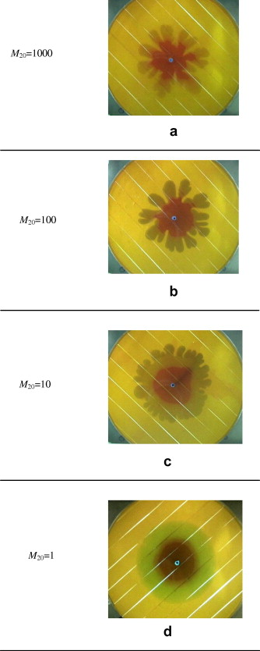
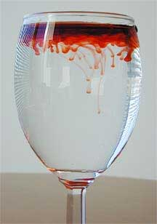
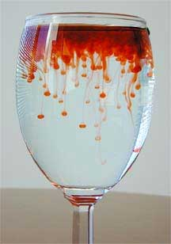
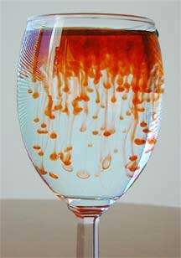
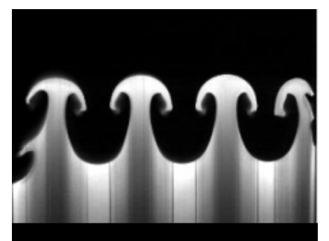
Instability with two fluids
μ_{in}/μ_{ambient} decreases→
Low visc displaces high visc fluid in Hele Shaw cell
High density over low density fluid
High g experiment
http://fluidlab.arizona.edu/RT_Incomp.html
http://www.sciencedirect.com/science/article/pii/S0894177709000144

Slide 17
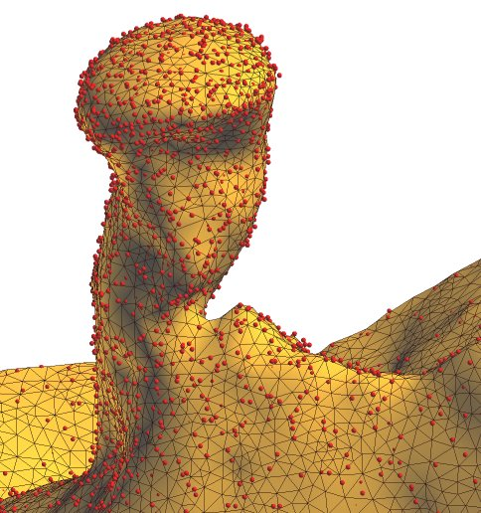
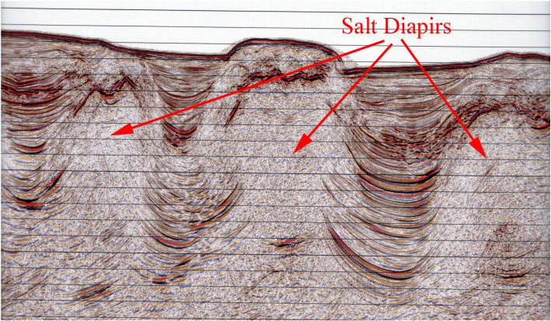
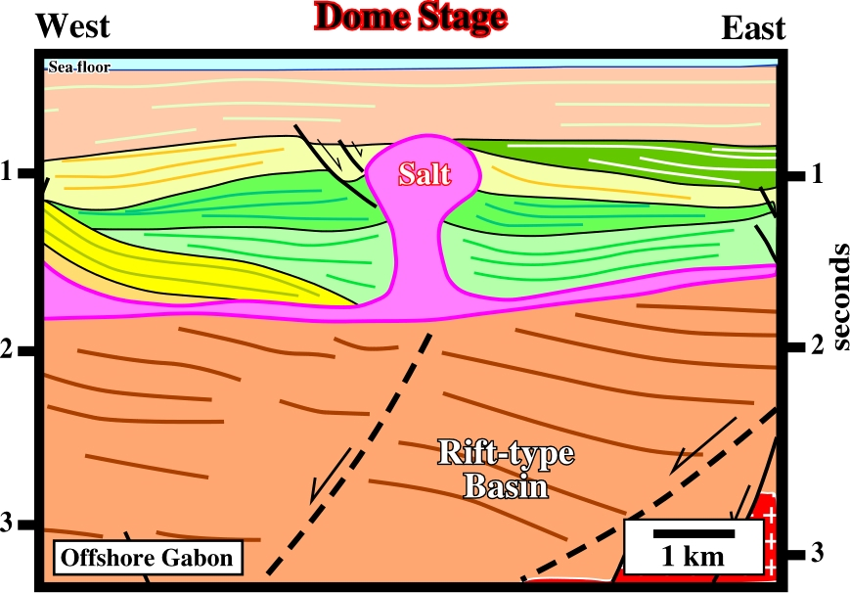
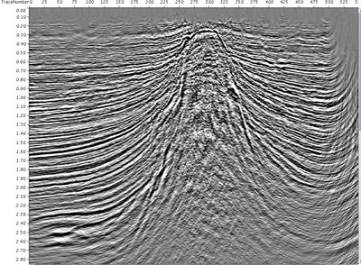
Large-scale Instability
Salt Dome in Sediments
http://www.gocad.org/w4/index.php/research/gallery
http://blogs.agu.org/georneys/files/2011/07/Brazil-Margin-Salt_edited.jpg
http://wholefish.blogspot.com/2009/05/salt-rulescooking-and-fishing.html
http://homepage.ufp.pt/biblioteca/GlossarySaltTectonics/Pages/PageD.html

Slide 18
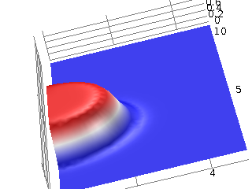
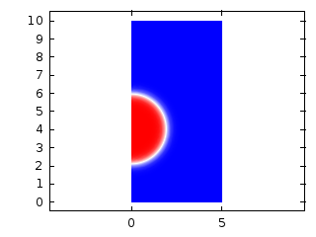
Analyzing Two separate fluids
Mass and momentum for each phase
Track the interface between phases
Use continuous variable with rapidly changing (but not sharp) transition.
Level set, Phase field
Level Set Function defining phases

Slide 19
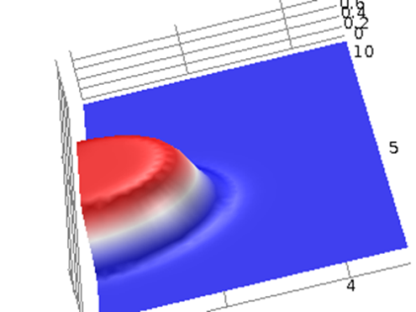
Level Set Method
Mass Conservation
Momentum
Level Set Parameter, φ
Unit vector normal to interface

Slide 20
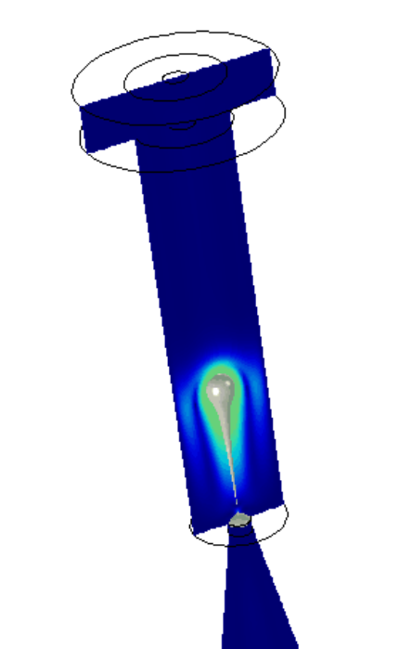
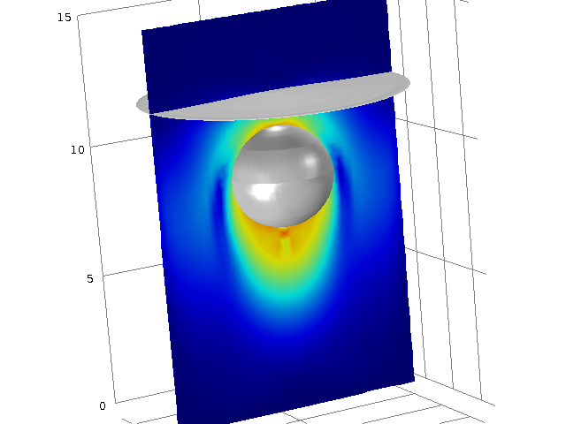
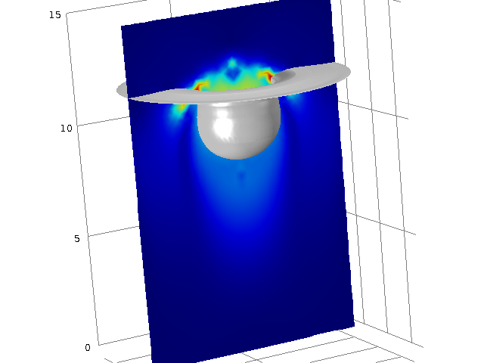
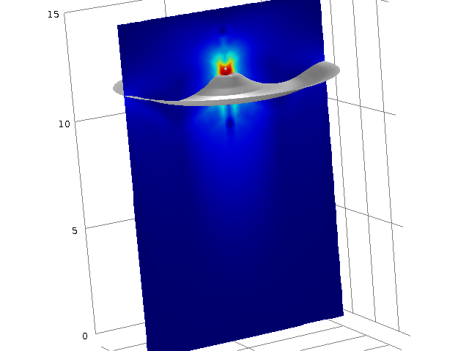
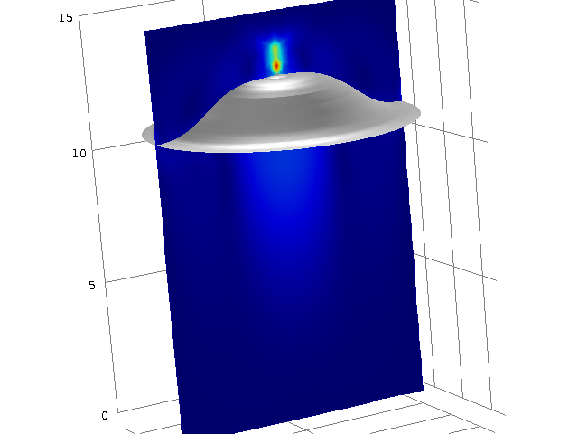
Applications of Level Set Method
Nozzle droplet, rising bubble .gif

Slide 21
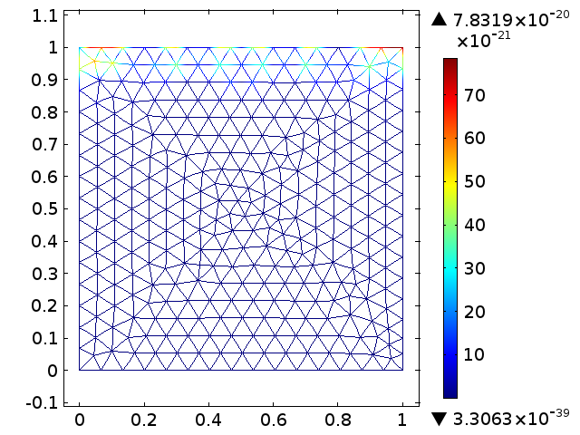
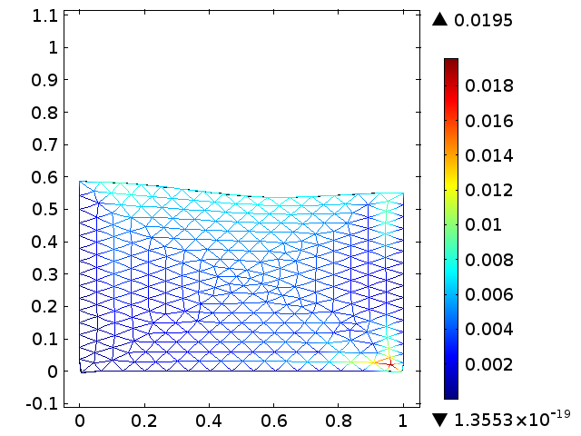
Moving Mesh
Moving mesh vid

Slide 22
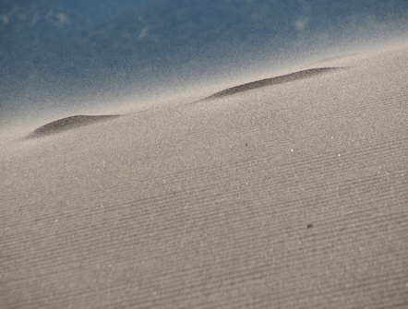
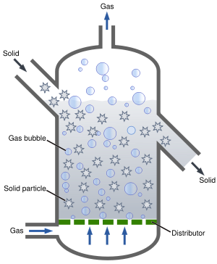
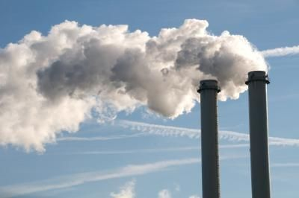
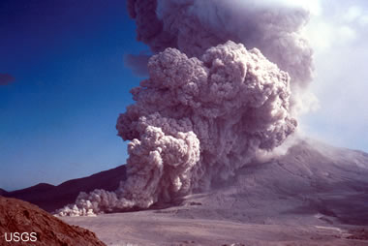
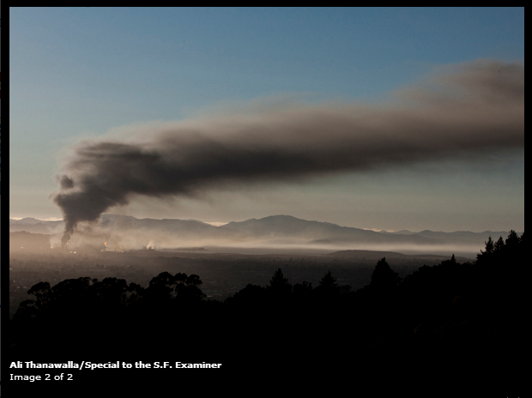
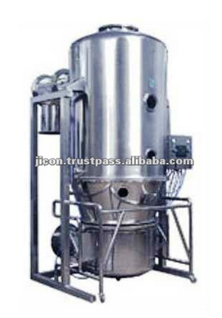
Mixtures of fluids and particles
Particles in gas
Saltation of sand on a dune
Pyroclastic flow
Mt. St Helens, 7 Aug. 1980
Air emission from industry
Fluidized bed reactor
Smoke plume from fire at oil refinery
http://geology.com/volcanoes/volcanic-hazards/
http://en.wikipedia.org/wiki/File:Pyroclastic_flows_at_Mayon_Volcano.jpg
http://www.sfexaminer.com/local/2012/08/fire-breaks-out-chevron-refinery-richmond
http://www.flickr.com/photos/rossdu/1357737030/

Slide 23
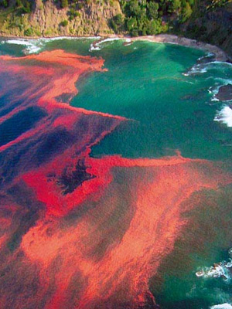
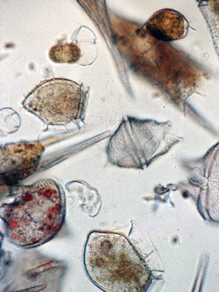
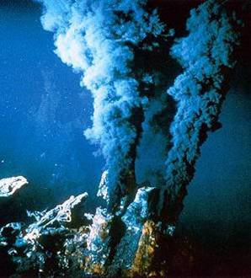
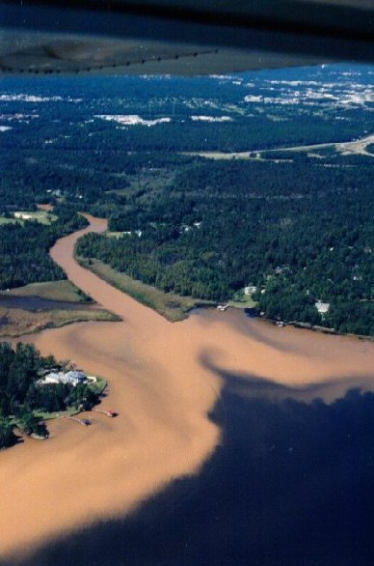
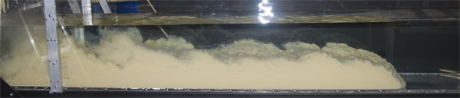
Solid particles in fluid
Noctiluca scintillans in New Zealand. (Photo by M. Godfrey)
Phytoplankton
Hydrothermal vent
Sediment plume from Moore Creek entering Dog River after heavy rain.
Turbidity current in lab flume
http://www.whoi.edu/redtide/
http://homepages.engineering.auckland.ac.nz/~hfri003/projects.htm
http://www.flickr.com/photos/rossdu/1357737030/lightbox/
http://discoverytimes.blogspot.com/2008/11/black-smoker-discovered-along-with-500.html
http://www.usouthal.edu/geography/fearn/480page/98Gerrit/SedPlume.html
http://serc.carleton.edu/images/NAGTWorkshops/sedimentary/activities/flume4.jpg

Slide 24
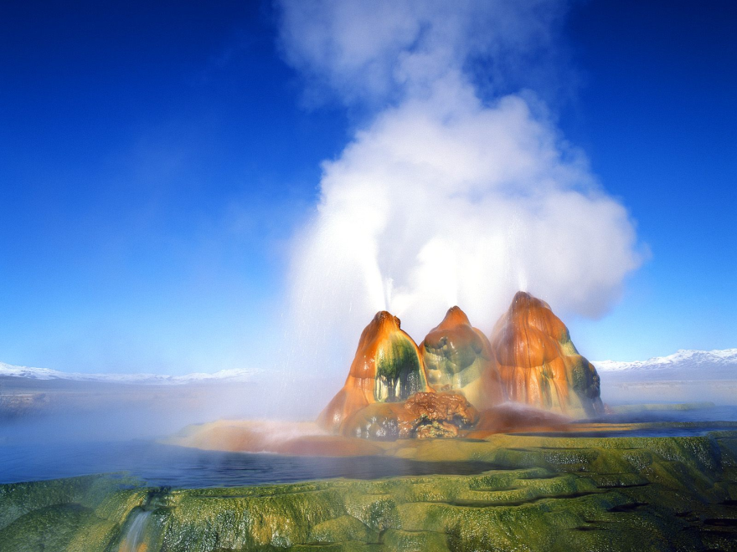



Gas-liquid mixtures
Fluid droplets in gas
Gas bubbles in fluid
Fly Geyser, NV
Achoo
http://biologyblockb.blogspot.com/2010/12/aerosol-spray-by-sammy-bozza.html
http://my.opera.com/cofoppyplop/albums/showpic.dml?album=371184&picture=5315272
http://footage.shutterstock.com/clip-826795-stock-footage-beer-bubbles-background.html

Slide 25


Particles in fluid
Euler-Euler method and related
  1 continuous fluid, 1 dispersed phase
  Vol fraction, φ, controls visc/density
  Transfer between particles and fluid
  Momentum
  Mass
  Heat
  Particle hydrodynamics
  Shape, size, coalescence, dispersion, breakup, collisions with wall/other particles….

Slide 26

Conservation of Mass
Continuous phase, c, and dispersed phase, d
ρ_{c} = density
φ_{c} = vol fraction
Storage
Advective Flux
Source
Governing
c_{c} = ρ_{c}φ_{c}
c_{d} = ρ_{d}φ_{d}
S_{c}=M_{c}
S_{d}=M_{d}
Couple to get 1

Slide 27

Conservation of Momentum
Approach→analyze mixture
= density of mixture
Storage
Advective Flux
Diffusive Flux
Source
c = ρu
Governing

Slide 28

Key aspects
Couple momentum c←→d
Slip velocity
Properties of mixture
Volume fraction solids in fluidized bed reactor

Slide 29

Alternative Approach: Particle Tracking
Follow explicit particles in the flow.
Fluid parcels in continuous fluid
Particles with mass, drag, etc.
Many particles possible
Rotating mixer

Slide 30

Example
Flow regimes during two phase flow in a vertical microtube
http://www.sciencedirect.com/science/article/pii/S0301932207001772

Slide 31


Conceptual Model for Gas-Liquid Flow in a Vertical Pipe.
http://www.sciencedirect.com/science/article/pii/S095559861000004X
Gas-oil mixture images with high-resolution wire mesh sensor
http://dpwsd.waterworld.com/index/display/article-display/3887904678/articles/membranes/volume-2/issue-30/Features/Importance_of_Air_Scour_in_Membrane_Bioreactor_Systems.html
http://www.sciencedirect.com/science/article/pii/S0043164805001882

Slide 32







Free-surface flow
Ripples from a water drop
Wake behind a boat, drag resistance
Sloshing in a tank
Flow over seawall during tsunami
Dam failure on Maquoketa River, Iowa
Displacement of water table
Flow over seawall during Katrina storm surge
http://news.nationalgeographic.com/news/2012/03/pictures/120309-japan-tsunami-earthquake-anniversary-fukushima/
http://upload.wikimedia.org/wikipedia/commons/4/43/2006-01-14_Surface_waves.jpg
http://flyadvisor.blogspot.com/2011/08/legendary-big-wave-surfing.html
http://en.wikipedia.org/wiki/File:Fjord.surface.wave.boat.jpeg
http://news.monstersandcritics.com/usa/features/article_1573085.php/In-Pictures-USA-Iowa-Dam-Break

Slide 33

Free surface
Level set
  Second fluid is air
Moving Mesh
  Move upper boundary with fluid
  Arbitrary Lagrangian Eulerian (ALE) method
Shallow water eqns
  Average NS over depth
  Solve directly for depth

Slide 34


ALE Method
Moving Mesh
Use boundary condition so boundary moves with fluid
e.g. Velocity of boundary = u*nx+v*ny
Boundary moves, entire mesh readjusts.
Problems with large displacements, distorted mesh
Possible to pause, regenerate mesh, restart analysis
Pull plug, tsunami.gif

Slide 35

Shallow water equations
c=hρ
M/A
c=hρu
Mv/A
Shallow water
τ = 0

Slide 36

Examples
Video : surface water waves

Slide 37






Porous media
Variable saturation with water
Multiple fluids, pore to field scale
NAPL-water-gas-supercritical
Infiltration of dyed water into Hanford sandy loam, even wetting front
Infiltration of dyed water into sand. Preferential flow
Infiltration tracer test
NAPL in lab experiment
https://www.agronomy.org/publications/sssaj/articles/66/2/347
http://acswebcontent.acs.org/prfar/2009/G8.html
http://www.sciencedirect.com/science/article/pii/S0920410500000905

Slide 38
Conservation of Mass
Storage
Advective Flux
No Diffusive Flux
Source
Governing
c = ρφS_{e}

Slide 39
Conservation of Momentum
Storage
Advective Flux
Diffusive Flux
Source
Governing
c = ρv
A= vc= vvρ
Units of stress or pressure

Slide 40


Flow in Porous Media
Mass
Momentum
Constitutive

