Slide 1
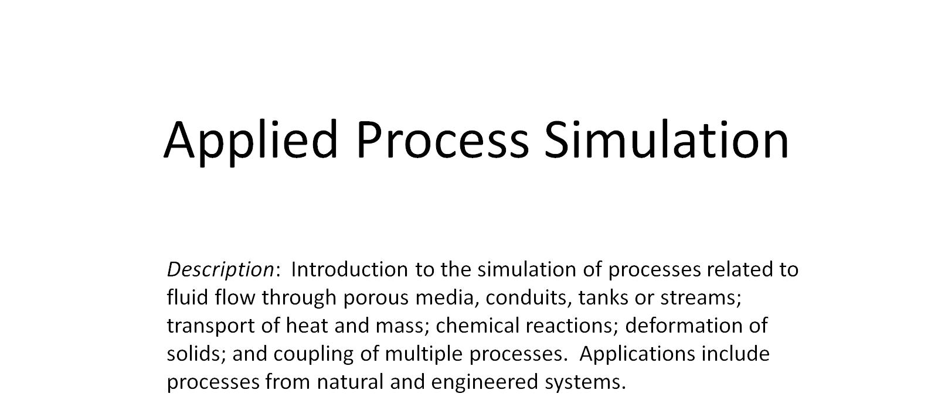
Applied Process Simulation

Slide 2
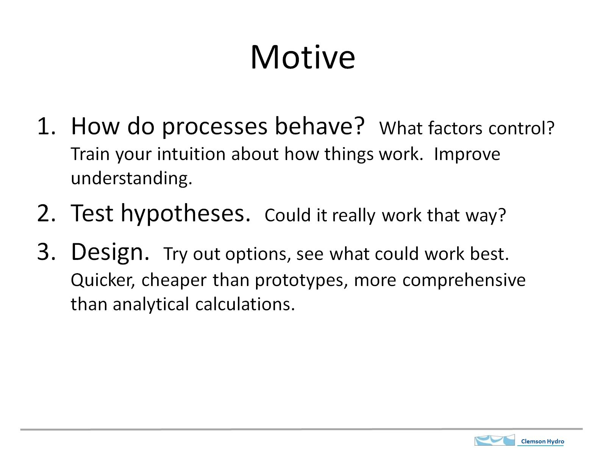
Motive

Slide 3
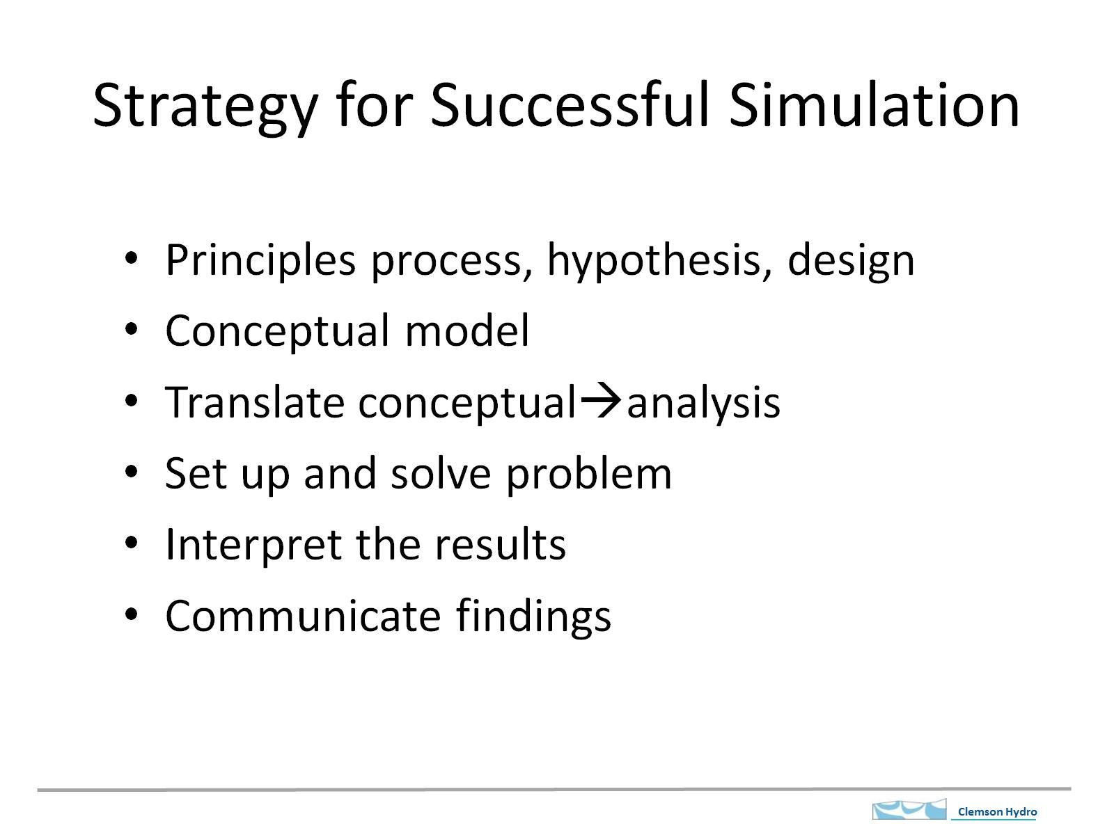
Strategy for Successful Simulation
Computation

Slide 4
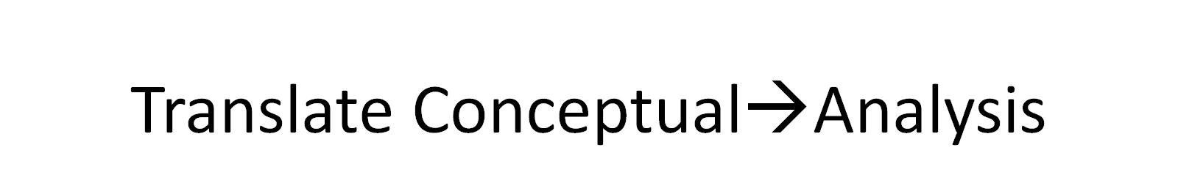
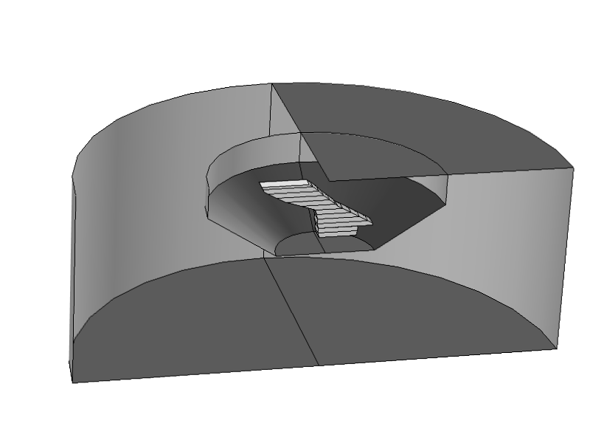
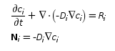
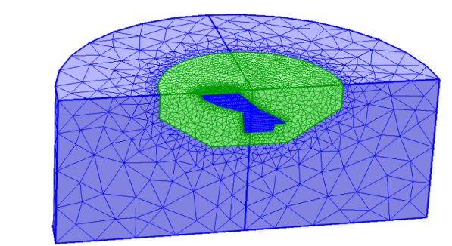
Translate Conceptual→Analysis
Geometry
Governing Equations
Boundary Conditions
Initial Conditions
Parameters, dimensionless groups
Constraints, other requirements
Discretization/mesh

Slide 5
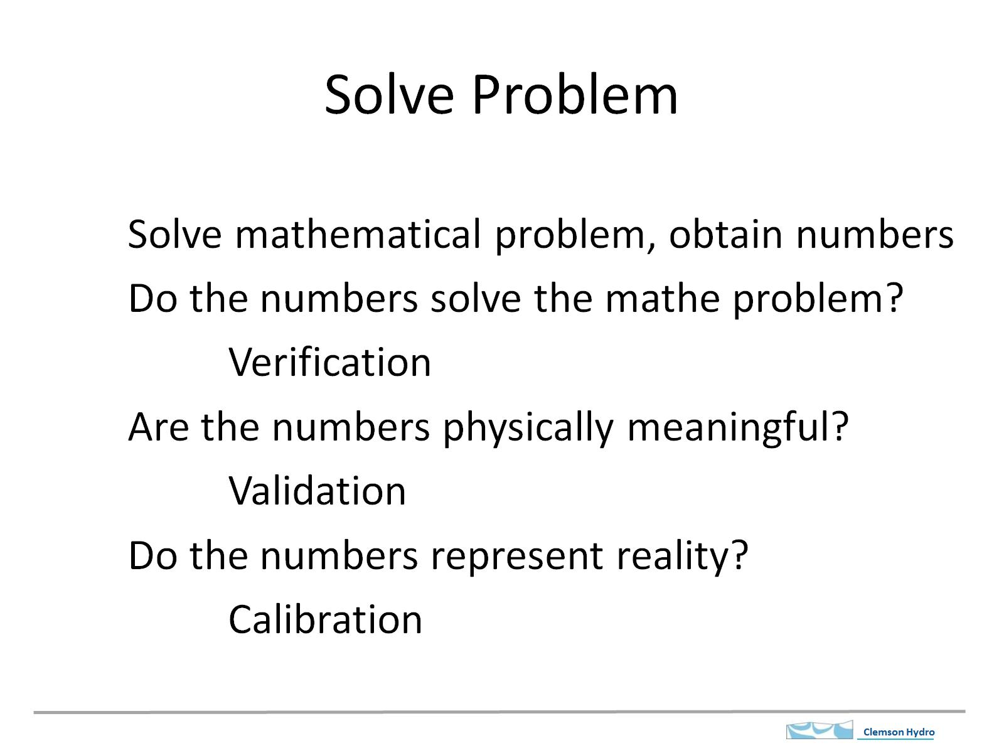
Solve Problem

Slide 6
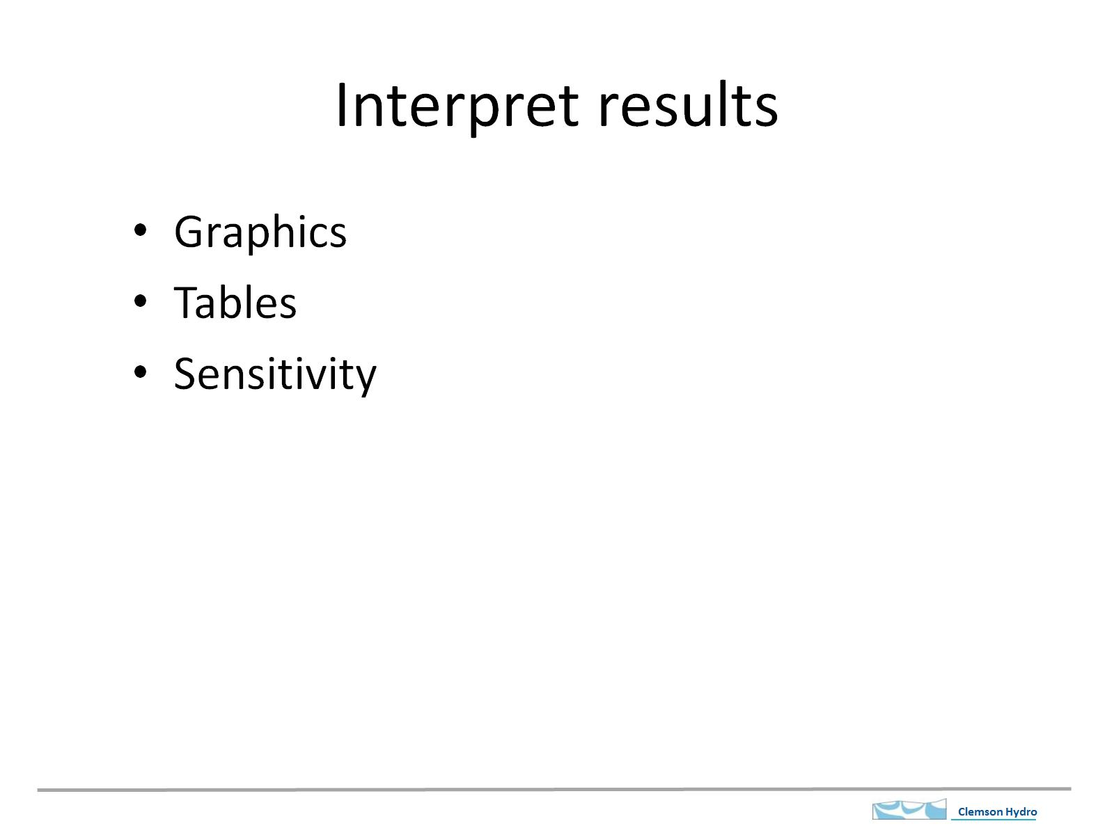
Interpret results

Slide 7
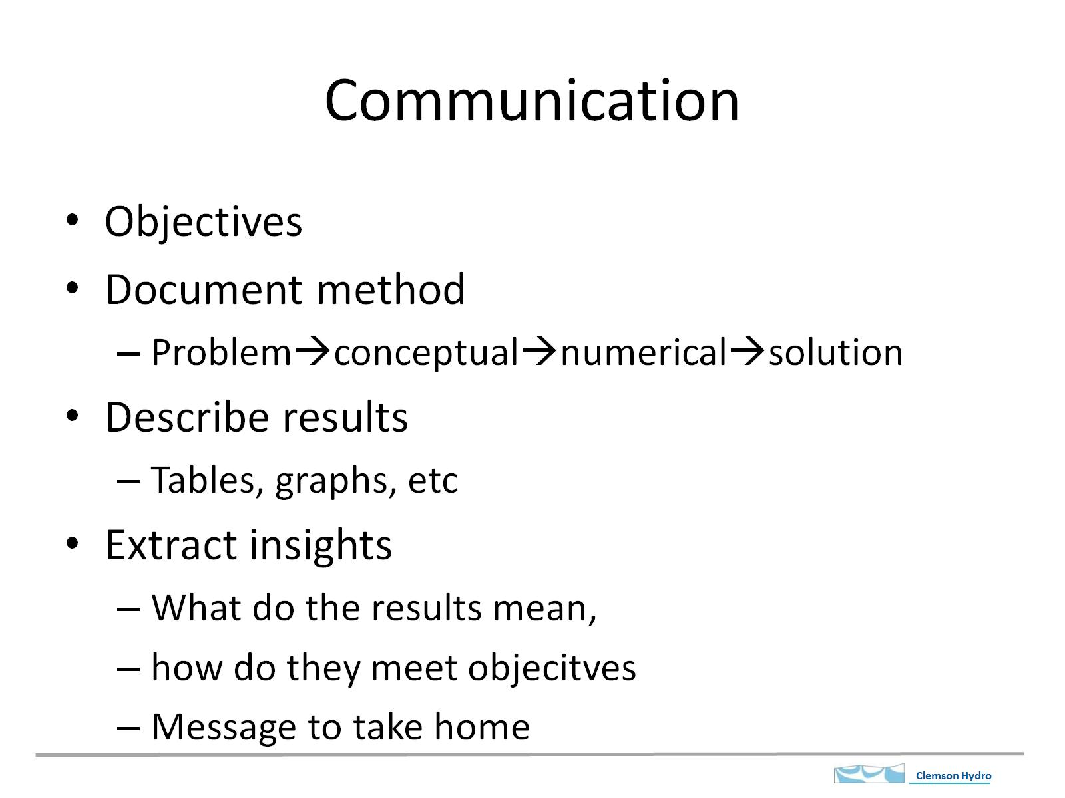
Communication

Slide 8
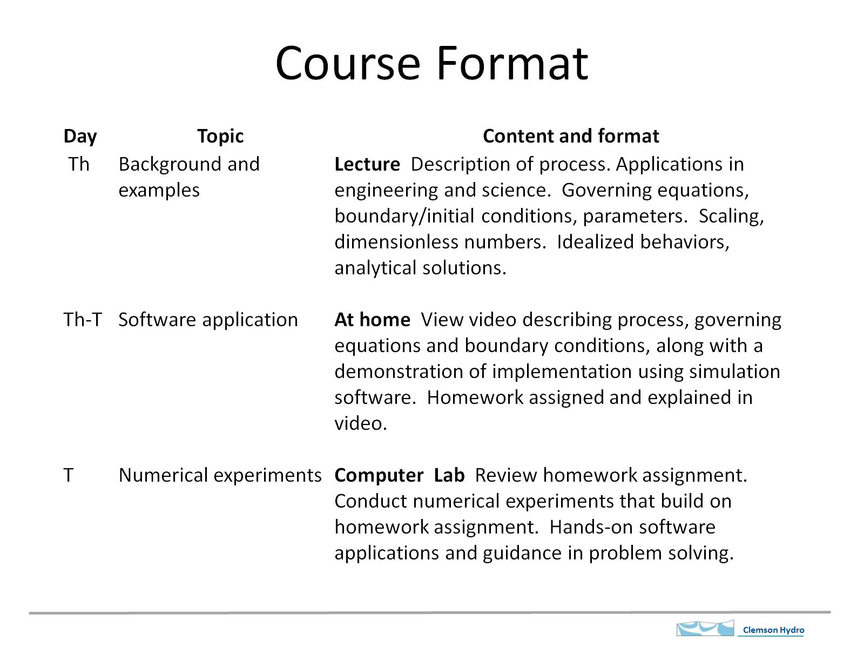
Course Format

Slide 9
Each Week
Description of process.
Applications in engineering and science. Governing equations, boundary/initial conditions, parameters.
Scaling, dimensionless numbers.
Idealized behaviors
Analytical solutions.
Translate Conceptual→Analysis
Solve
Verify, troubleshoot
Interpret results
Special techniques
Assignment

Slide 10
Grade
Grading: Homework: 0.75; final project: 0.25
Class cycle. Th lecture, View video, do readings Th-T, meet T in lab, homework due Th.
~14 homeworks, ~5% of final grade each
Projects: Pick a topic, conduct analysis, describe it, present it

Slide 11
Topics
Open to suggestions for topics, examples

Slide 12
Translate Conceptual→Analysis
Geometry
Governing Equations
Boundary Conditions
Initial Conditions
Parameters, dimensionless groups
Constraints, other requirements
Discretization/mesh

Slide 13

Process→Analysis
Governing Equations
expression of assumed principles
physical basis
based on conservation of basic quantities
Boundary Conditions
equation expressing process on boundary

Slide 14
Detour
Review of nomenclature and operations
Units:
Basic units: Mass: M, length: L, time: T, temperature: θ
Square brackets used to indicate basic units
F= force F=Ma;
P=Pressure [F/L²] same as stress, σ
E= energy, E=[FL] Power [E/T] [ML²/T³]
Concentration, by mass [M/L³] ; molarity Mol/L³
Actual units. Usually SI. m, kg, s, N[mkg/s²], Pa [N/m²], J [Nm] W[J/s]

Slide 15
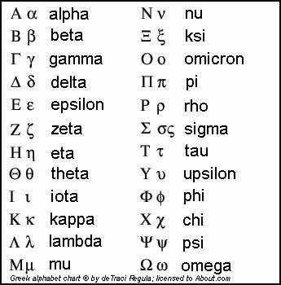
Greek alphabet

Slide 16
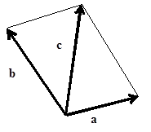
Review, Notation and operations
a = [a₁, a₂, a₃]
Vector
Addition/subtraction
Dot product
Vector magnitude

Slide 17
Vectors
Cross Product
Vector normal to boundary
q_{n}
q
α
q_{t}

Slide 18
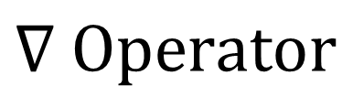
$$∇ Operator$$
Gradient of a scalar field
Divergence of a vector
10 9 8
a_{1A} a_{1B}
Δx₁

Slide 19
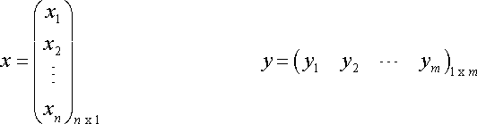
Matrices
Nomenclature
Add or subtract
Transpose
n = num rows
m = num cols
m,n dimensions of matrix
1D matrix = vector
Add or subtract components
Switch cols and rows

Slide 20
Multiply matrices
AB = C
Number of cols in A must match rows in B.
example
A_{mn}
B_{ij}
so
n must = i to multiply
Multiply row in A with col in B and add results to get one value in C.
http://tutorial.math.lamar.edu/Classes/DE/LA_Matrix.aspx

Slide 21
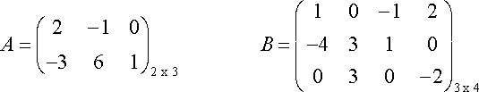
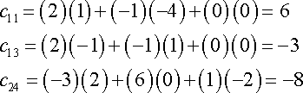

Multiply matrices
Number of cols in A must match rows in B.
example
A_{mn}
B_{ij}
so
n must = i to multiply
Multiply row in A with col in B and add results to get one value in C.
AB = C
http://tutorial.math.lamar.edu/Classes/DE/LA_Matrix.aspx

Slide 22
Simultaneous eqns
Matrix Nomenclature
Einstein summation convention…

Slide 23
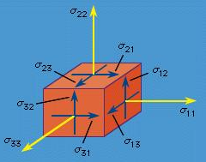
Tensors
Scalar = magnitude, describe by one number
Vector = direction and magnitude, several scalars in 1D array
Tensor = 2D array; vector of vectors
Examples, Stress, elastic modulus, permeability
Stress tensor
Different notation, same meaning
http://www.britannica.com/EBchecked/media/2307/The-nine-components-of-a-stress-tensor

Slide 24
Operators

Slide 25
Einstein notation repeated subscripts

Slide 26
Review
Units
Greek Alphabet
Vector arithmetic
Matrix operations
Tensors
Operators
Einstein notation
Read about topics above to refresh as needed.
Books on vectors, matrices, calculus.
Lots of on-line resources.

Slide 27
Back to the Main Road
Process→Analysis
Governing Equations
expression of assumed principles
based on conservation of basic quantities
Boundary Conditions
equation expressing process on boundary
Parameters
Properties that quantify behavior
Dimensionless numbers
Ratio of important quantities

Slide 28
Conservation Equations
Control volume
In = Out + Change in Storage
Rate in = Rate out + Rate of Change in Storage
Apply to fundamental quantities
Mass
Chemical species
Momentum
Heat
Electrical charge
Volume (special case)
other

Slide 29
Conservation Eqn Strategy
Define quantity to be conserved on per volume basis
Define movement in terms of fluxes of quantity
Identify sources
Identify storage change
Apply conservation law
Constitutive equations (additional info for some processes)
Simplify or refine as needed

Slide 30
Conserved Quantity on per volume basis
Express quantity Θ on a per L³ of control volume basis. In general
Dependent variable→ need to determine
Mass, Θ=[M] →c = [M/L³]→ ρ (density)
Chemical species, Θ=[M] → c = [M/L³]→C (concentration)
Momentum, Θ=[Mv] →c = [Mv/L³]=[ML/(TL³]=v ρ (velocity * density)
Heat, Θ=[E] →c = [E/L³]= = ρc_{p}T = (density* heat capacity * temp)
Electrical charge, Θ=[E_{c}] →c = [E_{c}/L³] = coulombs/V = charge density

Slide 31
Flux
Θ
L²
A Advection→ flux caused by moving fluid
D Diffusion and other→flux in static fluid
Γ = A + D = Total flux

Slide 32
Source
The rate of production of Θ in control volume by process other than crossing boundaries. Express per unit volume
Source term. Rate of production of Θ due to source per unit volume

Slide 33
Storage change
Θ stored per unit volume is c. Take temporal derivative to get rate of change of storage of Θ

Slide 34
Apply conservation law over unit volume. Assume only x direction
Rate in + rate produced= rate out + rate of storage change
Subtracting from both sides
Divide through by dV
Repeat for y and z directions
Use divergence operator
General Conservation eqn. Use this for everything

Slide 35
Boundary Conditions
Type I, Dirichlet condition. Specify c on boundary
Could be non-uniform or transient
Type II, Neuman condition. Specify normal flux or gradient
Type III, Cauchy condition.

Slide 36
More about fluxes
Θ
L²
A = advective flux, flux of Θ caused by fluid flow
A = qc/n; q=volumetric flux of fluid, n = porosity
where c defined per total volume
A = qc ; for n = 1, or c defined per volume fluid
D = diffusive flux, flux of Θ without fluid flow
Γ = A + D Total flux

Slide 37
Diffusive-like flux
Flux of Θ proportional to a gradient
Chemical species [M]→ [M/L³] →C (concentration)
Mass flux [M/TL²], Fick’s Law:
Momentum [Mv]→[Mv/L³]=[ML/(TL³]=v ρ (velocity *density)
Momentum flux [M/T²L] =stress or pressure = F/A = ML/T²L²

Slide 38
Diffusive-like flux
Heat→[E/L³]= =ρc_{p}θ = (density heat capacity temperature)
Heat flux, Fourier’s Law
Volume of fluid in porous media
Volume flux, Darcy’s Law
Mass→ [M/L³]→ ρ (density)
no diffusive flux is generally used here
Many important parameters (K, α, ρ, c_{p} …) appear in the expressions for diffusive-like flux

Slide 39
Lab for next Tuesday
Download Comsol 4.4 from the website: http://www.comsol.com/product-download/4.4/windows
There is a version for the Mac as well:
http://www.comsol.com/product-download/4.4/macosx
Comsol is also available in the computer lab, so you can use it there if you don’t have it on your own computer.
View the videos on BB to get started. Look through example models included with the software.

