Slide 1
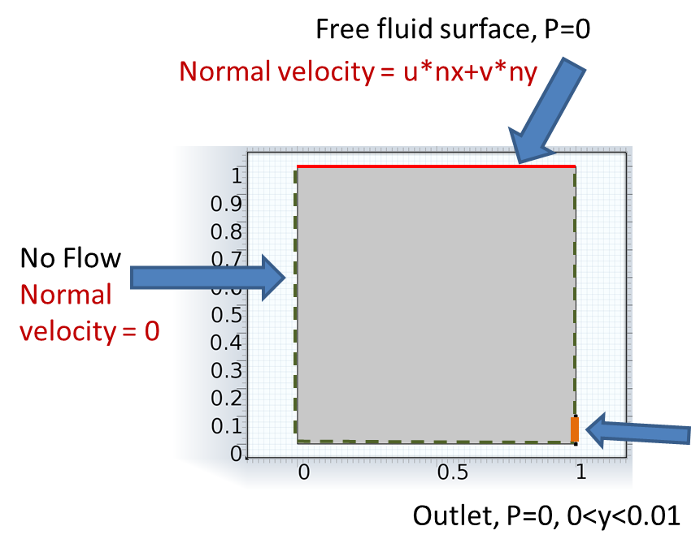
Moving Mesh
Boundary Conditions for Mesh
Boundary Conditions for Process
Mesh moves with process
Mesh controlled

Slide 2
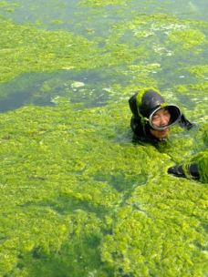
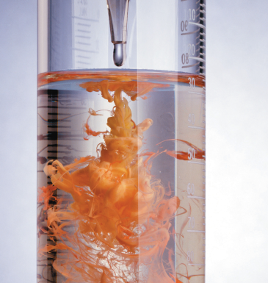
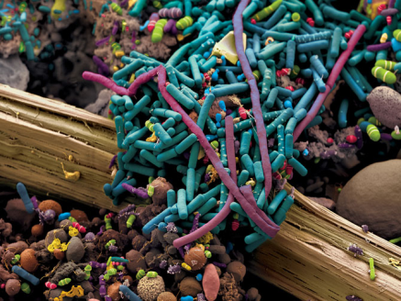
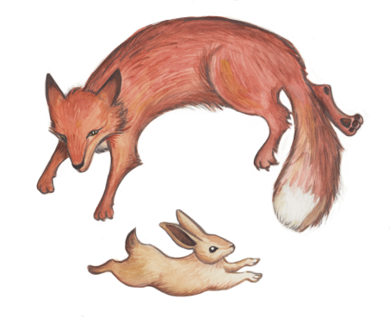
Reactions
Chemical
  Concentration of Species,
  by mass: M/L³
  by mole: Mol/L
  Production
  Decay
Biological
  Populations, M/L³ or #/L³
  Growth/Decline
Chemical Reactions Algae
Microbes Predator-Prey
http://hannahaha.deviantart.com/art/Fox-and-Hare-203136777
http://plantingseedsblog.cdfa.ca.gov/wordpress/?p=2938
http://catalog.flatworldknowledge.com/bookhub/reader/4309?e=averill_1.0-ch04

Slide 3
Conservation of Mass
Reactions
Storage
No Advective Flux
No Diffusive Flux
Source
Governing
c = C
S=R = reaction rate

Slide 4
Reaction Kinetics
Approach
Basic reactions
Reversible reactions
Decay chains
Population dynamics (microbes)
Microbial degradation

Slide 5
Chemical Reaction Kinetics
Concepts and terminology
A+2B→3P
Example reaction
How fast?
Ion Activity Product
Reaction Quotient
Another format
Compact Notation
Same as second from the top

Slide 6
Chemical Reaction Kinetics
Concepts and terminology
A+2B→3P
Forward reaction rate, depends on reactant concentrations
Backward reaction rate
Total reaction rate
Algebra
Reaction rate

Slide 7
Approach
Reaction: [A]+2[B]→3[P] [moles/L³]
Kinetics
Reaction Rate:
Far from equilibrium

Slide 8
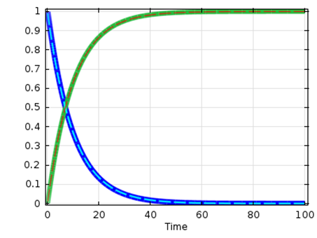
Examples
A→Products
2A=→Products
First Order Rxn
2nd Order Rxn

Slide 9
Basic Reactions
A and B are concentrations
k₀, k₁, k₂ are rate constants with different units
Need same number of equations as unknowns to solve

Slide 10
Mixed Higher Order
On your own for this
1 eqn, 1 unknown, P

Slide 11
Another Approach → Pseudo-First Order
1 eqn, 1 unknown, P

Slide 12
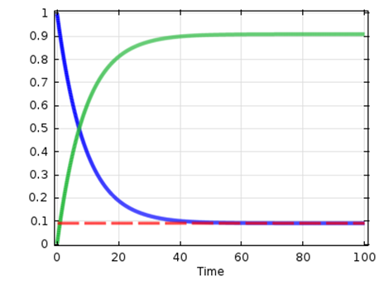
Reversible Reactions→Equilibrium Conc
Dynamic equilibrium
2 eqns, 2 unknowns = OK

Slide 13

Reversible Bi-molecular Reactions
On your own for this
4 eqns, 4 unknowns

Slide 14
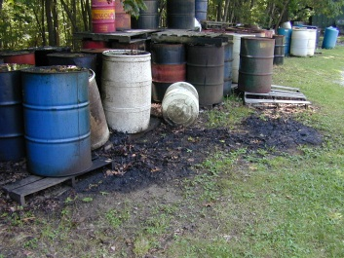
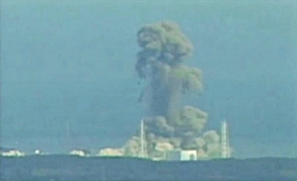
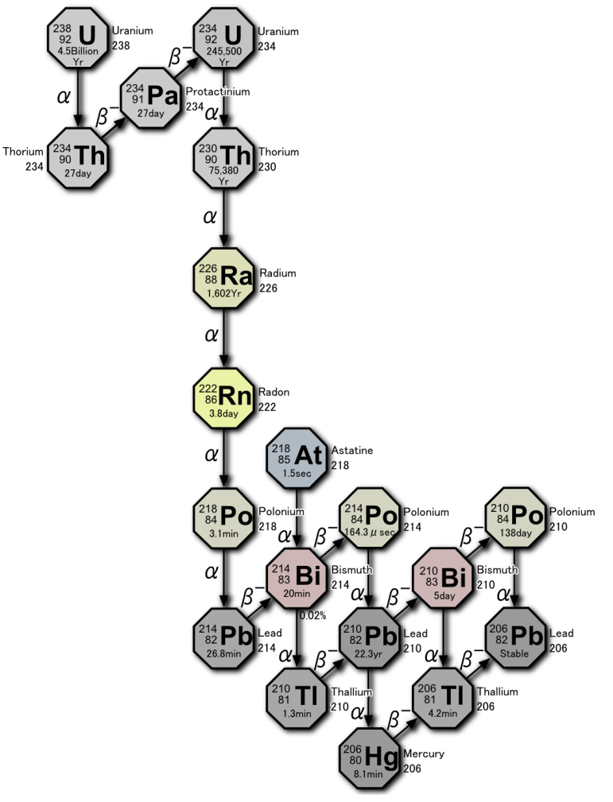
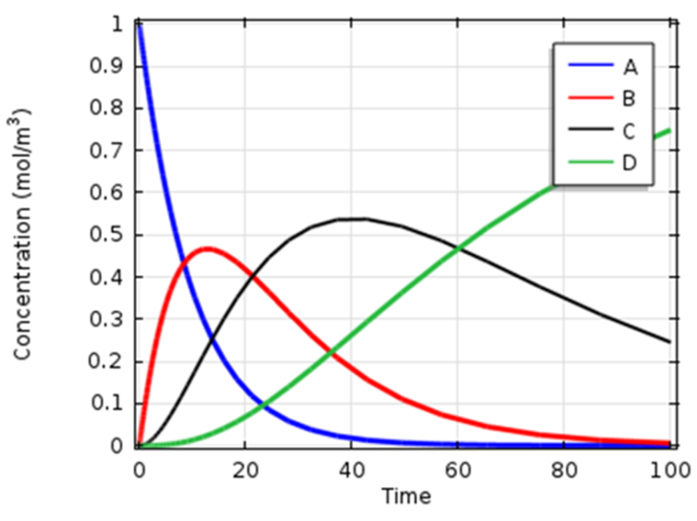
Decay Chains
Reductive Dechlorination Radioactive Decay
PCE→TCE→DCE→VC→ETH
Concentration as a function of time for a decay chain
http://engineering.tufts.edu/cee/impes/research_files/research-projects.htm
http://janettedillerstone.wordpress.com/nuclear-radiation-japans-fukushima-daiichi-plant-and-after-effects/
http://quibb.blogspot.com/2011/01/radioactive-decay.html
http://www.dep.wv.gov/WWE/ee/hw/Pages/hwservices.aspx

Slide 15
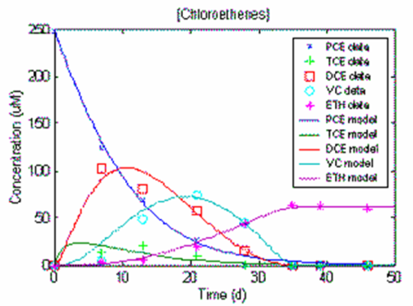
Decay Chain
A→B→C→D

Slide 16
Decay Chain
A→B→C→D
Compare to reversible rxn

Slide 17
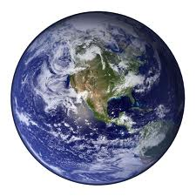
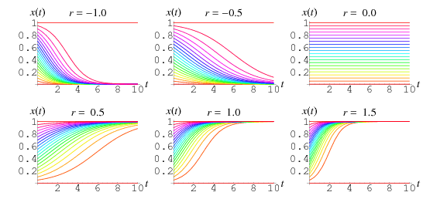
Population Dynamics
Growth-decline
Verhulst eqn. Logistic Eqn.
k₁ = Mathusian parameter [1/T]
k₂ = [1/(CT)]
k₁/k₂ = Maximum sustainable population
Limited Environment
Spread of Disease
Explosion-Extinction
Harvesting
First order growth when C is small, but the rate diminishes and eventually becomes negative as C increases.

Slide 18
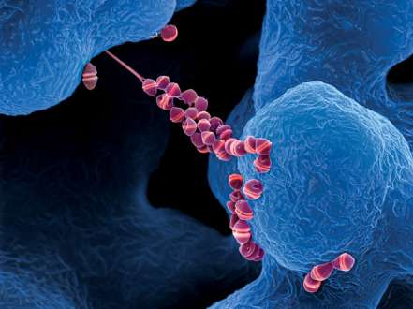
Population Dynamics
Microbial Growth, Substrate, Inhibition, Death, Reuse
INTESTINAL BACTERIA
STREPTOCOCCUS
Growth Reaction
Carbon+energy+electron acceptor+nitrogen+ other nutrients→ biomass+reduced acceptor + products
Simplify
Substrate (S_{s}) → Biomass (C)+ etc
From experiments
Plentiful substrate limited substrate
http://ngm.nationalgeographic.com/2013/01/microbes/oeggerli-photography#/05-intestinal-bacteria-670.jpg

Slide 19
Microbial Growth effect of substrate
INTESTINAL BACTERIA
STREPTOCOCCUS
Monod Eqn. relating microbe growth rate to substrate conc. S_{s} is conc. of rate limiting nutrient
Yield of Biomass from Substrate
Substrate degradation kinetics
http://ngm.nationalgeographic.com/2013/01/microbes/oeggerli-photography#/05-intestinal-bacteria-670.jpg

Slide 20
Microbes
Death/Lysis Decreasing Population
Rate of biomass loss from death/lysis
Growth when substrate consumed and loss from death/lysis
Substrate degradation kinetics with cell death/lysis
http://ngm.nationalgeographic.com/2013/01/microbes/oeggerli-photography#/05-intestinal-bacteria-670.jpg

Slide 21
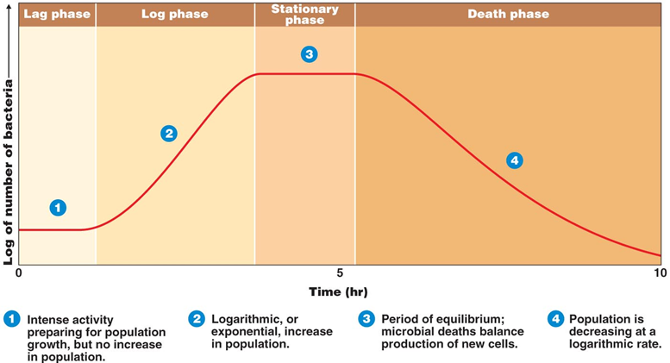
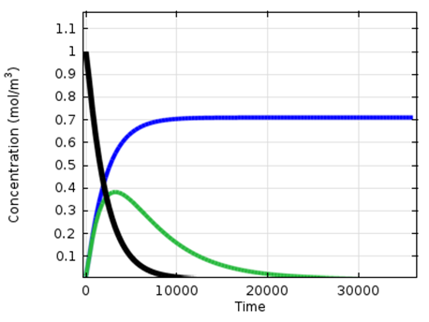
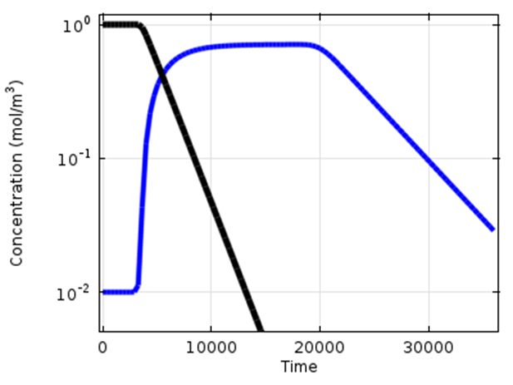
Application
Substrate concentration (black) and biomass concentration with k_{b}=0 (blue). k_{b}=0.0002 s⁻¹ (green).
Including step functions for k_{c1} and k_{b}.
Results in lag, log, stationary and death phases.

Slide 22
Microbial Growth
Inhibition models
INTESTINAL BACTERIA
STREPTOCOCCUS
High concentrations inhibit reaction
Haldane rate inhibition, depends on S_{s}
Competitive rate inhibition, depends on precursor to S_{s}
http://ngm.nationalgeographic.com/2013/01/microbes/oeggerli-photography#/05-intestinal-bacteria-670.jpg

Slide 23
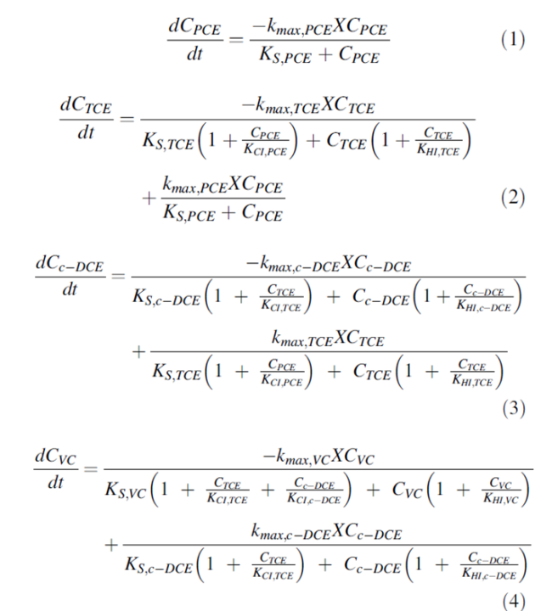
Example
Reductive dechlorination of PCE by microbes
Remediation mechanism
PCE→TCE→DCE→VC→ETH
Reactions
from Yu and Semprini [2004]

Slide 24
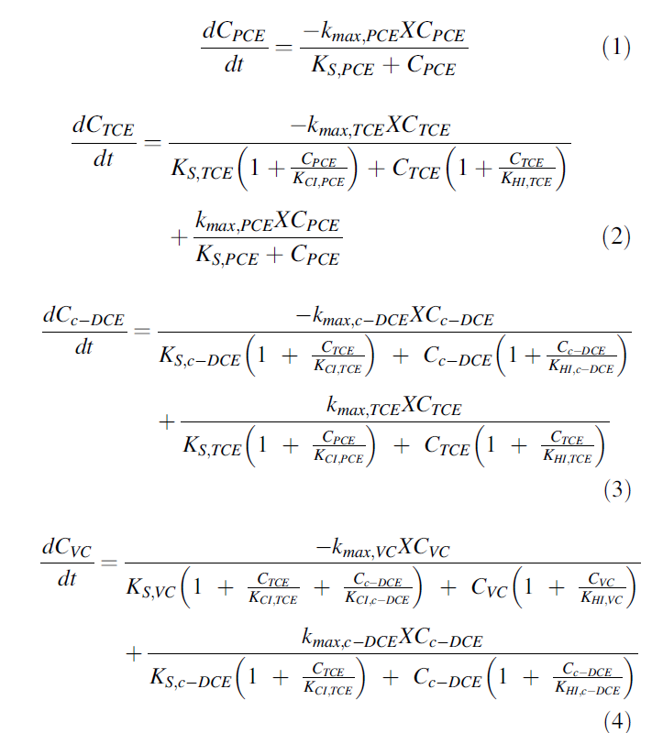
PCE Degradation from Yu and Semprini [2004]
Decay chain for PCE-TCE-DCE-VC-ETH.
Monod kinetics with inhibition

Slide 25
TCE Degradation from Yu and Semprini [2004]
Monod

Slide 26
TCE Degradation from Yu and Semprini [2004]
Decay Chain
Assuming microbe concentration fixed

Slide 27

TCE Degradation from Yu and Semprini [2004]

Slide 28
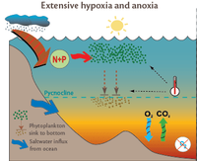
Microbes
Death/Lysis→Prod→Rxn
Rate of biomass loss from death/lysis
Production of material, S_{s1}, from cell lysis
Degradation of S_{s1}, by subsequent process→decay chain
http://ngm.nationalgeographic.com/2013/01/microbes/oeggerli-photography#/05-intestinal-bacteria-670.jpg

Slide 29
Effect of Temperature
Reaction Rate Constant Function
Arrhenius eq
E_{A}: activation energy for reaction
R: gas constant
T: temperature
A: rate term

Slide 30
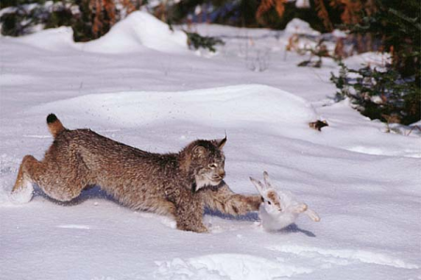
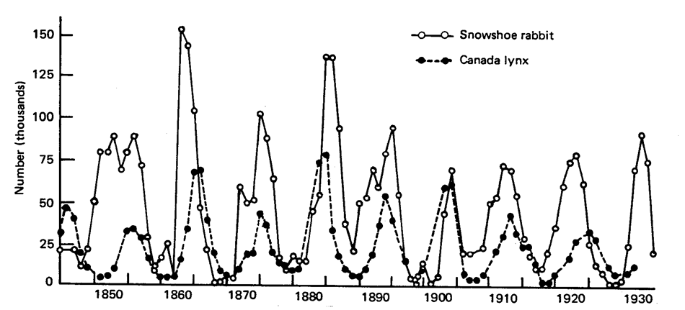
Population Dynamics
Predator-Prey, Parasite-host

Slide 31
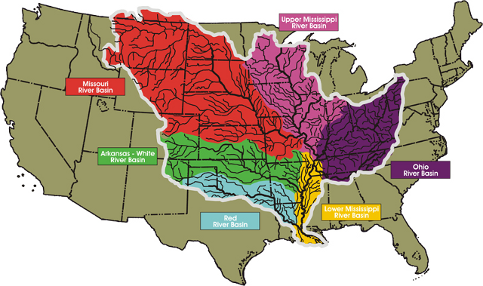
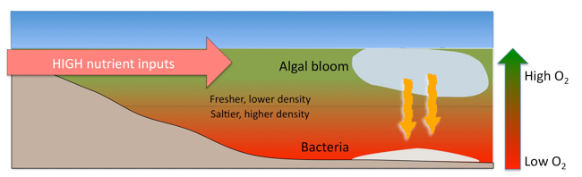
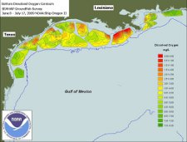
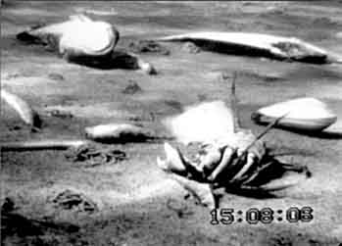
Hypoxia
Dead zone
mechanism
Dissolved Oxygen Conc. on seafloor
Dead organisms, Baltic hypoxia zone
http://www.balticnest.org/balticnest/activities/news/news/hypoxiainthebalticseahitsthecoastalzone.5.2beb0a011325eb5811a8000238433.html
http://www.thefullwiki.org/Dead_zone_(ecology)
http://www.earthlyissues.com/deadzones.htm

Slide 32
Lotka-Volterra Kinetics
Predator Prey Dynamics

Slide 33
Second order Decay Chain

Slide 34
Michaelis-Menten Kinetics
Catalyzed reactions are often described by the Michaelis-Menten reaction
where k₁ and k₂ are constants describing the reaction. This reaction behaves like a first-order process when C is small and a 0th order reaction when C is large.

Slide 35
Back to PCE→ETH
Decay chain
Monod kinetics
Inhibition

