Slide 1
Project
1. Proposal. Describe the problem you propose to analyze. Include
Background: describe the problem you intend to analyze, give motivation for doing the analysis, cite literature.
Objective: Describe what you intend to achieve as a result of doing the simulation
Method: Describe the analysis you will conduct. This should include a description of the mathematical problem, including governing equation, boundary and initial conditions, parameters, and geometry.
  Verification: Describe existing analyses you would use to verify your results. This could be an analytical solution or existing numerical solution.
  Validation or calibration: Describe data that you would use to calibrate your simulation. Identify the approach you would use for calibration.
  Approach: Outline 3-5 analyses of increasing complexity that ends with the final goal.
Results: Describe the results you expect to get from the analyses.
References: Identify and cite at least 3 papers

Slide 2
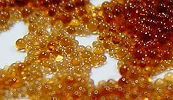
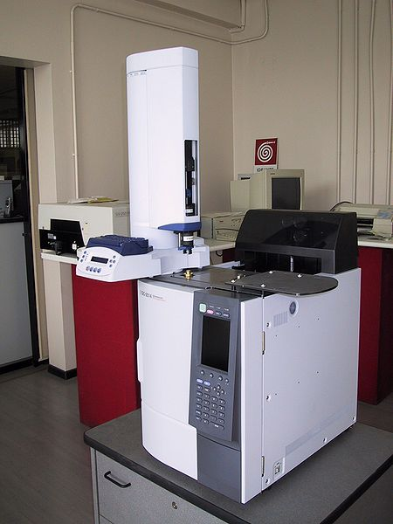
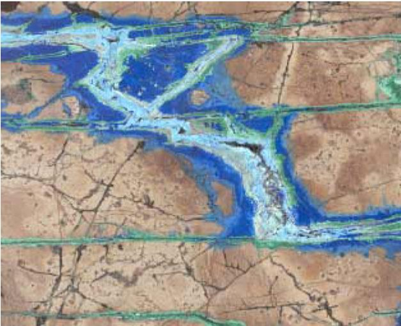
Transport with Fluid-Solid Reactions
Ion exchange resin
Gas chromatograph
Mineralized vein
http://www.insilico.hu/liesegang/index.html

Slide 3
Reaction Locations
Bulk Material (homogeneous rxn)
Fluid—Multi-scale mixing
Solid– Diffusion dominant
Interfaces (heterogeneous rxn)
Fluid-Solid—No flow at interface→diffusion
Liquid-Gas

Slide 4
Conceptual Model
C_{f}
fluid
solid
C_{s}

Slide 5
Concentrations
In water:
In soil:
On surfaces:

Slide 6
Processes
Sorption: bonding, but similar species as aqueous
Precipitation: change species
Clogging: significant thickness
Dissolution: remove solid
Biofilm: growth of film→reactions, clogging
Matrix diffusion: species into matrix, store/react

Slide 7
Reaction Rates
Fast relative to transport
  Equilibrium
  Partitioning between fluid/solid
  C_{s} = f(C_{f})
Similar or slower than transport
  Disequilibrium, kinetics important
  Reaction time scale: 1/k₁
  Diffusion time scale: L²/D
  Advection time scale: L/v

Slide 8
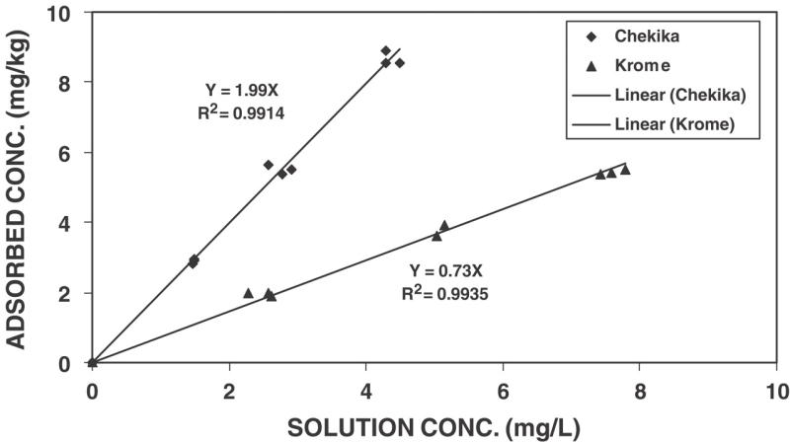
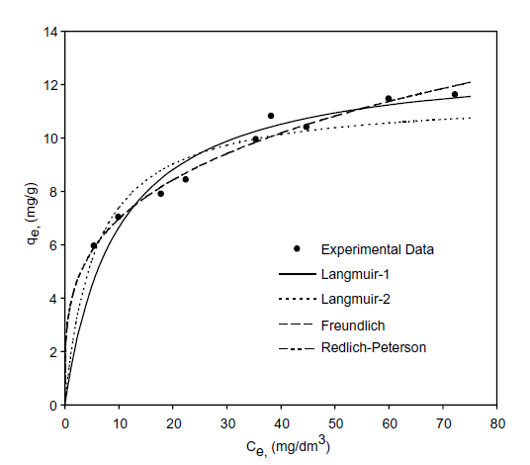
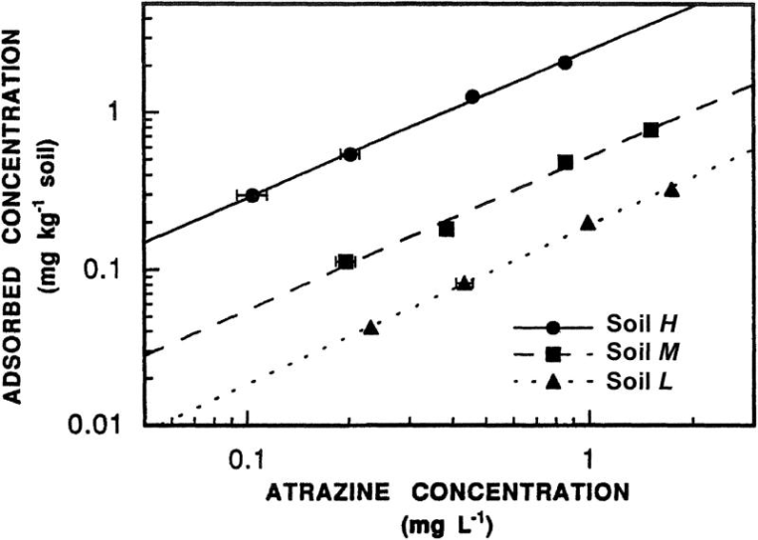
Sorption Isotherms
https://www.soils.org/publications/sssaj/articles/67/4/1140

Slide 9
Equilibrium Sorption
Linear Isotherm
Concentration sorbed (mass/mass)
Slope = Distribution Coefficient, K_{d}
Good for low concentrations
Concentration in water
Sorption sites fill at high concentrations
Concentration sorbed (mass/mass)
Non- linear Isotherm
High concentrations
Examples
Concentration in water

Slide 10
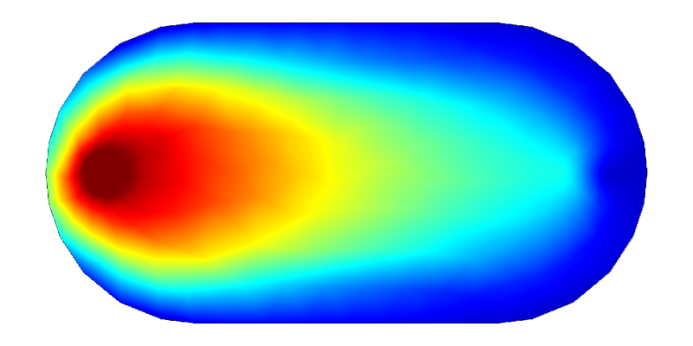
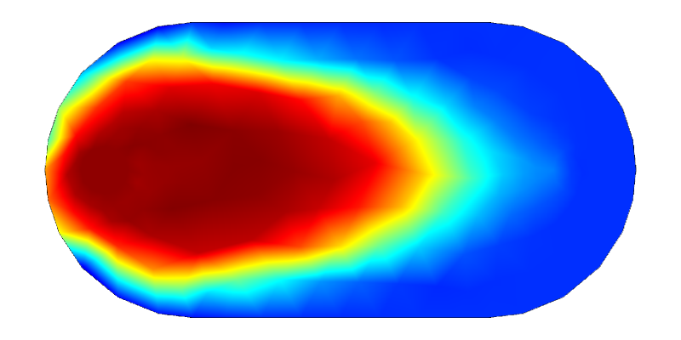
Important Concept, Fluid←→Solid Surface
Porous media, Two overlapping domains
Equilibrium Partitioning
Fluid concentration, C_{f}[M_{s}/L_{f}³]
Solid surface concentration, C_{s}[M_{s}/M_{so}]
Fluid conc
Solid conc

Slide 11
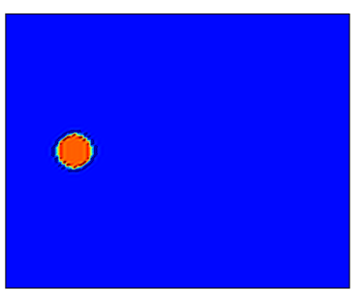
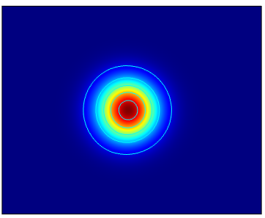
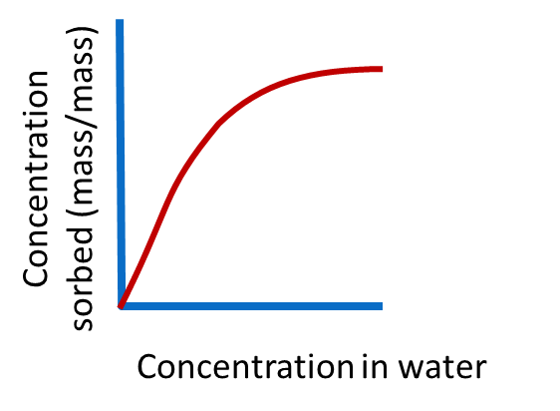
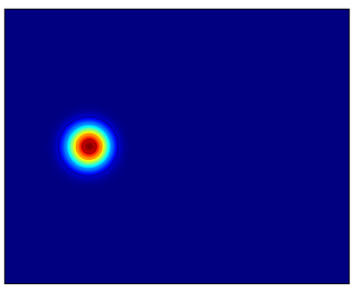
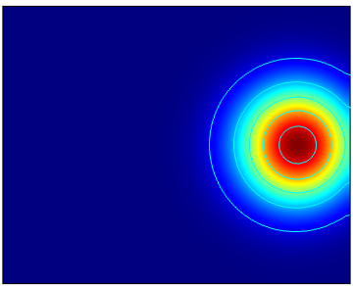
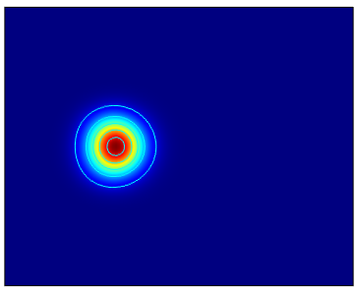
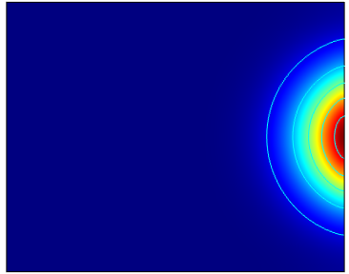
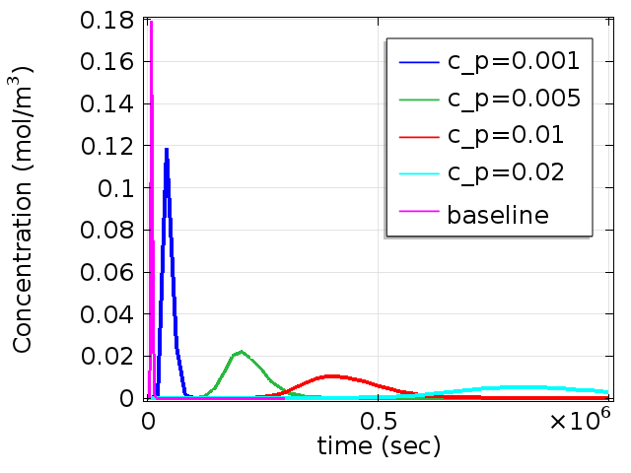
Effects of Equilibrium Sorption on Transport of a Plume
Breakthrough curves
Source as mass flux over a circular area
Chromatographic eff

Slide 12
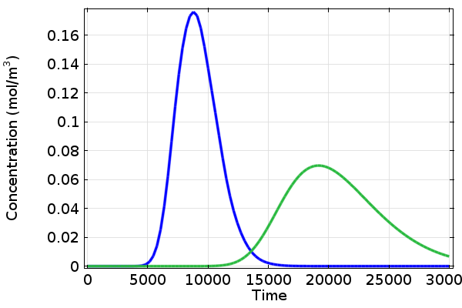
Application of pulse test to determine n_{e} and R
Average linear flow velocity
v=L/t_{m,w}
t_{m}=9215 s (from first moment, conservative tracer)
L=300m (from set up)
v=300m/9215 s =0.032 m/s
Effective porosity
Flux = q =0.01 m/s (specified in model)
Effective porosity =q/v = 0.01/0.032 = 0.31
Compare to porosity specified in model=0.3
Retardation factor
v_{c}=L/t_{m,c}
t_{m}=20700 s (from first moment sorbing compound)
v=300m/20700 s =0.014 m/s
L
R=v_{w}/v_{c}= 0.032/0.014=2.3
Chromatographic effect

Slide 13
Rate of change due to sorption

Slide 14
Governing Equation
Advection-Dispersion w/ surface reaction
c = Cn
Storage
Advective Flux
Diffusive Flux (Fick’s Law)
Dispersive Flux
Source
Governing

Slide 15
Governing Eq.
AD w/Equilibrium Sorption, Linear Isotherm
Linear Isotherm
Retardation factor

Slide 16
Governing Eq.
AD w/Equilibrium Sorption, Langmuir Isotherm
Langmuir Isotherm
Retardation factor

Slide 17
Governing Eq.
AD w/Equilibrium Sorption, Linear Isotherm
Comsol format
Linear Isotherm
For Reference
Retardation factor

Slide 18
Nonequilibrium (Kinetic) Sorption
Macroscopic, Two adjacent domains
C_{f}
Fluid concentration, C_{f} ,[mol/m³]
Solid surface concentration, C_{s} , [mol/m²]
k_{ads}: sorption rate constant [1/(m s)]
k_{des}: desorption rate constant [1/s]
Transport bulk fluid→ solid = Solid rxn rate
Fluid
solid
C_{s}
C_{f}
1st order sorption kinetics
reversible
Mass flux boundary condition
on fluid
J_{boundary}
C_{s}

Slide 19
Nonequilibrium Sorption Kinetics
http://www.sciencedirect.com/science/article/pii/S0883292706002629#

Slide 20
Non-equilibrium Sorption
Pore-scale
C_{f}
Specify rate of change of C_{s}
Fluid
solid
First-order irreversible kinetics
First-order reversible
C_{s}
Solid Fluid

Slide 21
Important Concept, Fluid←→Solid Surface
Porous media, Two overlapping domains
Dual Porosity, Dual Permeability
Two domains
(fractures, matrix)
(fluid, solid)
(liquid, gas)
Usually contrasting k
Mass transfer between domains

Slide 22
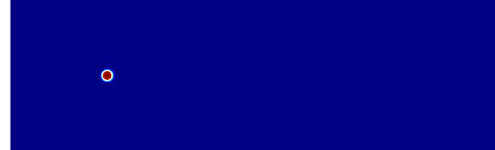
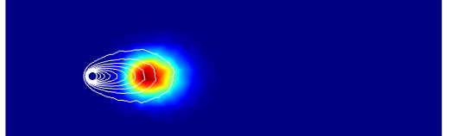
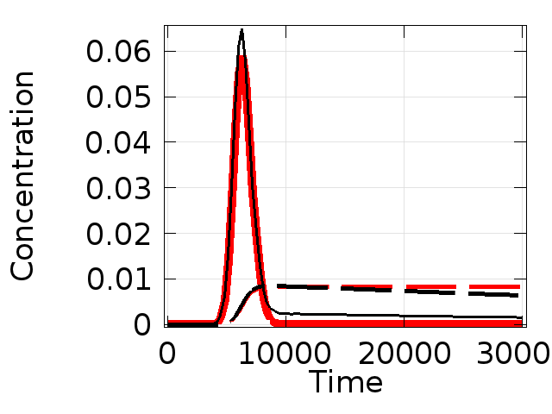
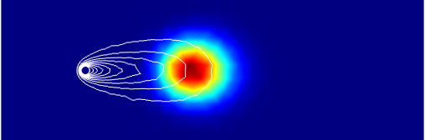
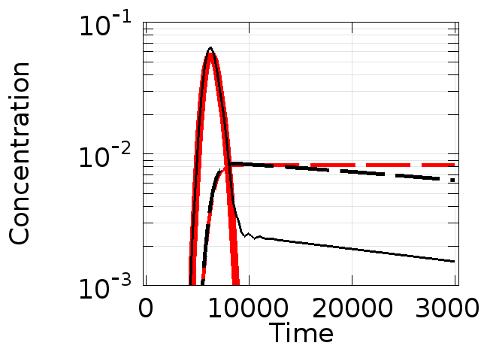
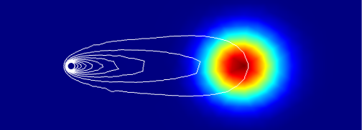
Example
First-order non-equilib sorption
Reversible and irreversible
Breakthrough curves
water
solid
Cwater
Non-reversible
water
reversible
Left behind on solid

Slide 23
Governing Equation
Advection-Dispersion w/ surface reaction
Dual Porosity Approach, with concentrations in both domains
Advection
Diffusion only

Slide 24
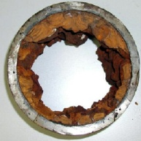
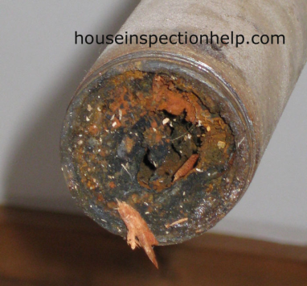
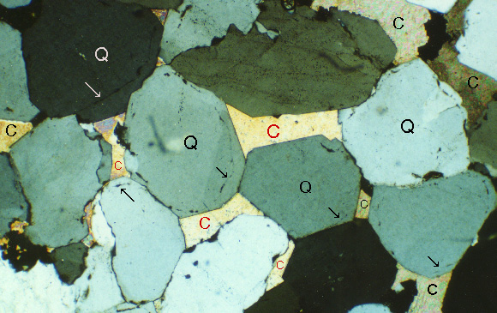
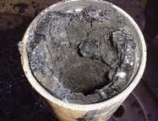
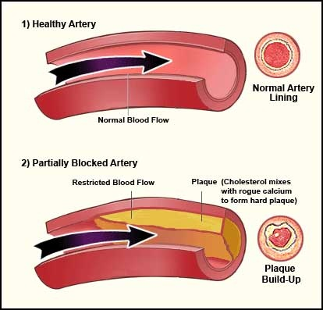
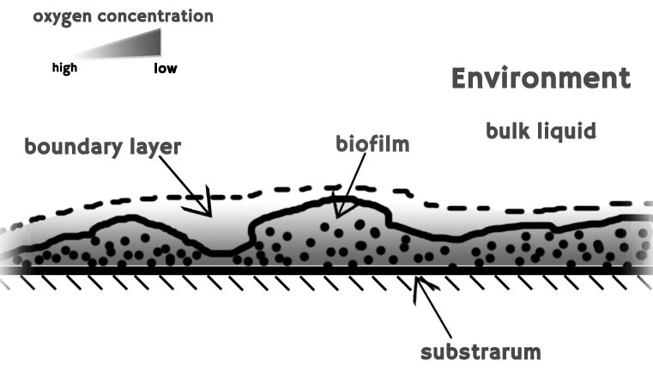
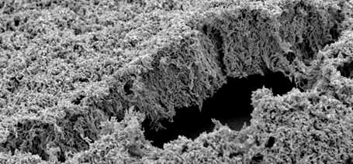
Clogging of a flow channel from precipitation on wall
Non-equilibrium sorption
Pipes clogged with precipitate
Cementation of pore space
biofilm
Plaque clogging artery
Biofilm

Slide 25
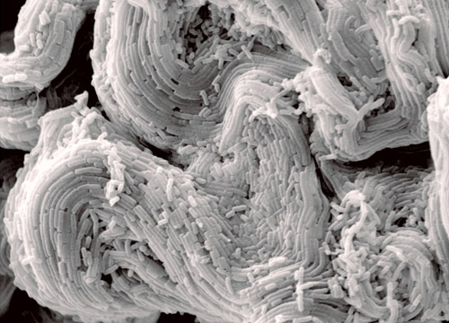

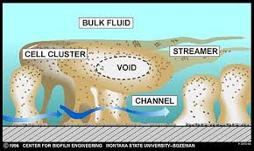
Biofilm
Conceptual Model
Growth/decay of biomass
uptake of nutrients, increase in thickness
decay, decrease in thickness
3D geometry on surface
interaction with flow
fluid shear→detachment
Mass transfer to biofilm
transport through fluid
mass transfer through stagnant water layer
mass transfer within biofilm
Reactions within biofilm
first-order, monod, growth/death other
vary within biofilm
http://wyss.harvard.edu/viewmedia/133/bacterial-biofilm-1;jsessionid=6F46332D65A9586919824B047248B4E0.wyss2
http://www.bti.umn.edu/bond/bond_lab___university_of_minnesota.html

Slide 26
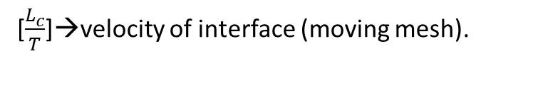
Clogging and Channeling
Fluid concentration, C_{f} ,[mol/m³]
Solid surface concentration, C_{s} , [mol/m²]
Solid concentration, C_{s} , [M_{s}/M_{os}]
Macroscopic model
REV Model
C_{f}
Fluid
solid
C_{s}
[$\frac{L_{c}^{}}{T}$]→velocity of interface (moving mesh).
Use to calc rate of change in porosity
Use porosity change to get k change

Slide 27
Clogging of flow channel from precipitation
Non-equilibrium sorption
C_{f}: fluid concentration [mol/m³]
C_{s}: concentration on solid [mol/m²]
k_{ads}: sorption rate constant [m/s]
k_{erode}: erosion rate constant[mol/m²]
τ_{w}: wall shear rate[1/s]
τ_{w}: critical wall shear stress for erosion[1/s]
ω: thickness of layer along wall [m]
M_{vol}: Molar volume [m³/mol]
C_{f}
Fluid
solid
ω
C_{s}
Reaction
Flux out of fluid
Movement of wall
C_{f}
J_{boundary}
ω
C_{s}

Slide 28
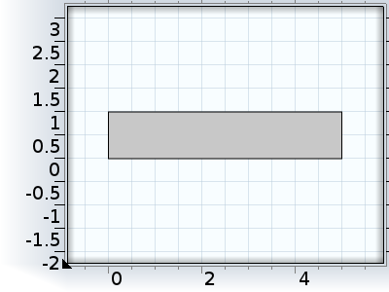
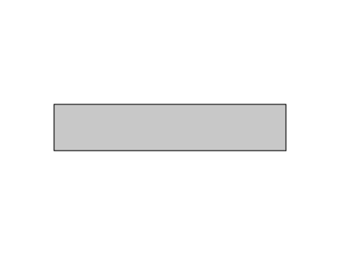
Example
Geometry (mm)
No flow
0.001m/s P=0
Fluid
Transport
In water
Surface reaction
No flow
No flux
C_{f}=1 Outflow
No diffusive flux
Flux out = -rxn
Physics
Laminar flow
  Viscosity = f(C_m)
Transport, rxn
  C_substrate
  C_microbe population
non-reactive | reactive

Slide 29
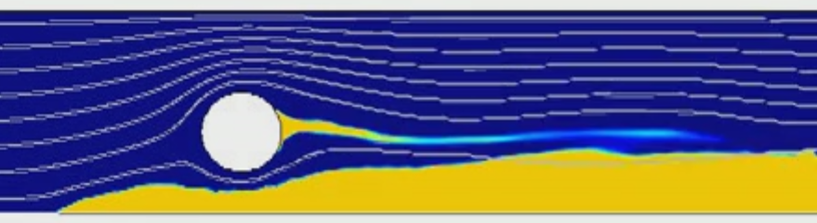
Biofilm growth and clogging
https://vimeo.com/65554224
Baseline, fluid shear has no effect
Less sensitive to shear
More sensitive to shear
https://vimeo.com/65554293
https://vimeo.com/65554294

Slide 31
Strategy
Geometry, definitions, physics
Flow
Flow+transport
Flow+transport+surface rxn
Flow+transport+surface rxn+deformed mesh

Slide 32
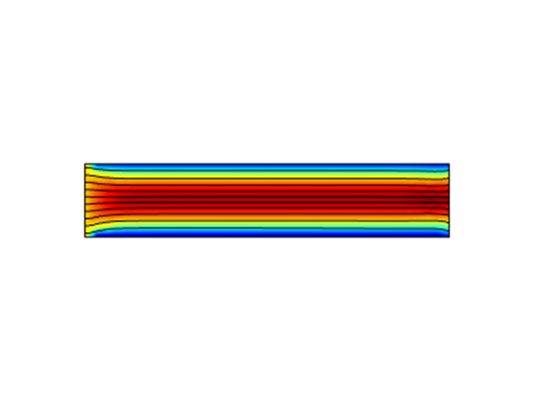
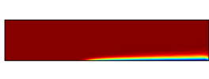
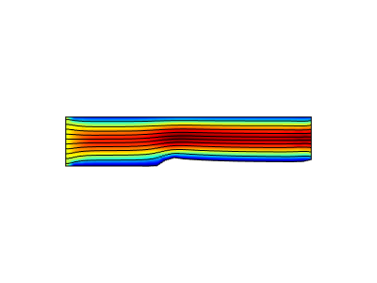
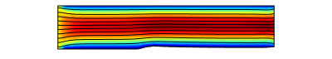
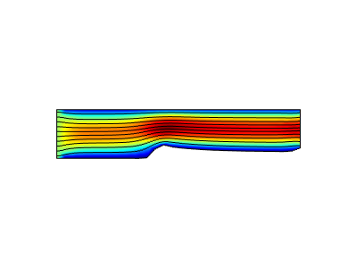
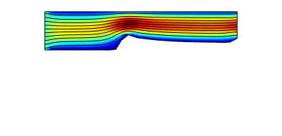
concentration
non-reactive | reactive

Slide 33
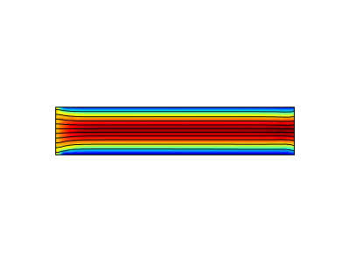
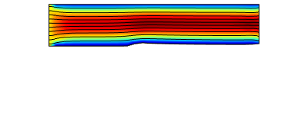
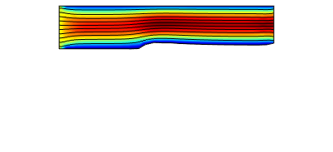
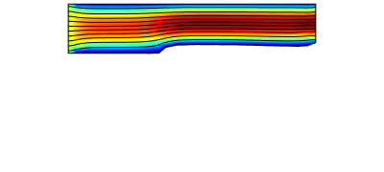
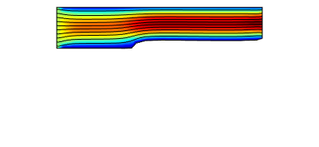

Slide 34
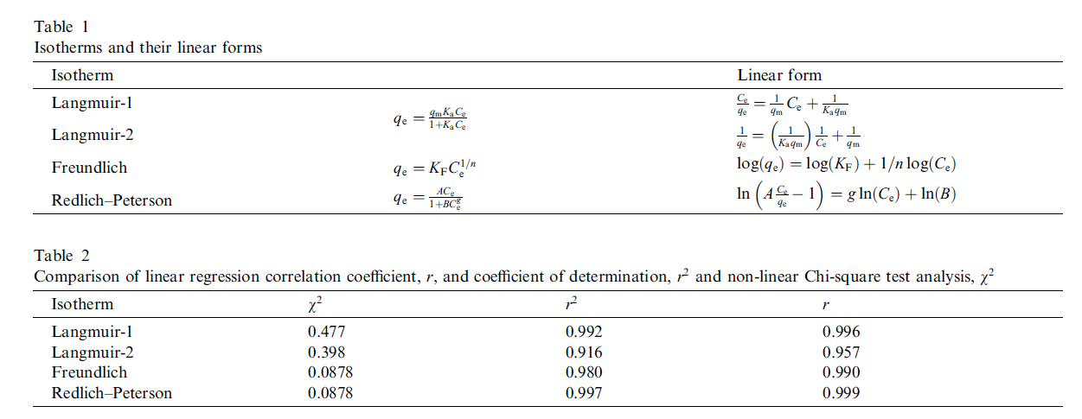
http://ac.els-cdn.com/S0008622304002155/1-s2.0-S0008622304002155-main.pdf?_tid=2c787188-8be7-11e2-b17d-00000aab0f02&acdnat=1363183759_8cfe4ddd81d00a9db89666573888753f

