Slide 1
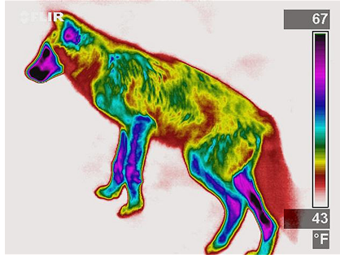
Heat Transport
Temperature of a wolf pup

Slide 2
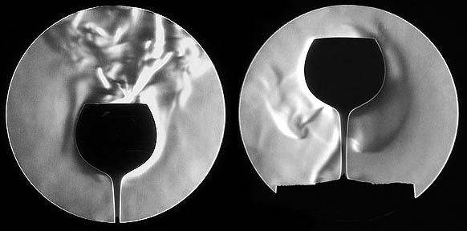
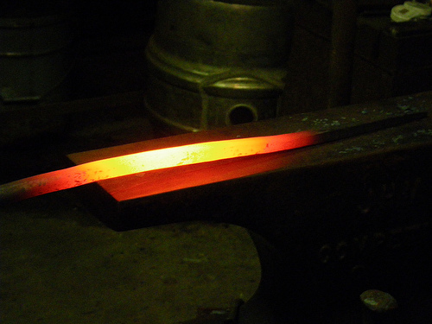
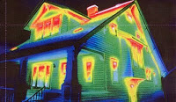
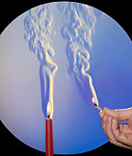
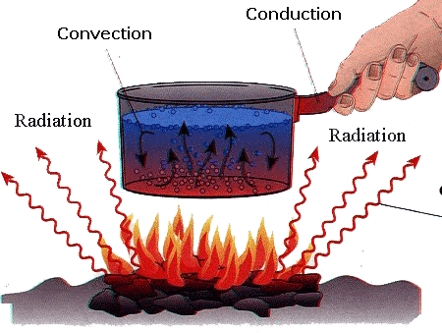
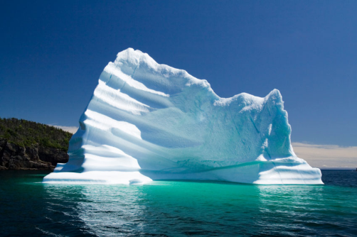
Goblet filled with coffee and ice water
Thermal plume, Lake Michigan
Solar radiation
Radiating steel bar
Temperature distribution
Schlieren image of natural convection. Note laminar-turbulent transition
Multiphase flow
http://www.geog.ucsb.edu/~jeff/115a/remote_sensing/thermal/thermalirinfo.html

Slide 3
Concepts
Storage
Source
Flux

Slide 4
Heat Storage
Latent heat of vaporization
Internal
Energy
[E/M];
[J/kg]
Latent heat of fusion
Sensible heat
solid liquid vapor
Temperature

Slide 5
Heat Storage as Sensible Heat
Internal
Energy
(J/kg)
c_{p}=specific heat capacity = Energy/(Mass Temp)
Change of sensible heat
On a per volume basis
C_{p}ρ=Energy/(Vol Temp)
Sensible heat
Temperature

Slide 6
Specific Heat Capacity
kJ/(kg K)
Water: 4.18
Ice: 2.11
Air: 1.00
CO2: 0.84
Gold: 0.13
Hydrogen: 14 (max)
Span factor of 100
Water in upper 90%

Slide 7
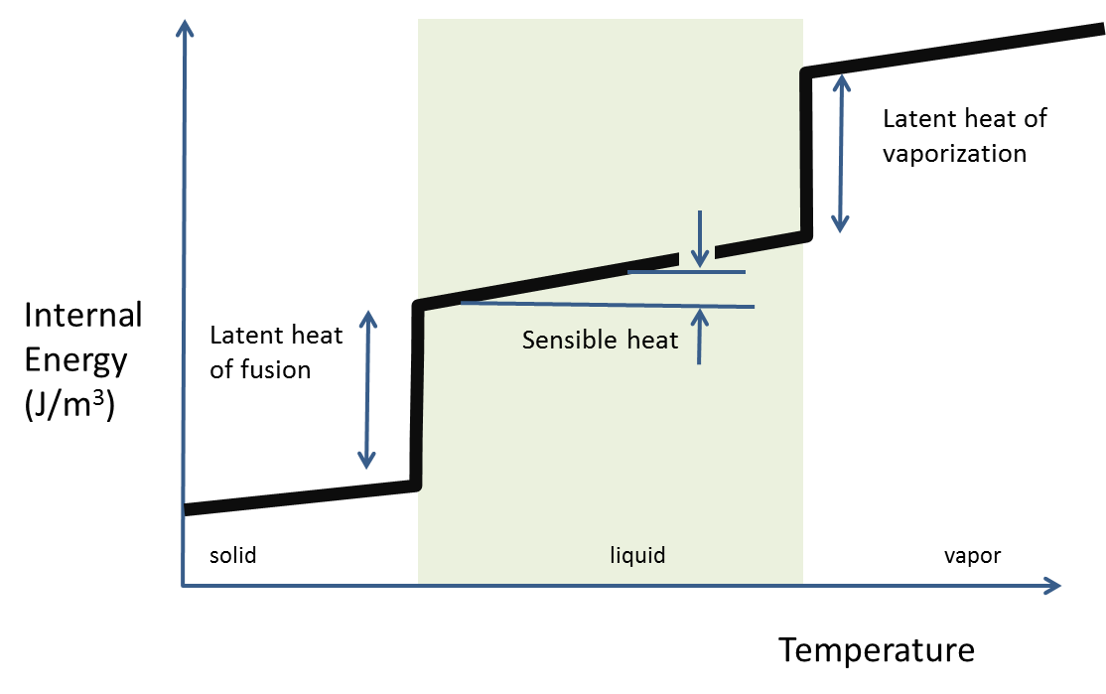
Heat Storage as Latent Heat
Water
Internal
Energy
(J/kg)
Melting water: 334 kJ/kg
Heating, 0-100ºC: 420 kJ/kg
Vaporing water: 2260 kJ/kg
solid liquid vapor
Temperature

Slide 8
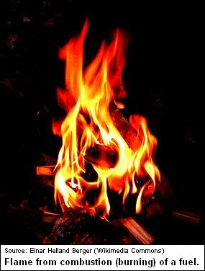
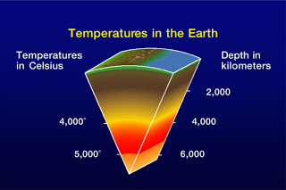
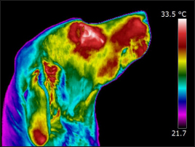
Heat Sources
Heat generated internally
Friction: fluids, solids, energy dissipation
Chemical reaction: Exo, Endothermic
Radioactive: Fission, fusion
Biological: Metabolism
Dielectric: Microwaves, oven
Joule: Electrical resistance, toaster

Slide 9
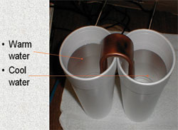
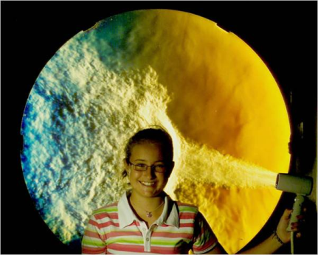
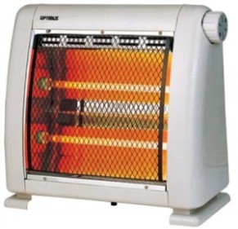
Types of heat transfer
Conduction: Static media, Diffusion
Convection: Fluid moving, advection
Forced; Free or Natural
Radiation: Emit and adsorb EM, no media
Thermal flux

Slide 10
Radiation
Heat transfer flux by radiation
“Black” body absorbs all incoming radiation and is a perfect emitter.
σ = Stefan-Boltzman constant
5.67x10⁻⁸ W/(m² K⁴)
= emissivity (0-1); ~1: black; ~0: shiny
T₁ T₂
Stefan’s Law
http://www.thermoworks.com/emissivity_table.html

Slide 11
Thermal Conduction
Fourier’s Law, energy flux
Thermal conductivity

Slide 12
Thermal conductivity
W/(mºC)
Vacuum: 0.001
Air: 0.02
Water: 0.6
Ice: 2
Steel: 10
Copper: 400
Diamond: 1000
http://web.mit.edu/lienhard/www/ahttv202.pdf

Slide 13
Convection
Energy flux:
Forced: Fluid flow driven by processes other than thermal, pump etc.
Free or Natural: Fluid flow by thermally induced density differences

Slide 14
Convection
Energy flux:
Forced: Fluid flow driven by processes other than thermal, pump etc.
Free or Natural: Fluid flow by thermally induced density differences

Slide 15
Convective heat transfer —fluid←→solid
T_{f}
T_{s}
b

Slide 16
Convective Heat Transfer Coefficient
http://web.mit.edu/lienhard/www/ahttv202.pdf

Slide 17
https://docs.google.com/viewer?url=http%3A%2F%2Fwww.bakker.org%2Fdartmouth06%2Fengs150%2F13-heat.pdf

Slide 18
Governing Equation
Conservation of Heat Energy
Storage
Advective Flux
Diffusive Flux (Fourier’s Law)
Dispersive Flux
Source
Governing
c =c_{p}ρnT
S = S_{h}

Slide 19
Simulation of Heat Transport

Slide 20
Parameters
c_{p} heat capacity [E/Mθ]
ρ Density [M/L³]
K_{h} thermal conductivity [E/TLθ]
q fluid flux [L/T]
n porosity [--]
D_{hyd} dispersion [E/TLθ]

Slide 21
Coupled effects
Chemical reaction rate
Phase change
Material properties
Thermal expansion
Solid-Fluid in porous media
Biological growth

Slide 22
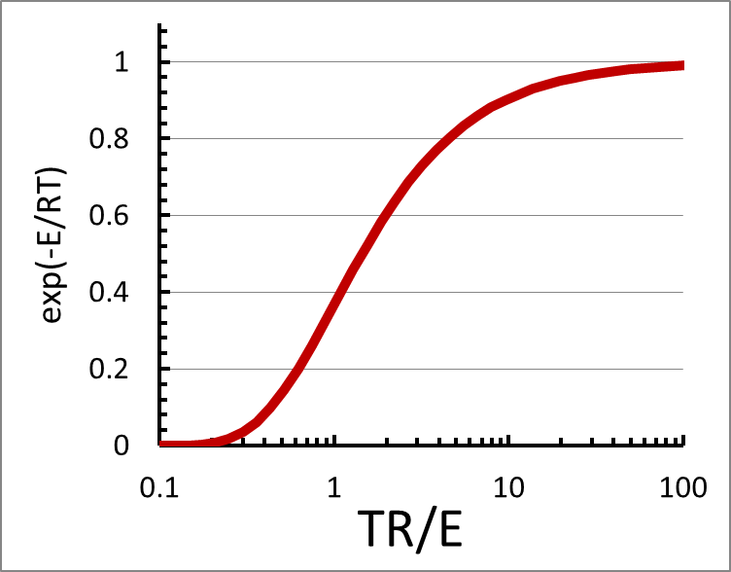
Temperature and Chemical Rxn
Reaction Rate Constant Function
Arrhenius eq
E_{A}: activation energy for reaction
R: gas constant
T: temperature
A: Max rate term
Other Arrhenius-like expressions

Slide 23
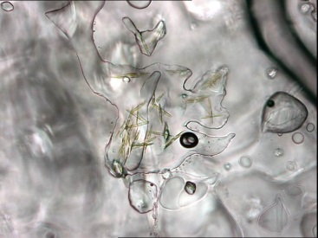
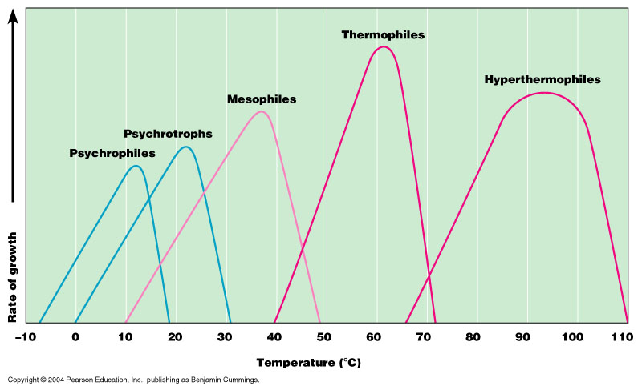
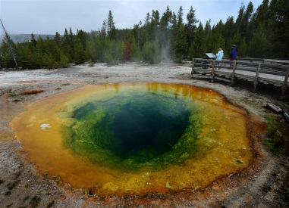
Temperature and Bio Rxn
Growth rate for bacteria over temperature band
Algae in sea ice
Psychrophile
Setting for hyperthermophiles
Arhennius-like over low temp. Include additional term for high temp

Slide 24
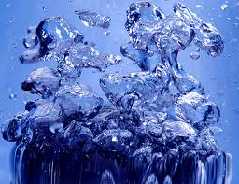
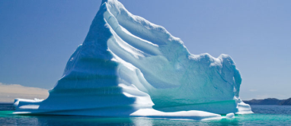
Including phase change
U Internal
Energy
(J/kg)
solid liquid vapor
Temperature
Area under curve = latent heat
C_{p}(E/(kgθ))
C_{p}=dU/dθ
Temperature (θ)

Slide 25
Water properties
Viscosity
Density
Thermal Conductivity
C_{p}(E/(kg³θ))
Temperature (θ)

Slide 26
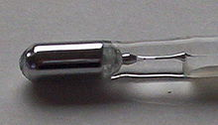
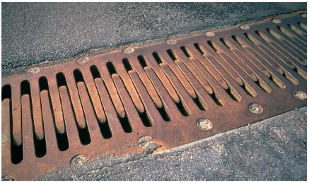
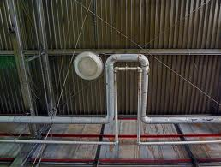
Thermal expansion
Volumetric
Linear
α≈10⁻⁵ 1^{/o}C

Slide 27
Solid Phase in Porous Media
Exchange heat
T_{f} T_{s}
Heat loss by fluid
dE/dt like kinetics in mass transport

Slide 28
Solid Phase in Porous Media
Exchange heat
T_{f} T_{s}
Heat loss by fluid Heat balance between fluid and solid
dE/dt like kinetics in mass transport

Slide 29
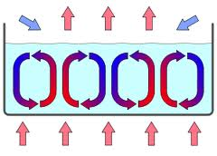
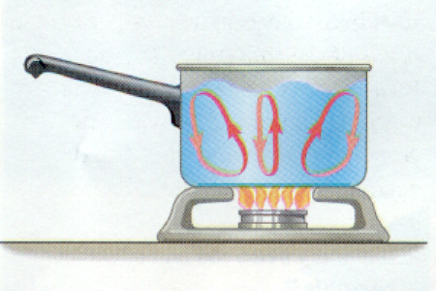
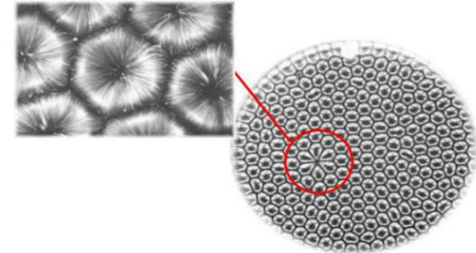
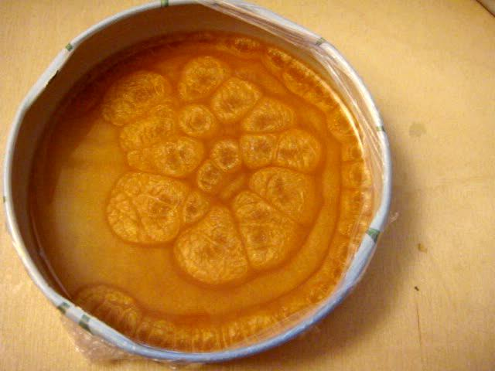
Free Convection Rayleigh-Bernard Convection Cells

Slide 30
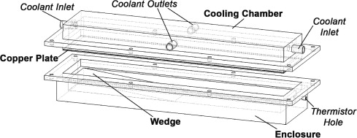
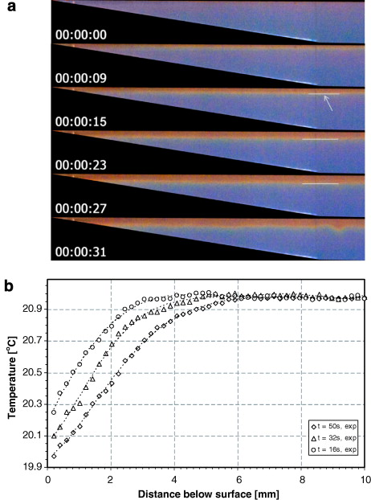
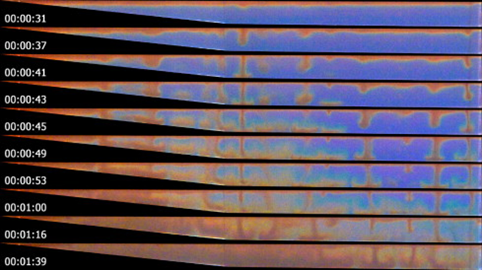
Experiment cooling at the top in scaled down lake
Simulated lake
[Bednarz et al. 2008]
http://www.sciencedirect.com/science/article/pii/S0894177707001409

Slide 31
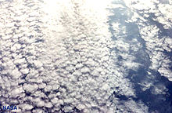
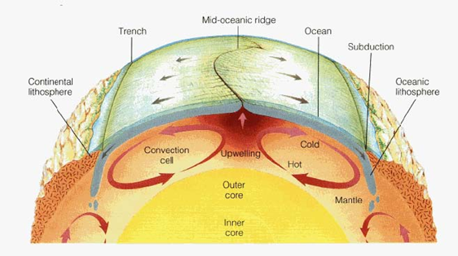
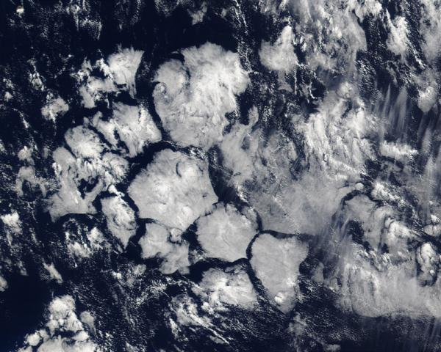
Convection in the Earth and Atm
Mantle Convection

Slide 33
Dimensionless Numbers
Prandtl number, momentum diffusion/thermal diffusion
Grashof number, buoyancy/viscous forces (thermal forcing)
Nusselt number, convective/conductive resistance at boundary;
Raleigh number,
Thermal diffusivity [L2/T]
Onset of natural convection depends on Ra
For a layer with a free top surface: Ra_{crit}=1100

Slide 34
Rayleigh number
Onset of natural convection depends on Ra
For a layer with a free top surface: Ra_{crit}=1100

Slide 35
Coefficient of Thermal Expansion

Slide 37
Material Properties
https://docs.google.com/viewer?url=http%3A%2F%2Fwww.bakker.org%2Fdartmouth06%2Fengs150%2F13-heat.pdf

Slide 38
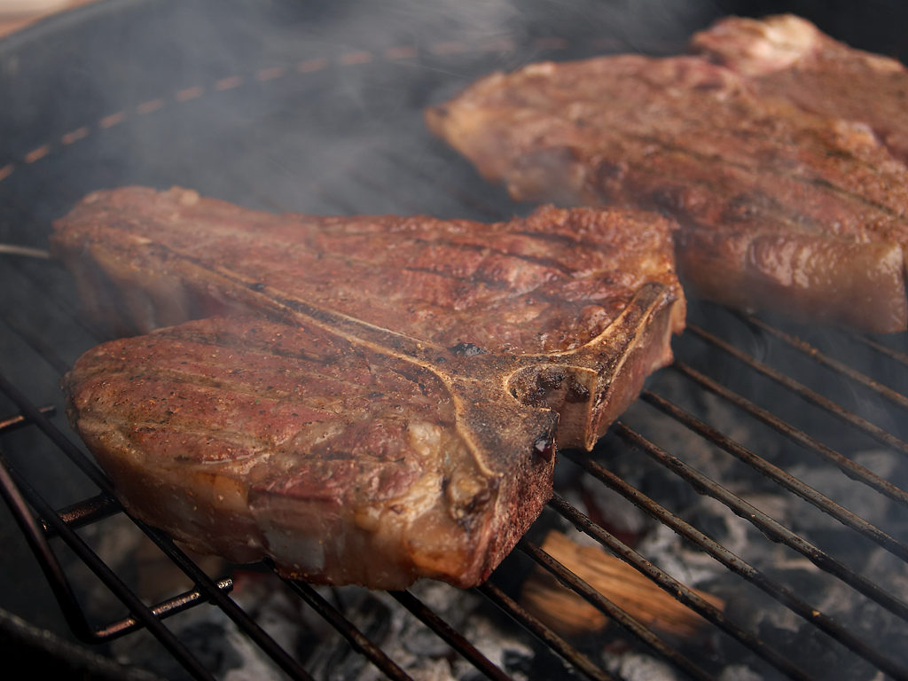
Heat Transfer by Radiation and Convection

Slide 39
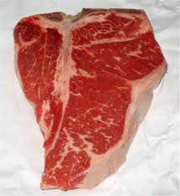
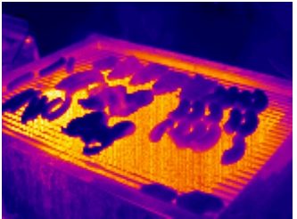

Slide 40
Conceptual Model
Radiation and convection
Radiation and convection

Slide 42
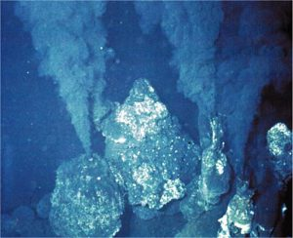
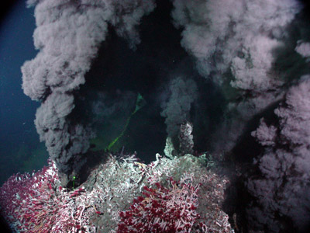

Slide 43
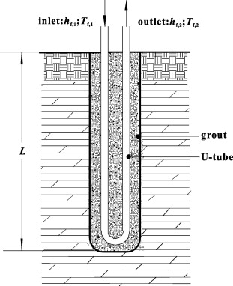
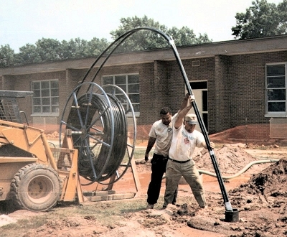
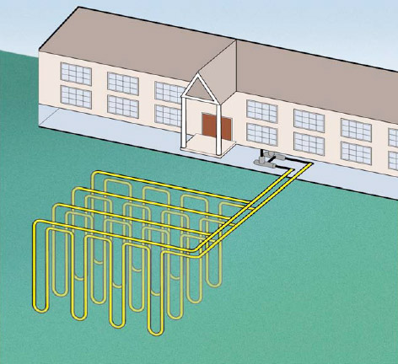
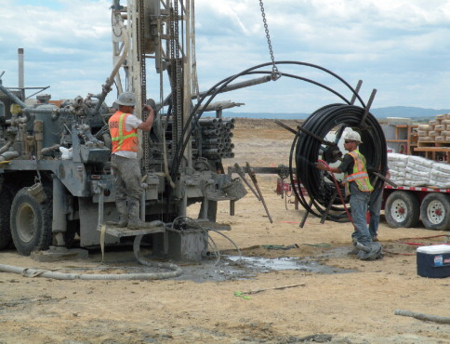
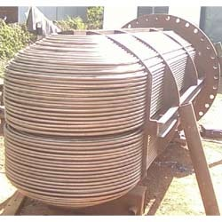
U-tube Heat Exchanger
Installation of a U-tube in a borehole
Two pipes from a U-tube heat exchanger in a borehole
U-tube heat exchanger
Array of U-tube heat exchangers

Slide 45
Free Convection Rayleigh-Bernard Convection Cells

Slide 46
Convection in the Earth and Atm

Slide 47
Experiment cooling at the top
Simulated lake
http://www.sciencedirect.com/science/article/pii/S0894177707001409

Slide 48
Rayleigh number
Onset of natural convection depends on Ra
For a layer with a free top surface: Ra_{crit}=1100

Slide 49
Coefficient of Thermal Expansion

Slide 50
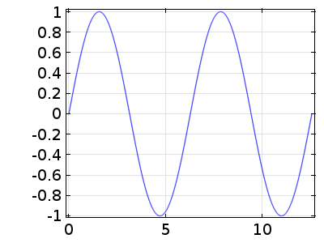
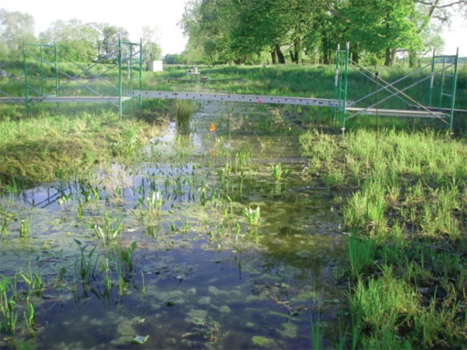
Effect of varying temperature on mixing in surface water
Cyclic heating/cooling affects heat transfer in lakes, like Lake Hartwell next to Clemson’s campus.
Cyclic heating/cooling can be an important factor affecting mixing and chemical reactions in wetlands and lakes.

